Slide 1

Nuevas evidencias en el tratamiento de las dislipemias
Dr. José Tuñón
Jefe Asociado, Departamento de Cardiología del Hospital Universitario Fundación Jiménez Díaz, Madrid
Coordinador Nacional del Estudio ODYSSEY OUTCOMES

Slide 2
The ODYSSEY OUTCOMES Trial: Topline Results
Alirocumab in Patients After Acute Coronary Syndrome
Gregory G. Schwartz, Michael Szarek, Deepak L. Bhatt, Vera Bittner, Rafael Diaz, Jay Edelberg,
Shaun G. Goodman, Corinne Hanotin, Robert Harrington, J. Wouter Jukema, Guillaume Lecorps, Angèle Moryusef, Robert Pordy, Matthew Roe, Harvey D. White, Andreas Zeiher,
Ph. Gabriel Steg
On behalf of the ODYSSEY OUTCOMES Investigators and Committees
American College of Cardiology – 67th Scientific Sessions
March 10, 2018
ClinicalTrials.gov: NCT01663402

Slide 3
Residual Risk After Acute Coronary Syndrome
Remains high despite evidence-based preventive therapies
Is related, in part, to levels of low-density lipoprotein cholesterol (LDL-C)
Is reduced when LDL-C is lowered by
  Statin therapy, compared with placebo¹
  High-intensity, compared with moderate-intensity statin therapy²
  Ezetimibe, compared with placebo, added to statin³
1. Schwartz GG, et al. JAMA 2001;285:1711-8. 2. Cannon CP, et al. NEJM 2004;350:1495-504.
3. Cannon CP, et al. NEJM 2015;372:2387-97.

Slide 4
Alirocumab
PCSK9 is a validated target for risk reduction in stable atherosclerotic cardiovascular disease^{1–3}
A fully human monoclonal antibody against PCSK9
Produces substantial and sustained reductions in LDL-C and other atherogenic lipoproteins²
Has been safe and well-tolerated in studies to date⁴
PCSK9, proprotein convertase subtilisin/kexin type 9
1. Sabatine et al, NEJM 2017;376:713-22. 2. Robinson JG et al. NEJM 2015;372:1489-99.
3. Ridker PM et al. NEJM 2017;376:1527-39. 4. Robinson JG et al. JACC 2017;69:471-82.

Slide 5
Study Hypothesis
Alirocumab, versus placebo, reduces cardiovascular (CV) morbidity and mortality after recent acute coronary syndrome (ACS) in patients with elevated levels of atherogenic lipoproteins despite intensive or maximum-tolerated statin therapy
Schwartz GG, et al. Am Heart J 2014;168:682-689.e1.

Slide 6
Main Inclusion Criteria
  Age ≥40 years
  ACS
    1 to 12 months prior to randomization
    Acute myocardial infarction (MI) or unstable angina
  High-intensity statin therapy*
    Atorvastatin 40 to 80 mg daily or
    Rosuvastatin 20 to 40 mg daily or
    Maximum tolerated dose of one of these agents for ≥2 weeks
  Inadequate control of lipids
    LDL-C ≥70 mg/dL (1.8 mmol/L) or
    Non-HDL-C ≥100 mg/dL (2.6 mmol/L) or
    Apolipoprotein B ≥80 mg/dL
*Patients not on statins were authorized to participate if tolerability issues were present and documented
Schwartz GG, et al. Am Heart J 2014;168:682-689.e1.

Slide 7
Key Exclusion Criteria
Uncontrolled hypertension
NYHA class III or IV heart failure;
LVEF <25% if measured
History of hemorrhagic stroke
Fasting triglycerides >400 mg/dL
(4.52 mmol/L)
Use of fibrates other than fenofibrate or fenofibric acid
Recurrent ACS within 2 weeks prior to randomization visit
Coronary revascularization performed within 2 weeks prior to randomization visit, or planned after randomization
Liver transaminases >3 × ULN;
hepatitis B or C infection
Creatine kinase >3 × ULN
eGFR <30 mL/min/1.73 m²
Positive pregnancy test
eGFR, estimated glomerular filtration rate; ULN, upper limit of normal
Schwartz GG, et al. Am Heart J 2014;168:682-689.e1.

Slide 8
Primary Efficacy Outcome
Time of first occurrence of:
  Coronary heart disease (CHD) death, or
  Non-fatal MI, or
  Fatal or non-fatal ischemic stroke, or
  Unstable angina requiring hospitalization*
All outcomes adjudicated by the Clinical Events Committee, under the auspices of the Duke Clinical Research Institute (DCRI). Members were unaware of treatment assignment and lipid levels
*Required all of the following:
Hospital admission >23 h for MI symptoms, ↑ tempo in prior 48 hours and/or ≥20 min of chest discomfort at rest
New ECG findings consistent with ischemia or infarction
Angiographically significant obstructive coronary disease
Schwartz GG, et al. Am Heart J 2014;168:682-689.e1.

Slide 9
Major Secondary Efficacy Endpoints
Tested in the following hierarchical sequence:
CHD event: CHD death, non-fatal MI, unstable angina requiring hospitalization, or ischemia-driven coronary revascularization*
Major CHD event: CHD death or non-fatal MI
CV event: CV death, non-fatal CHD event, or non-fatal ischemic stroke
All-cause death, non-fatal MI, non-fatal ischemic stroke
CHD death
CV death
All-cause death
*Revascularization performed because of recurrent ACS, new or progressive symptoms of myocardial ischemia or new or progressive abnormalities on functional testing, except revascularization due to restenosis at a prior coronary intervention site.

Slide 10
Other Secondary and Safety Endpoints
Other secondary endpoints
  Components of the primary endpoint considered individually:
    CHD death
    Non-fatal MI
    Fatal and non-fatal ischemic stroke
    Unstable angina requiring hospitalization
  Ischemia-driven coronary revascularization
  Congestive heart failure requiring hospitalization
Safety endpoints
  Adverse events
  Laboratory assessments

Slide 11
Treatment Assignment
Post-ACS patients (1 to 12 months)
Run-in period of 2−16 weeks on high-intensity or maximum-tolerated dose of atorvastatin or rosuvastatin
At least one lipid entry criterion met
Randomization
Alirocumab SC Q2W
Placebo SC Q2W
Patient and investigators remained blinded to treatment and lipid levels for the entire duration of the study
Schwartz GG, et al. Am Heart J 2014;168:682-689.e1.

Slide 12
A Target Range for LDL-C
Target range
Undesirably high
baseline range
We attempted to maximize the number of patients in the target range and minimize the number below target by blindly titrating alirocumab (75 or 150 mg SC Q2W) or blindly switching to placebo.
Acceptable range
Below target
Alirocumab
0
15
25
50
70
LDL-C (mg/dL)
Schwartz GG, et al. Am Heart J 2014;168:682-689.e1.
Notes:
First view: Right-hand yellow zone to indicate patients qualifying for study with LDL-C “undesirably high” (i.e., >/=70 mg/dL)
Second view: Alirocumab dose is blindly adjusted to maximize the number of patients in a low but physiologic range of LDL-C (i.e., 25-50 mg/dL)
Third view: Alirocumab dose is also blindly adjusted to minimize patients with persistently very low levels of LDL-C (i.e., <15 mg/dL )

Slide 13
Statistical Considerations
All analyses conducted by independent academic statistical team at State University of New York (SUNY) Downstate School of Public Health, in parallel with the sponsor
Efficacy analysis by intention-to-treat (ITT)
Assumptions
  Cumulative incidence of primary endpoint in placebo group 11.4% at 48 months
  Baseline LDL-C 90 mg/dL; reduction to 45 mg/dL with alirocumab
  15% expected hazard reduction for primary endpoint
  Loss to follow-up at 24 months: 1%
  Log-rank test with 1-sided 2.5% significance level
  Continuation of the trial until 1613 patients with a primary endpoint (for 90% power) AND all surviving patients followed for ≥2 years (for adequate safety assessments), whichever came later*
* Except for patients enrolled in China (enrollment started on May 5, 2016)

Slide 14
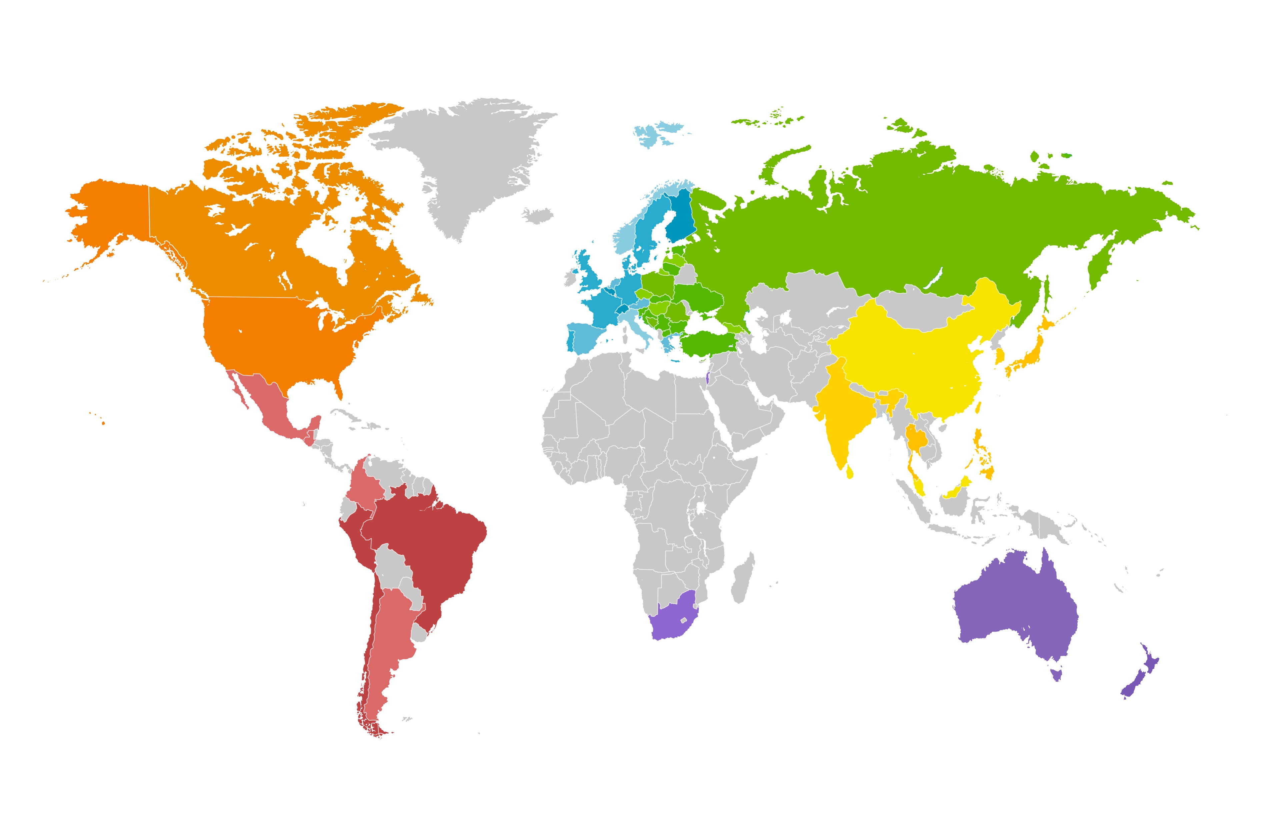

ODYSSEY OUTCOMES: 18,924 patients randomized at 1315 sites in 57 countries, Nov 2, 2012 − Nov 11, 2017
Canada/USA
Canada 361
US 2511
Western Europe
Austria 58
Belgium 197
Denmark 352
Finland 116
France 185 Germany 509
Greece 70
Italy 275
Netherlands 686
Norway 97
Portugal 174
Spain 826
Sweden 250
Switzerland 88
UK 292
Central/Eastern Europe
Bosnia–Herzegovina 156 Macedonia 132
Bulgaria 333 Poland 926
Croatia 70 Romania 145
Czech Republic 381 Russian Federation 1109
Estonia 216 Serbia 255
Georgia 131 Slovakia 340
Hungary 224 Slovenia 36
Latvia 80 Turkey 78
Lithuania 188 Ukraine 639
Asia
China 614
Hong Kong 17
India 521
Japan 204
Korea 94
Malaysia 110
Philippines 116
Singapore 49
Sri Lanka 314
Taiwan 93
Thailand 161
Latin America
Argentina 592
Brazil 928
Chile 132
Colombia 354
Guatemala 25
Mexico 349
Peru 208
We thank the patients, their families, all investigators and coordinators involved in this study, and DCRI
Rest of World
Australia 216
Israel 582
New Zealand 257
South Africa 505

Slide 15
Patient Disposition
Randomized 18,924 patients
Alirocumab
(N=9462)
Placebo
(N=9462)
Follow-up*: median 2.8 (Q1–Q3 2.3–3.4) years
8242 (44%) patients with potential follow-up ≥3 years
1955 patients experienced a primary endpoint
726 patients died
Premature treatment discontinuation
Blinded switch to placebo (2 consecutive LDL-C values <15 mg/dL)
Patients lost to follow-up (vital status)
1343 (14.2%)
1496 (15.8%)
730 (7.7%)
Not applicable
14
9
*Ascertainment was complete for 99.1% and 99.8% of potential patient-years of follow-up for the primary endpoint and all-cause death, respectively

Slide 16
Baseline Demographics
Characteristic | Alirocumab (N=9462) | Placebo (N=9462)
Age, years, median (Q1−Q3) | 58 (52−65) | 58 (52−65)
Female, n (%) | 2390 (25.3) | 2372 (25.1)
Medical history, n (%)
Hypertension | 6205 (65.6) | 6044 (63.9)
Diabetes mellitus | 2693 (28.5) | 2751 (29.1)
Current tobacco smoker | 2282 (24.1) | 2278 (24.1)
Prior MI | 1790 (18.9) | 1843 (19.5)

Slide 17
Baseline Index Events
Characteristic | Alirocumab (N=9462) | Placebo (N=9462)
Time from index ACS to randomization, months, median (Q1−Q3) | 2.6 (1.7−4.4) | 2.6 (1.7−4.3)
ACS type, n (%)
NSTEMI | 4574 (48.4) | 4601 (48.7)
STEMI | 3301 (35.0) | 3235 (34.2)
Unstable angina | 1568 (16.6) | 1614 (17.1)
Revascularization for index ACS, n (%) | 6798 (71.8) | 6878 (72.7)

Slide 18
Baseline Lipid Characteristics
Characteristic, mg/dL, median (Q1–Q3) | Alirocumab (N=9462) | Placebo (N=9462)
LDL-C | 87 (73–104) | 87 (73–104)
Non-HDL-C | 115 (99−136) | 115 (99−137)
Apolipoprotein B | 79 (69−93) | 80 (69−93)
HDL-C | 43 (37−50) | 42 (36−50)
Triglycerides | 129 (94−181) | 129 (95−183)
Lipoprotein(a) | 21 (7−59) | 22 (7−60)
92.5% of patients qualified on the basis of LDL-C ≥70 mg/dL

Slide 19
Baseline Lipid-Lowering Therapy
Therapy, n (%) | Alirocumab (N=9462) | Placebo (N=9462)
High-dose atorvastatin/rosuvastatin | 8380 (88.6) | 8431 (89.1)
Low-/moderate-dose atorvastatin/rosuvastatin | 830 (8.8) | 777 (8.2)
Other statin | 19 (0.2) | 27 (0.3)
Ezetimibe, with or without statin | 269 (2.8) | 285 (3.0)
No lipid-lowering therapy* | 87 (0.9) | 91 (1.0)
*Patients not on statins were authorized to participate if tolerability issues were present and documented

Slide 20
Guideline-Recommended Post-ACS Medications
Medication, n (%) | Alirocumab (N=9462) | Placebo (N=9462)
Aspirin | 9050 (95.6) | 9036 (95.5)
P2Y₁₂ antagonist | 8296 (87.7) | 8245 (87.1)
ACE-I/ARB | 7356 (77.7) | 7360 (77.8)
Beta-blocker | 7998 (84.5) | 7992 (84.5)
ACE-I, angiotensin-converting enzyme inhibitor; ARB, angiotensin receptor blocker

Slide 21
LDL-C: ITT and On-Treatment Analyses
Placebo
ITT
On-treatment*
Alirocumab
ITT†
On-treatment*
*Excludes LDL-C values after premature treatment discontinuation or blinded switch to placebo
†All LDL-C values, including those after premature treatment discontinuation, blinded down titration, or blinded switch to placebo
Notes:
Includes all LDL-C values, regardless of blinded down titration or switch to placebo or premature treatment discontinuation
discontinuation, or blinded down titration or switch to placebo
Includes all LDL-C values, regardless of discontinuation or blinded down titration or switch to placebo

Slide 22
LDL-C: On-Treatment Analysis
Placebo
Alirocumab
Excludes LDL-C values after premature treatment discontinuation or blinded switch to placebo
Approximately 75% of months of active treatment were at the 75 mg dose

Slide 23
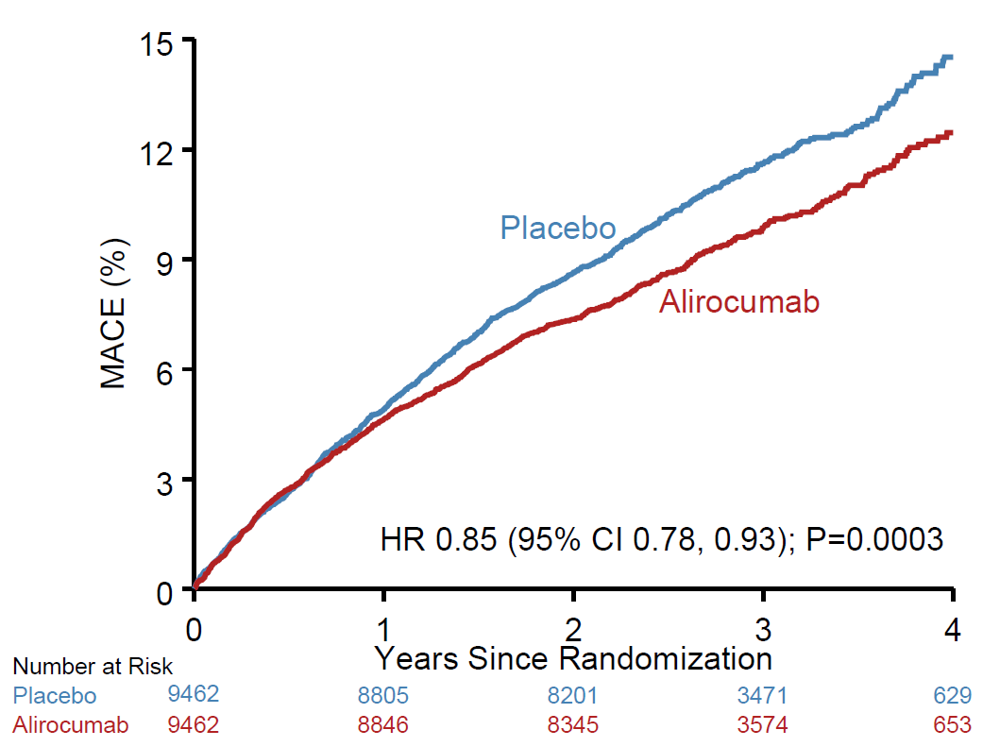
Primary Efficacy Endpoint: MACE
ARR* 1.6%
HR 0.85
(95% CI 0.78, 0.93)
P=0.0003
  MACE: CHD death,
  non-fatal MI,
  ischemic stroke, or
  unstable angina requiring
  hospitalization
*Based on cumulative incidence

Slide 24
Primary Efficacy and Components
Endpoint, n (%) | Alirocumab (N=9462) | Placebo (N=9462) | HR (95% CI) | Log-rank P-value
MACE | 903 (9.5) | 1052 (11.1) | 0.85 (0.78, 0.93) | 0.0003
CHD death | 205 (2.2) | 222 (2.3) | 0.92 (0.76, 1.11) | 0.38
Non-fatal MI | 626 (6.6) | 722 (7.6) | 0.86 (0.77, 0.96) | 0.006
Ischemic stroke | 111 (1.2) | 152 (1.6) | 0.73 (0.57, 0.93) | 0.01
Unstable angina | 37 (0.4) | 60 (0.6) | 0.61 (0.41, 0.92) | 0.02

Slide 25
Main Secondary Efficacy Endpoints: Hierarchical Testing
Endpoint, n (%) | Alirocumab (N=9462) | Placebo (N=9462) | HR (95% CI) | Log-rank P-value
CHD event | 1199 (12.7) | 1349 (14.3) | 0.88 (0.81, 0.95) | 0.001
Major CHD event | 793 (8.4) | 899 (9.5) | 0.88 (0.80, 0.96) | 0.006
CV event | 1301 (13.7) | 1474 (15.6) | 0.87 (0.81, 0.94) | 0.0003
Death, MI, ischemic stroke | 973 (10.3) | 1126 (11.9) | 0.86 (0.79, 0.93) | 0.0003
CHD death | 205 (2.2) | 222 (2.3) | 0.92 (0.76, 1.11) | 0.38
CV death | 240 (2.5) | 271 (2.9) | 0.88 (0.74, 1.05) | 0.15
All-cause death | 334 (3.5) | 392 (4.1) | 0.85 (0.73, 0.98) | 0.026*
*Nominal P-value

Slide 26
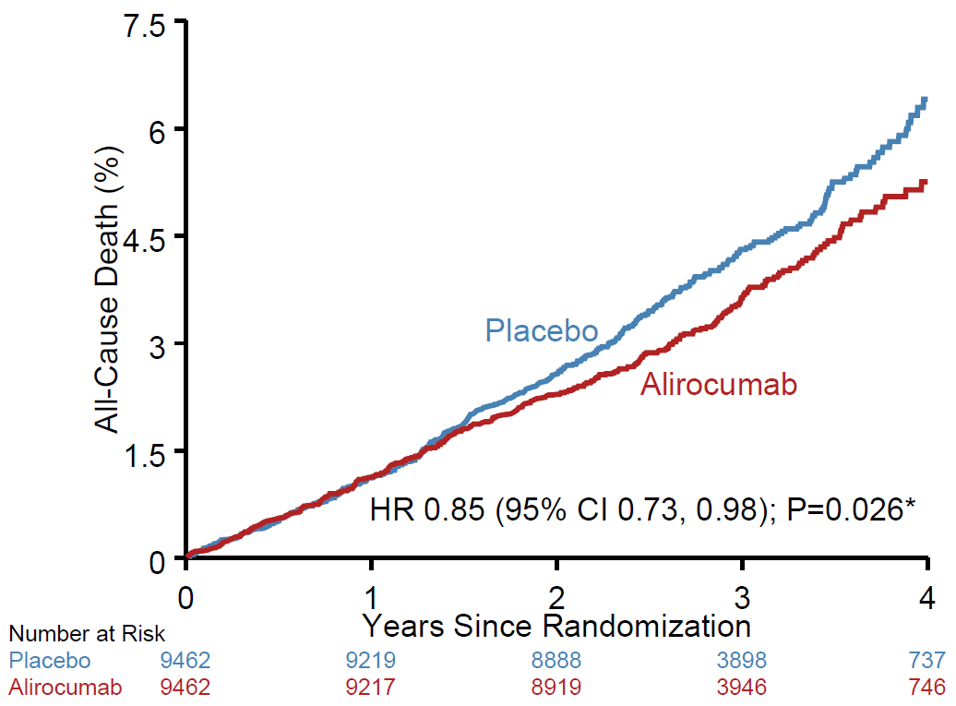
All-Cause Death
ARR† 0.6%
HR 0.85
(95% CI 0.73, 0.98)
P=0.026*
*Nominal P-value
†Based on cumulative incidence

Slide 27
Other Efficacy Endpoints
Endpoint n (%) | Alirocumab (N=9462) | Placebo (N=9462) | HR (95% CI) | Log-rank P-value
Ischemia-driven coronary revascularization | 731 (7.7) | 828 (8.8) | 0.88 (0.79, 0.97) | 0.009
Hospitalization for CHF | 176 (1.9) | 179 (1.9) | 0.98 (0.79, 1.20) | 0.84

Slide 28
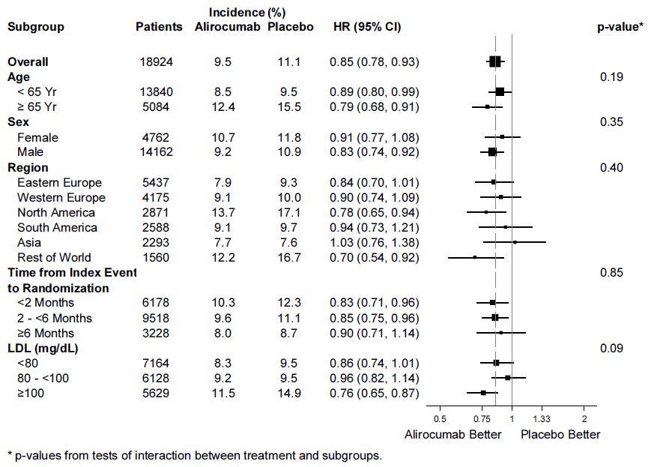
Primary Efficacy in Main Prespecified Subgroups
*P-values for interaction

Slide 29
Primary Efficacy in Main Prespecified Subgroups
Incidence (%)
Subgroup Patients Alirocumab Placebo HR (95% CI) p-value*
*P-values for interaction
<80 mg/dL
80 to <100 mg/dL
≥100 mg/dL

Slide 30
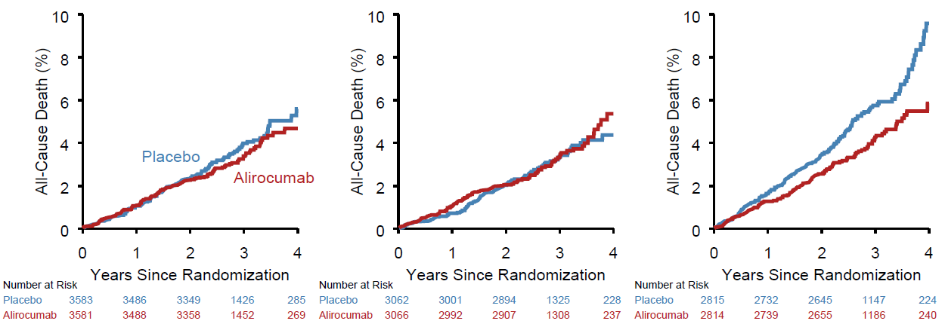
Post Hoc Analysis: All-Cause Death by Baseline LDL-C Subgroups
ARR* 1.7%
P_{interaction}=0.12
<80 mg/dL
HR 0.89
(95% CI 0.69, 1.14)
80 to <100 mg/dL
HR 1.03
(95% CI 0.78, 1.36)
≥100 mg/dL
HR 0.71
(95% CI 0.56, 0.90)
*Based on cumulative incidence

Slide 31
Efficacy: Subgroup with Baseline LDL-C ≥100 mg/dL
(Median Baseline LDL-C 118 mg/dL)
Endpoint, n (%) | Alirocumab (N=2814) | Placebo (N=2815) | Absolute risk reduction (%) | HR (95% CI)
MACE | 324 (11.5) | 420 (14.9) | 3.4 | 0.76 (0.65, 0.87)
CHD death | 69 (2.5) | 96 (3.4) | 1.0 | 0.72 (0.53, 0.98)
CV death | 81 (2.9) | 117 (4.2) | 1.3 | 0.69 (0.52, 0.92)
All-cause death | 114 (4.1) | 161 (5.7) | 1.7 | 0.71 (0.56, 0.90)

Slide 32
Safety (1)
Treatment-emergent adverse events, n (%) | Alirocumab (N=9451) | Placebo (N=9443)
Any | 7165 (75.8) | 7282 (77.1)
Serious | 2202 (23.3) | 2350 (24.9)
Laboratory value | Alirocumab | Placebo
ALT >3 × ULN, n/N (%) | 212/9369 (2.3) | 228/9341 (2.4)
Creatine kinase >10 × ULN, n/N (%) | 46/9369 (0.5) | 48/9338 (0.5)
Notes:
Neutralizing anti-drug antibodies (available data)
42 (0.5%) in alirocumab
6 (<0.1%) in placebo
Roth EM, et al. NEJM 2017; 376:1589-1590

Slide 33
Safety (2)
Event | Alirocumab (N=9451) | Placebo (N=9443)
Diabetes worsening or diabetic complications: pts w/DM at baseline, n/N (%) | 506/2688 (18.8) | 583/2747 (21.2)
New onset diabetes; pts w/o DM at baseline, n/N (%) | 648/6763 (9.6) | 676/6696 (10.1)
General allergic reaction, n (%) | 748 (7.9) | 736 (7.8)
Hepatic disorder, n (%) | 500 (5.3) | 534 (5.7)
Local injection site reaction, n (%)* | 360 (3.8) | 203 (2.1)
Neurocognitive disorder, n (%) | 143 (1.5) | 167 (1.8)
Cataracts, n (%) | 120 (1.3) | 134 (1.4)
Hemorrhagic stroke, n (%) | 9 (<0.1) | 16 (0.2)
*HR vs. placebo 1.82 (95% CI 1.54, 2.17)

Slide 34
Conclusions
Compared with placebo in patients with recent ACS,
alirocumab 75 or 150 mg subcutaneous Q2W targeting LDL-C levels 25–50 mg/dL, and allowing levels as low as 15 mg/dL:
  Reduced MACE, MI, and ischemic stroke
  Was associated with a lower rate of all-cause death
  Was safe and well-tolerated over the duration of the trial

Slide 35
Clinical Perspective
In this nearly 19,000-patient placebo-controlled trial, including many patients treated for ≥3 years, there was no safety signal with alirocumab other than injection site reactions
Among patients with ACS and baseline LDL-C ≥100 mg/dL, alirocumab reduced MACE by 24% (ARR 3.4%) and
all-cause death by 29% (ARR 1.7%) compared with placebo
  These are the patients who may benefit most from treatment
ARR, absolute risk reduction

Slide 36
ODYSSEY OUTCOMES National Leaders
Argentina R. Diaz
Australia P.E. Aylward
Austria H. Drexel
Belgium P. Sinnaeve
Bosnia and Herzegovina M. Dilic
Brazil R.D. Lopes
Bulgaria N.N. Gotcheva
Canada S.G. Goodman
Chile J.-C. Prieto
China H. Yong
Colombia P. López-Jaramillo
Croatia I. Pećin
Czech Republic P. Ostadal
Denmark S. Hvitfeldt Poulsen
Estonia M. Viigimaa
Finland M.S. Nieminen
France N. Danchin
Georgia V. Chumburidze
Germany N. Marx
Greece E. Liberopoulos
Guatemala P.C. Montenegro Valdovinos
Hong Kong H.-F. Tse
Hungary R. Gabor Kiss
India D. Xavier
Israel D. Zahger
Italy M. Valgimigli
Japan T. Kimura
Korea H. Soo Kim
Latvia A. Erglis
Lithuania A. Laucevicius
Macedonia S. Kedev
Malaysia K. Yusoff
Mexico G.A. Ramos López
Netherlands M. Alings
New Zealand H.D. White
Norway S. Halvorsen
Peru R.M. Correa Flores
Philippines R.G. Sy
Poland A. Budaj
Portugal J. Morais
Romania M. Dorobantu
Russian Federation Y. Karpov
Serbia A.D. Ristic
Singapore T. Chua
Slovakia J. Murin
Slovenia Z. Fras
Republic of South Africa A.J. Dalby
Spain J. Tuñón
Sri Lanka H. Asita de Silva
Sweden E. Hagström
Switzerland C. Müller
Taiwan C.-E. Chiang
Thailand P. Sritara
Turkey S. Guneri
Ukraine A. Parkhomenko
UK K.K. Ray
USA P. Moriarty, M Roe, R. Vogel

Slide 37
ODYSSEY OUTCOMES Committees
Executive Steering Committee
G.G. Schwartz and Ph.G. Steg (Co-Chairs)
D.L. Bhatt, V. Bittner, R. Diaz, S.G. Goodman, R.A. Harrington, J.W. Jukema, M. Szarek, H. White, A. Zeiher
Non-voting members:
Ex officio: P. Tricoci, M.T. Roe, K.W. Mahaffey
Sponsor representatives: C. Hanotin, G. Lecorps, A. Moryusef, R. Pordy, W.J. Sasiela, J.-F. Tamby
Clinical Events Committee
P. Tricoci (Chair), J.H. Alexander, L. Armaganijan, A. Bagai, M.C. Bahit, J.M. Brennan, S. Clifton, A.D. DeVore, S. Deloatch, S. Dickey, K. Dombrowski, G. Ducrocq, Z. Eapen, P. Endsley, A. Eppinger, R.W. Harrison, C.N. Hess, M.A. Hlatky, J.D. Jordan, J.W. Knowles, B.J. Kolls, D.F. Kong, S. Leonardi, L. Lillis, R.D. Lopes, D.J. Maron, K.W. Mahaffey, J. Marcus, R. Mathews, R.H. Mehta, R.J. Mentz, H.G. Moreira, C.B. Patel, S.B. Pereira, L. Perkins, T.J. Povsic, E. Puymirat, M.T. Roe, W. Schuyler Jones, B.R. Shah, M.W. Sherwood, K. Stringfellow, D. Sujjavanich, M. Toma, C. Trotter, S.F.P. van Diepen, M.D. Wilson, A. T.-K. Yan
Data Safety Monitoring Board
B. Chaitman (Chair), S.F. Kelsey, A.G. Olsson, J.-L. Rouleau, M.L. Simoons
Monitoring of safety in patients with low LDL-C values
K. Alexander, C. Meloni, R.S. Rosenson, E.J.G. Sijbrands

Slide 38
ODYSSEY OUTCOMES Trial Organization
Academic and Contract Research Organizations
Brazilian Clinical Research Institute, São Paulo, Brazil R. Lopes, F. Egydio, A. Kawakami, J. Oliveira
Canadian VIGOUR Centre, University of Alberta, Toronto, Canada S.G. Goodman, J. Wozniak
Covance, Marlow, Buckinghamshire, UK A. Matthews, C. Ratky, J. Valiris
Duke Clinical Research Institute, Durham, NC, USA L. Berdan, K. Quintero, T. Rorick
Estudios Clínicos Latino America, Rosario, Santa Fe, Argentina R. Diaz, A. Pascual, C. Rovito
French Alliance for Cardiovascular Trials, Paris, France N. Danchin, M. Bezault, E. Drouet, T. Simon
Green Lane Coordinating Centre, Kingsland, Auckland, New Zealand H.D. White, C. Alsweiler
Leuven Klinisch Coördinatiecentrum, Leuven, Belgium P. Sinnaeve, A. Luyten
South Australian Health & Medical Research Institute P. Aylward, J. Butters, L. Griffith, M. Shaw
Uppsala Kliniska Forskningscentrum, Uppsala, Sweden E. Hagstrom, L. Grunberg
Independent Statistical Team
SUNY Downstate School of Public Health M. Szarek, S. Islam

Slide 39
Statistical Considerations
All analyses conducted by independent academic statistical team at State University of New York (SUNY) Downstate School of Public Health, in parallel with the sponsor
Efficacy analysis by intention-to-treat (ITT)

Slide 40
A Target Range for LDL-C
Undesirably high
baseline range
0
15
25
50
70
LDL-C (mg/dL)
Schwartz GG, et al. Am Heart J 2014;168:682-689.e1.
Notes:
First view: Right-hand yellow zone to indicate patients qualifying for study with LDL-C “undesirably high” (i.e., >/=70 mg/dL)
Second view: Alirocumab dose is blindly adjusted to maximize the number of patients in a low but physiologic range of LDL-C (i.e., 25-50 mg/dL)
Third view: Alirocumab dose is also blindly adjusted to minimize patients with persistently very low levels of LDL-C (i.e., <15 mg/dL )

Slide 41
A Target Range for LDL-C
Target range
Undesirably high
baseline range
Alirocumab
0
15
25
50
70
LDL-C (mg/dL)
Schwartz GG, et al. Am Heart J 2014;168:682-689.e1.
Notes:
First view: Right-hand yellow zone to indicate patients qualifying for study with LDL-C “undesirably high” (i.e., >/=70 mg/dL)
Second view: Alirocumab dose is blindly adjusted to maximize the number of patients in a low but physiologic range of LDL-C (i.e., 25-50 mg/dL)
Third view: Alirocumab dose is also blindly adjusted to minimize patients with persistently very low levels of LDL-C (i.e., <15 mg/dL )

Slide 42
A Target Range for LDL-C
Target range
Undesirably high
baseline range
Acceptable range
Alirocumab
0
15
25
50
70
LDL-C (mg/dL)
Schwartz GG, et al. Am Heart J 2014;168:682-689.e1.
Notes:
First view: Right-hand yellow zone to indicate patients qualifying for study with LDL-C “undesirably high” (i.e., >/=70 mg/dL)
Second view: Alirocumab dose is blindly adjusted to maximize the number of patients in a low but physiologic range of LDL-C (i.e., 25-50 mg/dL)
Third view: Alirocumab dose is also blindly adjusted to minimize patients with persistently very low levels of LDL-C (i.e., <15 mg/dL )

Slide 43
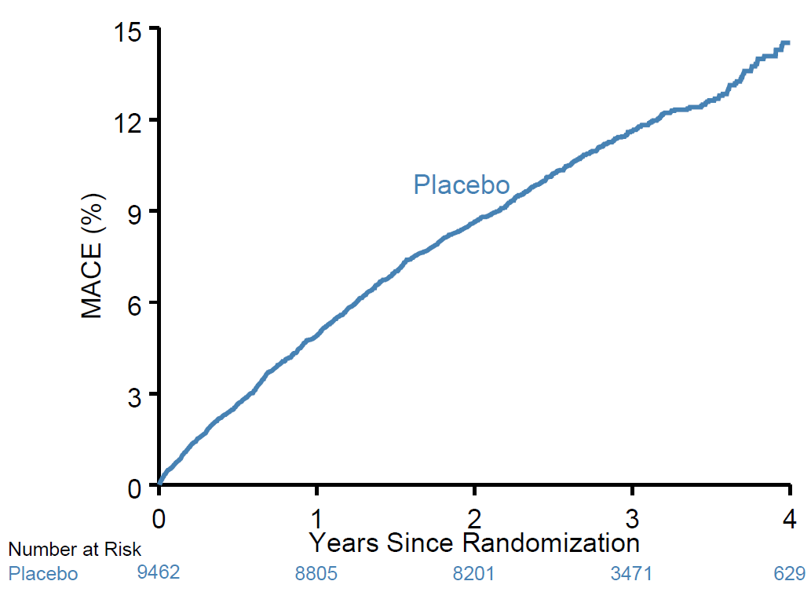
Primary Efficacy Endpoint: MACE
  MACE: CHD death,
  non-fatal MI,
  ischemic stroke, or
  unstable angina requiring
  hospitalization

Slide 44
Primary Efficacy in Main Prespecified Subgroups
Incidence (%)
Subgroup Patients Alirocumab Placebo HR (95% CI) p-value*
*P-values for interaction

Slide 45
Primary Efficacy in Main Prespecified Subgroups
Incidence (%)
Subgroup Patients Alirocumab Placebo HR (95% CI) p-value*
*P-values for interaction
<80 mg/dL
80 to <100 mg/dL
≥100 mg/dL

Slide 46
Post Hoc Analysis: All-Cause Death by Baseline LDL-C Subgroups
≥100 mg/dL
HR=0.71
<80 mg/dL
HR 0.89
(95% CI 0.69, 1.14)
80 to <100 mg/dL
HR 1.03
(95% CI 0.78, 1.36)

Slide 47
Clinical Perspective
In this nearly 19,000-patient placebo-controlled trial, including many patients treated for ≥3 years, there was no safety signal with alirocumab other than injection site reactions

Slide 48



