Slide 1
Inhibidores PCSK9
¿Además de la morbilidad, también reducen la mortalidad?
Dr. Lluís Masana
Hospital Universitario Sant Joan de Reus, Tarragona

Slide 2
Alirocumab Reduces Risk of Death after ACS in Patients with Persistently Elevated Atherogenic Lipoproteins on Intensive Statin Treatment
Gregory G. Schwartz, Michael Szarek, Deepak L. Bhatt, Vera A. Bittner, Marie-France Bregeault,
Anthony J. Dalby, Rafael Diaz, Jay M. Edelberg, Shaun G. Goodman, Corinne Hanotin,
Robert A. Harrington, J. Wouter Jukema, Guillaume Lecorps, Kenneth W. Mahaffey, Angèle Moryusef,
Petr Ostadal, Alexander Parkhomenko, Robert Pordy, Matthew T. Roe, Pierluigi Tricoci, Robert Vogel,
Harvey D. White, Andreas M. Zeiher, Ph. Gabriel Steg
On behalf of the ODYSSEY OUTCOMES Investigators and Committees
American Heart Association Scientific Sessions
November 11, 2018
ClinicalTrials.gov: NCT01663402

Slide 3
All-Cause Death:
All Patients vs Patients Eligible for ≥3 Years of Follow-Up
Schwartz et al, AHA 18
Eligible for ≥3 years follow-up
(N=8242)
All patients (N=18,924)
*
*Nominal P-value due to hierarchical position of all-cause death among secondary endpoints
Notes:
On the right among patients eligible for at least 3 years of follow-up, alirocumab reduced death with a hazard ratio of 0.78 and P-value 0.01. Together, these data indicate more pronounced benefit of alirocumab on death in patients with longer treatment and follow-up.

Slide 4
Post Hoc Analysis: All-cause Death in Three Predefined Categories of Baseline LDL-C
ARR*
0.4%
ARR*
-0.1%
ARR*
1.7%
Relative risk reduction: Interaction P=0.12
*Absolute risk reduction: Interaction P=0.005
*Based on cumulative incidence
Notes:
This slide shows the cumulative incidence of death in each baseline LDL cholesterol category. Absolute risk of death in the placebo group was substantially greater in the subgroup with baseline LDL-C of at least 100mg/dl. [advance] The absolute reduction in risk of death with alirocumab was 1.7% in that subgroup, compared with little effect of treatment on death in the two lower subgroups. Although there was no significant interaction of baseline LDL-C category and treatment on the relative risk of death, there was a highly significant interaction on the absolute reduction in the risk of death. In sum, patients with baseline LDL-C at least 100 mg/dl had the highest risk of death in the placebo group, and the largest reductions in both LDL-C and death with alirocumab.

Slide 5
Effect of Alirocumab on All-Cause, CV, and Non-CV Death
†
*Stratified by geographic region
† Nominal P-value
Notes:
… and non-cardiovascular deaths with alirocumab than with placebo. To better understand the last finding, we investigated whether effects of alirocumab on non-fatal cardiovascular events and non-cardiovascular death might be linked.

Slide 6
Schwartz et al, AHA 18
Is an Effect of Alirocumab on Non-CV Death Linked to Effects on Non-fatal CV Events?
Results of joint semi-parametric modelling
 | HR (95% CI) | P-value
Non-fatal CV events (MI, stroke, unstable angina: 1034 events for alirocumab vs 1240 for placebo):
Alirocumab treatment | 0.82 (0.74, 0.91) | 0.0002
Non-CV death (94 events for alirocumab vs 121 for placebo):
Alirocumab treatment | 0.76 (0.58, 1.00) | 0.052
Association between non-fatal and fatal events 2.35 (95% CI 1.98, 2.73) |  | 0.0001
*
Alirocumab treatment favorably affected risks of non-fatal CV events and non-CV death.
The association parameter of 2.35 indicates that these risks are strongly linked; therefore, an effect of alirocumab to reduce the risk of non-fatal CV events may lead to fewer non-CV deaths.
*HR and P-values from this model differ from Cox regression
Notes:
Here are the results of the model showing hazard functions for non-fatal CV events and non-CV death, and the association parameter for these two types of events. [Advance build] In the red box, you can see that alirocumab favorably affected the risks of non-fatal CV events and non-CV death. [Advance build] In the blue box, the association parameter of 2.35 indicates that these risks are strongly linked; therefore, an effect of alirocumab to reduce non-fatal CV events may lead to fewer non-CV deaths.

Slide 7
Conclusions and Clinical Relevance
Alirocumab, added to intensive statin therapy, has the potential to reduce death after ACS, particularly when
  treatment can be maintained for at least 3 years.
  baseline LDL-C is at least 100 mg/dL.
After ACS, the risks of non-fatal CV events and non-CV death are associated.
  Thus, an effect of alirocumab to reduce the risk of non-fatal CV events may result in fewer non-CV deaths, contributing to fewer all-cause deaths.
Notes:
Read

Slide 8
All Cause Death in 2^{ry} prevention LLT trials (2)
More intensive vs less intensive regimen
PROVE-IT (2004)¹ | HR = 0,72
A2Z (2004)² | HR = 0,79 (0,61-1,02)
TNT (2005)³ | HR = 1,01 (0,85–1,19)
IDEAL (2005)⁴ | HR = 0,98 (0,85-1,13)
SEARCH (2010)⁵ | HR = 0,99 (0,91–1,09)
IMPROVE-IT (2014)⁶ | HR = 0,99 (0,91–1,07)
FOURIER (2017)⁷ | HR = 1,04 (0,91-1,19)
ODYSSEY OUTCOMES (2018)⁸ | HR = 0,85 (0,73-0;98)
0,2
0,5
0,8
1
1,2
1,4
More intensive therapy better
Less intensive therapy better
1- N Engl J Med 2004;350:1495-504.
2- JAMA. 2004;292:1307-1316
3- N Engl J Med 2005;352:1425-35.
4- JAMA. 2005;294:2437-2445
5- Lancet 2010; 376: 1658–69.
6- N Engl J Med 2015; 372:2387-2397
7- N Engl J Med 2017; 376:1713-172.
8- Schwartz GG, et al. N Eng J Med 2018

Slide 9
¿Hay algún riesgo asociado a la reducción intensiva de colesterol LDL?

Slide 10
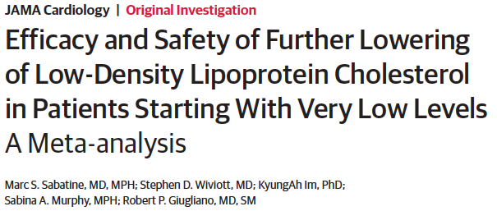
JAMA Cardiol. doi:10.1001/jamacardio.2018.2258

Slide 11
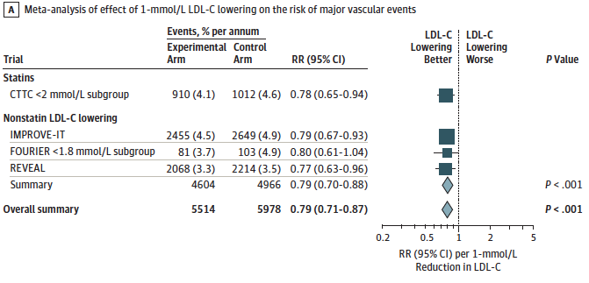
Effect of Low-Density Lipoprotein Cholesterol (LDL-C) Lowering on the Risk of Major Vascular Events
JAMA Cardiol. doi:10.1001/jamacardio.2018.2258

Slide 12
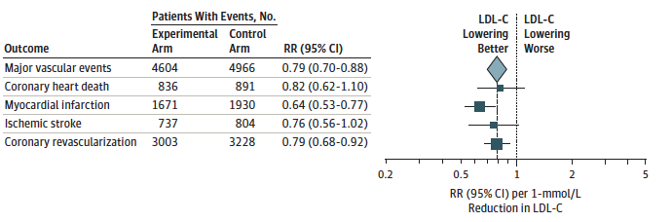
Individual Efficacy Outcomes in Nonstatin Trials
JAMA Cardiol. doi:10.1001/jamacardio.2018.2258

Slide 13
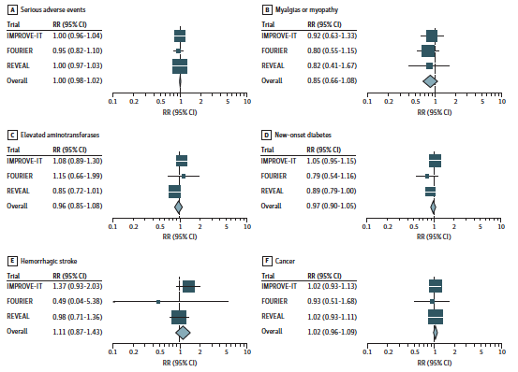
Safety Outcomes in Nonstatin Trials
JAMA Cardiol. doi:10.1001/jamacardio.2018.2258

Slide 14
El descenso de los niveles de colesterol LDL comportan una disminución del riesgo cardiovascular, sin que hasta el momento se haya podido identificar un valor suelo en el que el efecto beneficioso desaparezca.
Los niveles de LDL extremadamente bajos no parecen comportan riesgo adicional alguno.
Estos datos aportan evidencia científica para contemplar objetivos terapéuticos más ambiciosos que los actuales en pacientes de extremado riesgo cardiovascular

Slide 15
¿Y con las HDL dónde estamos?

Slide 16

Los fármacos dirigidos a modular HDL no han mostrado eficacia en la reducción de eventos cardiovasculares
ILLUMINATE
Torcetrapib
DAL-OUTCOMES
Dalcetrapib
ACCORD
Fenofibrato
FIELD
Fenofibrato
AIM-HIGH
Niacina
HPS2-THRIVE
Niacina
ACCELERATE
Evacetrapib
Notes:
No hacen recomendaciones sobre el uso de otras medicaciones hipolipemiantes.
Consideran que no hay evidencias de su beneficio o bien estas son incluso negativas.

Slide 17
Extreme high high-density lipoprotein cholesterol is paradoxically associated with high mortality in men and women: two prospective cohort studies
Masden CM et al. European Heart Journal (2017) 38, 2478–2486

Slide 18
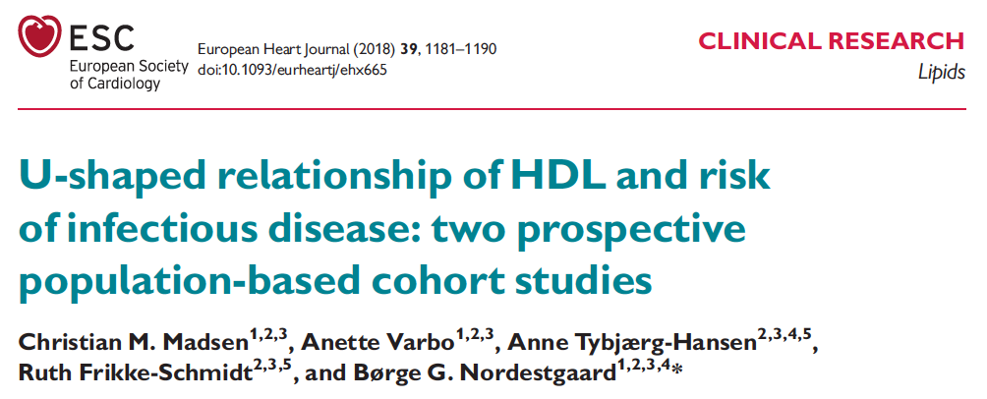

Slide 19
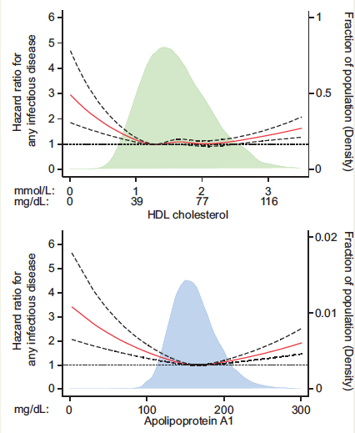
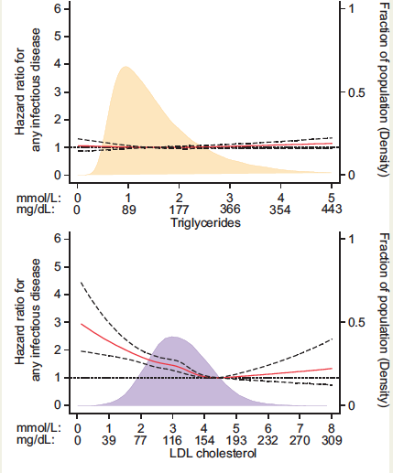
European Heart Journal (2018) 39, 1181–1190

Slide 20
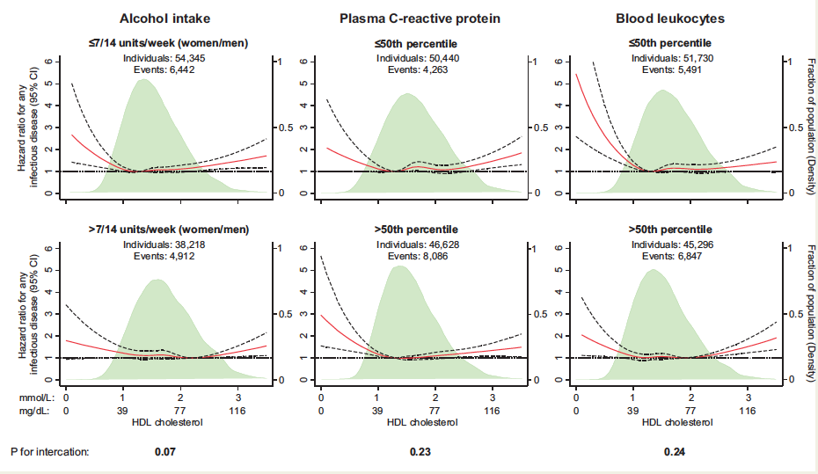
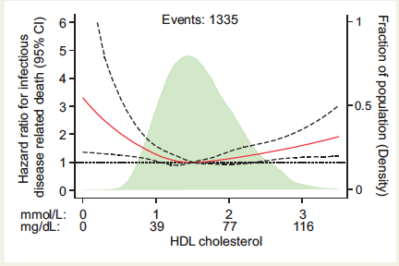
European Heart Journal (2018) 39, 1181–1190

Slide 21
Las HDL suponen el 95% de las partículas lipoproteicas circulantes
Su función fisiológica no es totalmente conocida pero sin duda va mucho más allá del transporte reverso del colesterol
Entre sus funciones hay aspectos relacionados con el control de la inflamación y la inmunidad

Slide 22
Guías ACC/AHA
¿La teoría estatínica de la arteriosclerosis?

Slide 23

LDL
statins
Masana L EAS Lisbon 2018

Slide 24
INFORMACIÓN ADICIONAL DESDE LAS GUÍAS ACC/AHA 2013
      IMPROVE-IT
      FOURIER
      ODYSSEY
      META-ANÁLISIS
      ESTUDIOS DE RANDOMIZACIÓN MENDELIANA

Slide 25
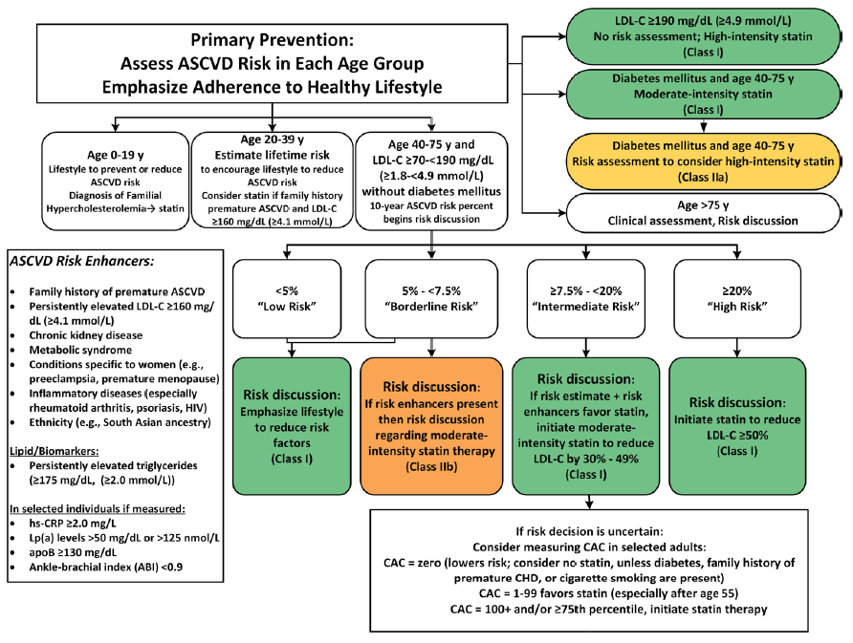

Slide 26
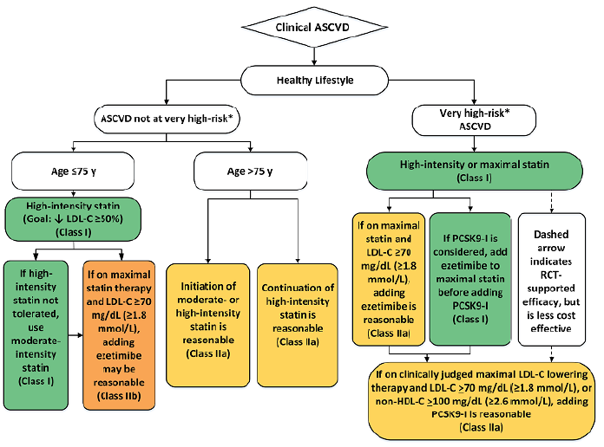

Slide 27
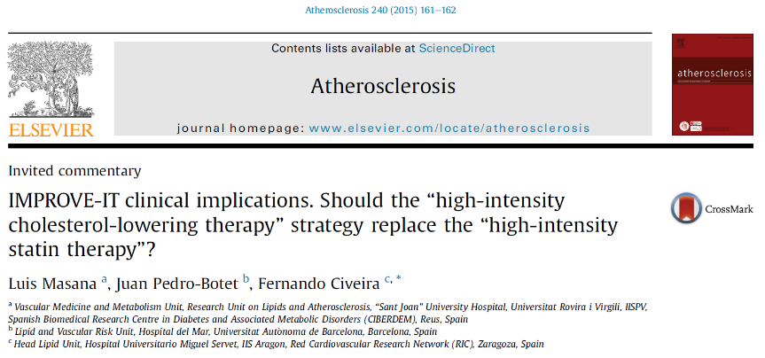
High-intensity
statin therapy
High intensity
cholesterol-lowering
therapy
SAES.ALI.19.01.0079a Enero 2019

