Slide 1


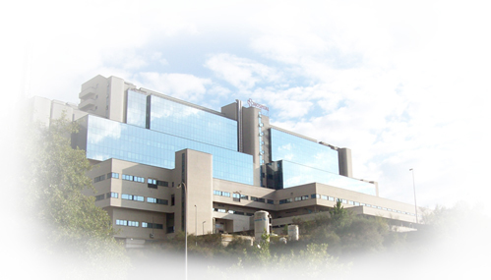

SAES.ALI.18.10.1377 Noviembre 2018
SEC-2018 SEVILLA
Sesión Conjunta SCC, SChC, AnCAM-SEC.
¿Los Cardiólogos Tratamos los Factores de Riesgo o el Riesgo Global?
José R González Juanatey
Cardiology Department.
University Hospital
Santiago de Compostela. Spain
CIBERCV

Slide 2
Disclosures:
Research Grants: AZ, Boehringer Ingelheim, Pfizer, Novartis, Daichii-Sankyo, Sanofi-Aventis, Bayer, MSD, Servier, Ferrer
Consultant/Honorarium. AZ, Boehringer-Ingelheim, Bayer, Pfizer, BMS, MSD, Daichii-Sankyo, Servier, Menarini; Ferrer

Slide 3
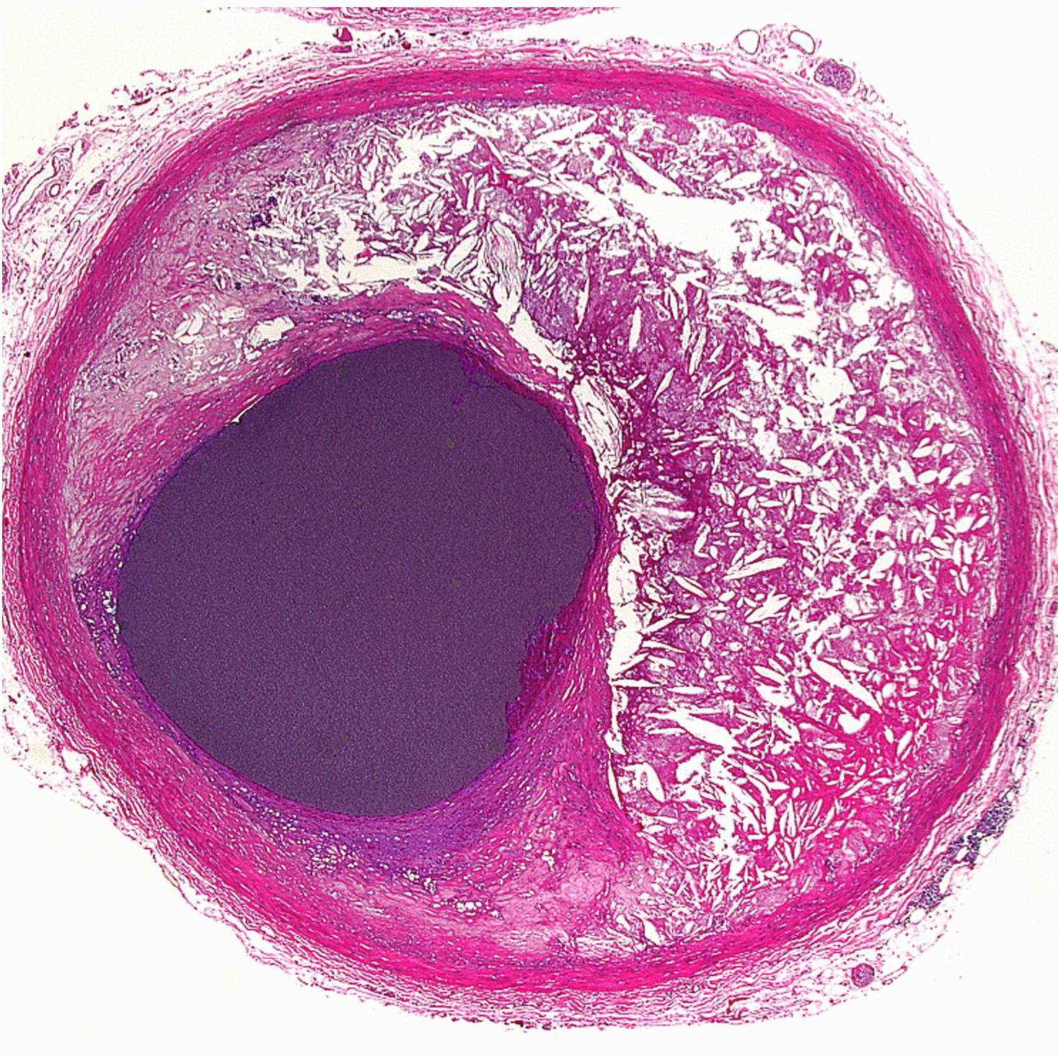
GLOBAL RISK
LIPID RISK
INFLAMMATION
THROMBOTIC RISK
LIFE STYLE
GLUCO-METABOLIC RISK
BP RISK

Slide 4
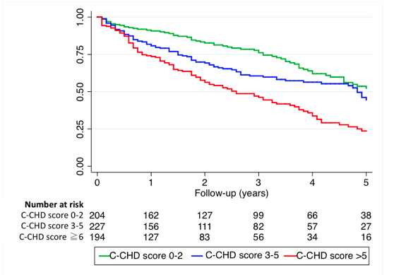
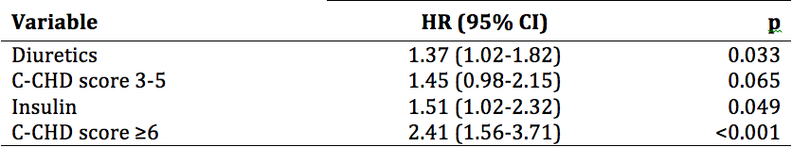
Design and validation of a risk scale for patients with chronic coronary heart disease. REPAR/CIBAR Registries.
Cordero A,…, Gonzalez-Juanatey JR. IJC 2017.

Slide 5
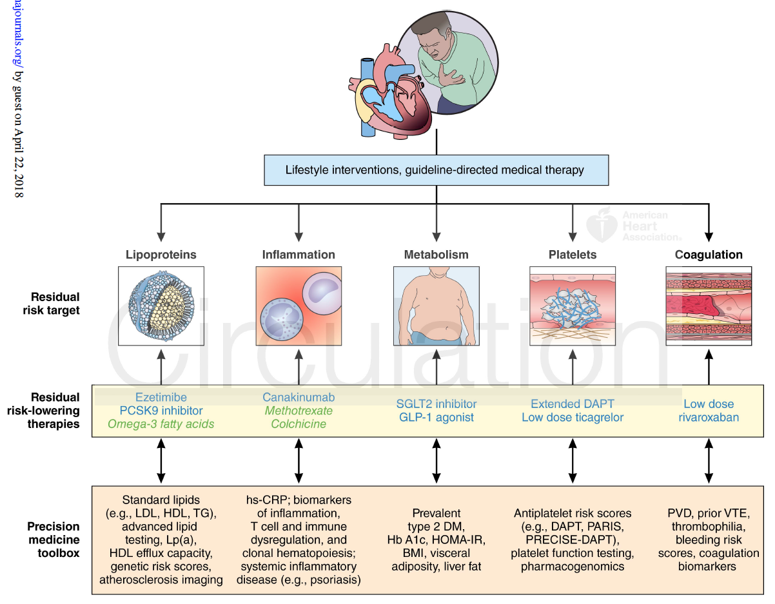
Secondary Prevention. Precision Medicine
LIFE STYLE, guideline-directed medical therapy
Lipoproteins
Inflammation
Metabolism
Platelets
Coagulation
Patel K et al. Circulation 2018

Slide 6
IHD 2ªPrev. An Extraordinary Journey
Innovation | Year | Impact
B-Blockers | 70´ | Mortality
ASA | 80´ | Mortality
Life-style changes/Rehab | 70-15´ | Mortality
ACE Ih | 80-90´ | Morbi-mortality
Statins | 90´ | Morbi-Mortality
Empa/Canaglifocin/Liragutide | 16´ | Morbi/mortality
Revasc (subgroups) | 00´ | Morbi-mortality
iPCSK9 (Evolocumab, Alirocumab) | 17´/18’ | Morbi-mortality
Rivaroxaban | 17´ | Morbi-mortality
Ticagrelor | 15´ | Morbi-mortality
Ezetimibe | 15´ | Morbi-mortality
10
%/y
2
%/y

Slide 7
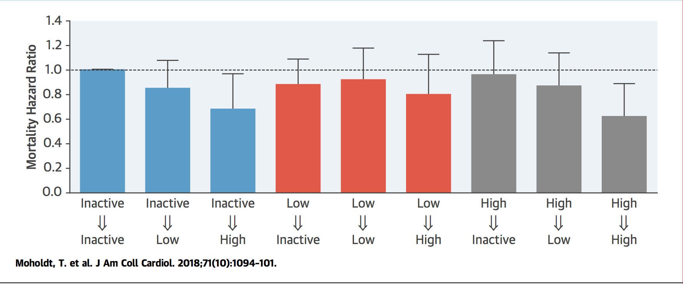
Change in Physical Activity Level and Mortality Risk
In 2018, exercise is the most potent drug!!

Slide 8
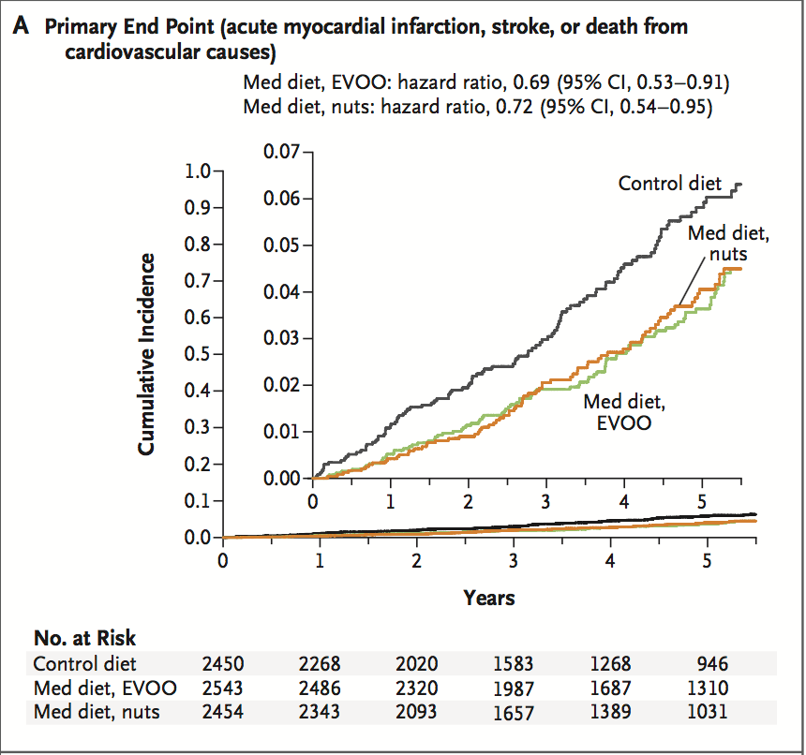
Primary Prevention (HIGH RISK) of CV disease with a mediterranean diet supplemented with extra-virgin olive oil or nuts. PREDIMED
Primary End Point (AMI, stroke, CV death)
… and Mediterranean diet!!
Estruch R, et al. NEJM 2018; June 13.

Slide 9
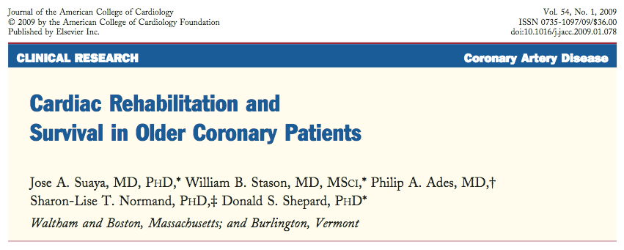

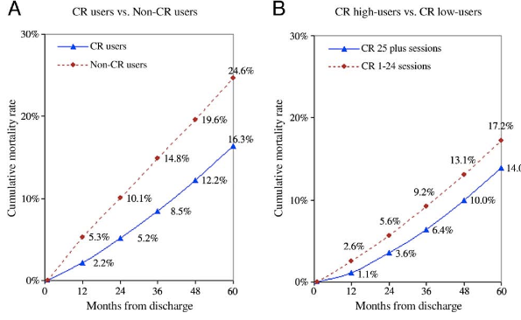

Slide 10
Prevención Secundaria: Balance Beneficio/Riesgo
Resultados en Salud que importan a los pacientes
(Beneficio-Daño* Calidad percibida por el paciente)
Valor
Dinero
Tiempo
CO₂
(Gasto en el ciclo completo de la asistencia)
(Cantidad de energía que gasta el sistema para producir un resultado)

Slide 11
GLOBAL RISK
LIPID RISK
INFLAMMATION
THROMBOTIC RISK
LIFE STYLE
GLUCO-METABOLIC RISK
BP RISK

Slide 12
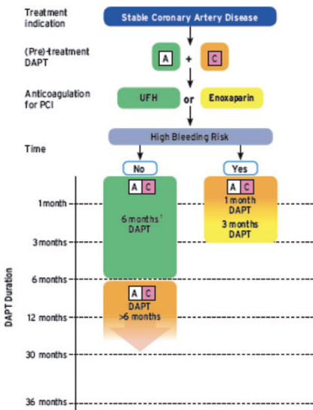

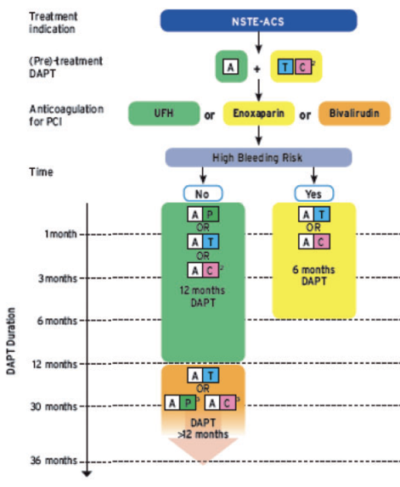
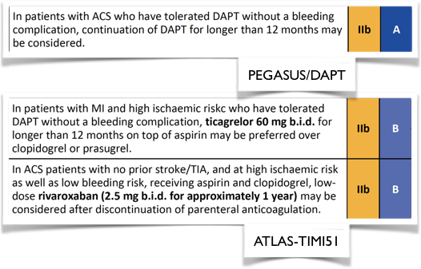


Stable CAD
ACS

Slide 13

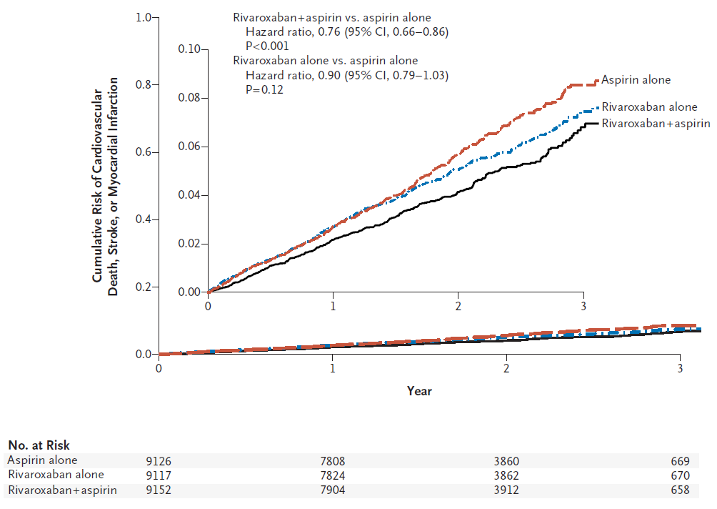
Dual Therapy with Rivaroxaban
Primary endpoint: CV death, stroke, MI
Outcome | R + A N=9,152 | R N=9,117 | A N=9,126 | Rivaroxaban + aspirin vs. aspirin |  | Rivaroxaban vs. aspirin
 | N (%) | N (%) | N (%) | HR (95% CI) | p | HR (95% CI) | p
CV death, stroke, MI | 379 (4.1%) | 448 (4.9%) | 496 (5.4%) | 0.76 (0.66-0.86) | <0.0001 | 0.90 (0.79-1.03) | 0.12
Outcome | R + A N=9,152 | R N=9,117 | A N=9,126 | Rivaroxaban + Aspirin vs. Aspirin |  | Rivaroxaban vs. Aspirin
 | N (%) | N (%) | N (%) | HR (95% CI) | P | HR (95% CI) | P
Major bleeding | 288 (3.1%) | 255 (2.8%) | 170 (1.9%) | 1.70 (1.40-2.05) | <0.0001 | 1.51 (1.25-1.84) | <0.0001
Fatal | 15 (0.2%) | 14 (0.2%) | 10 (0.1%) | 1.49 (0.67-3.33) | 0.32 | 1.40 (0.62-3.15) | 0.41
Non fatal ICH* | 21 (0.2%) | 32 (0.4%) | 19 (0.2%) | 1.10 (0.59-2.04) | 0.77 | 1.69 (0.96-2.98) | 0.07
Non-fatal other critical organ* | 42 (0.5%) | 45 (0.5%) | 29 (0.3%) | 1.43 (0.89-2.29) | 0.14 | 1.57 (0.98-2.50) | 0.06
Outcome | R + A N=9,152 | A N=9,126 | Rivaroxaban + Aspirin vs. Aspirin
 | N (%) | N (%) | HR (95% CI) | p
CV death | 160 (1.7%) | 203 (2.2%) | 0.78 (0.64-0.96) | 0.02
Stroke | 83 (0.9%) | 142 (1.6%) | 0.58 (0.44-0.76) | <0.0001
MI | 178 (1.9%) | 205 (2.2%) | 0.86 (0.70-1.05) | 0.14
Eikelboom JW et al. N Engl J Med. 2017;377:1319-30.

Slide 14
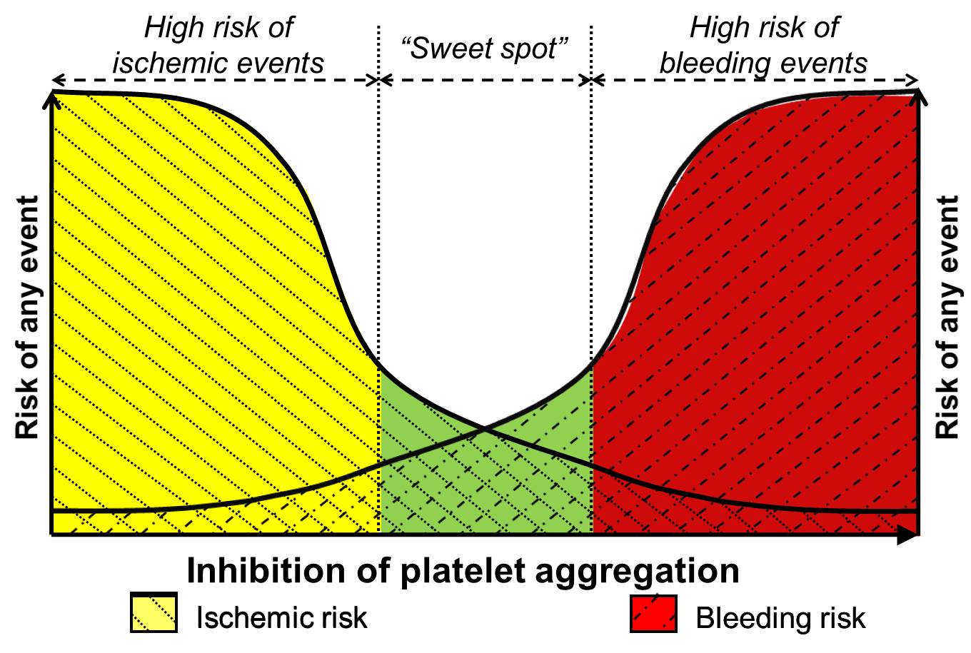
Balancing Ischemic and Bleeding Risks….
Intensity and duration of antiplatelet therapy
Modified from Ferreiro JL et al. Thromb Haemost 2010;103:1128-35.

Slide 15
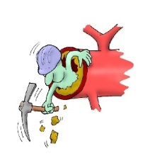

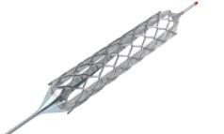
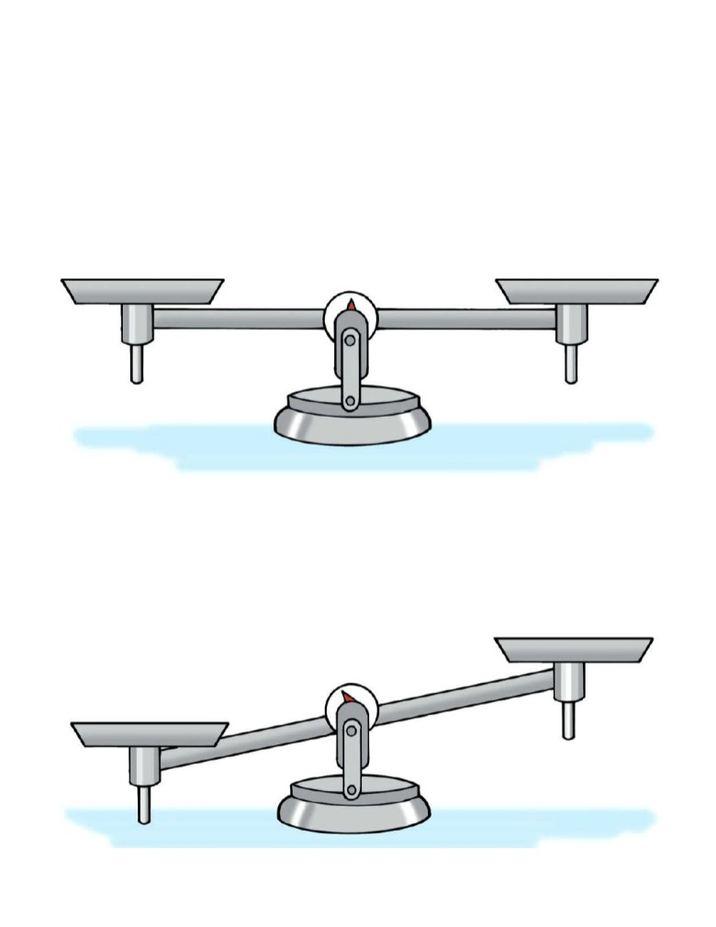
Duration of Anti-thrombotics Depends on…
Complex anatomy or PCI
Long lesions, small vessels
LM, bifurcations
Multiple stents…
Device-related factors
2nd generation DES
BVS
Patient-related factors
Stable CAD or ACS
DM, CKD, PAD, prior ST…
Hx of bleeding
When?:
Aspirin Alone
ASA + Ticagrelor
ASA + Rivaroxaban
Ischemic
Risk
Bleeding
Risk

Slide 16
GLOBAL RISK
LIPID RISK
INFLAMMATION
THROMBOTIC RISK
LIFE STYLE
GLUCO-METABOLIC RISK
BP RISK

Slide 17

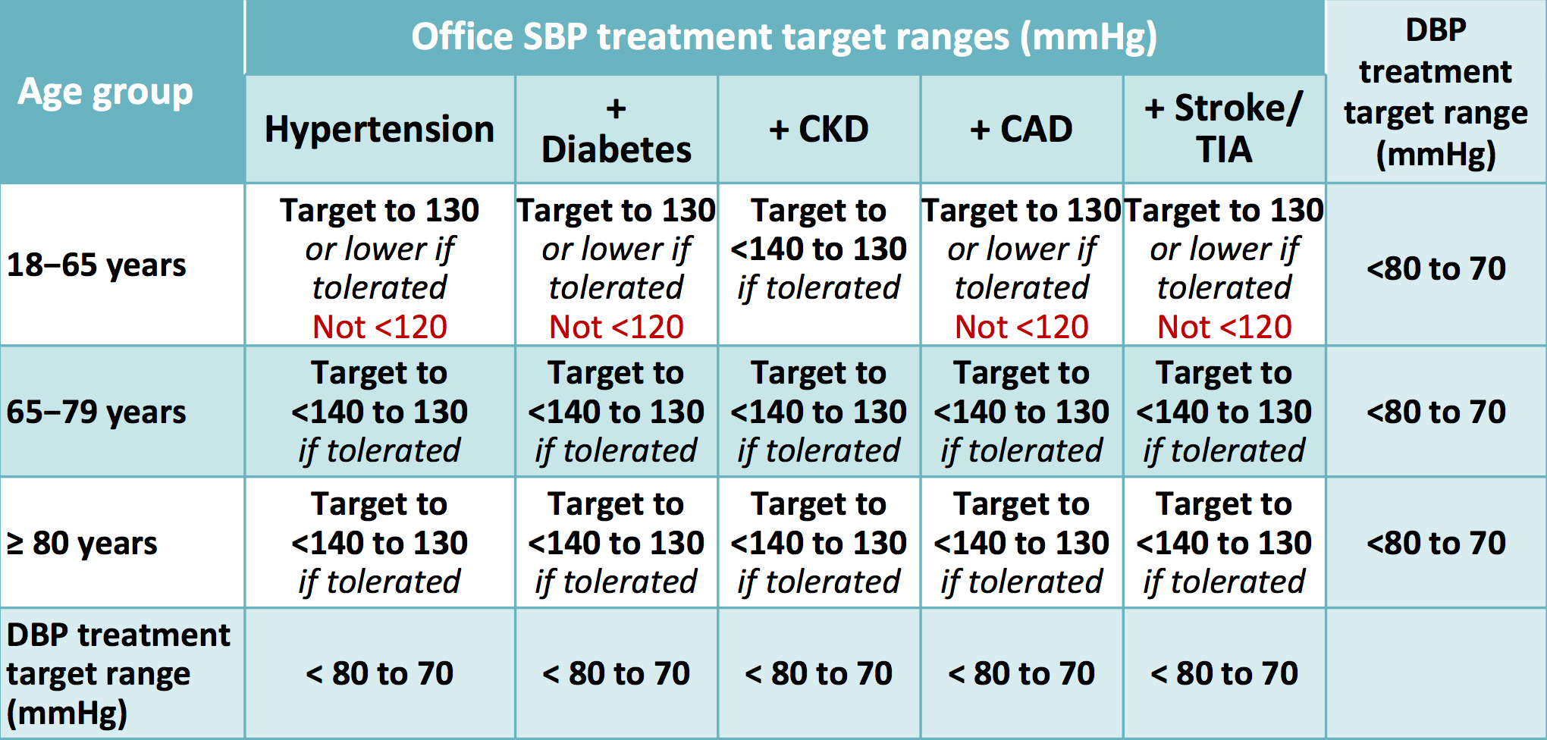
ESC / ESH 2018
HT > 140/90 mmHg
< 130/80 mmHg in High Risk Patients, Diabetic patients
< 140/80 mmHg in Older Patients, CKD

Slide 18

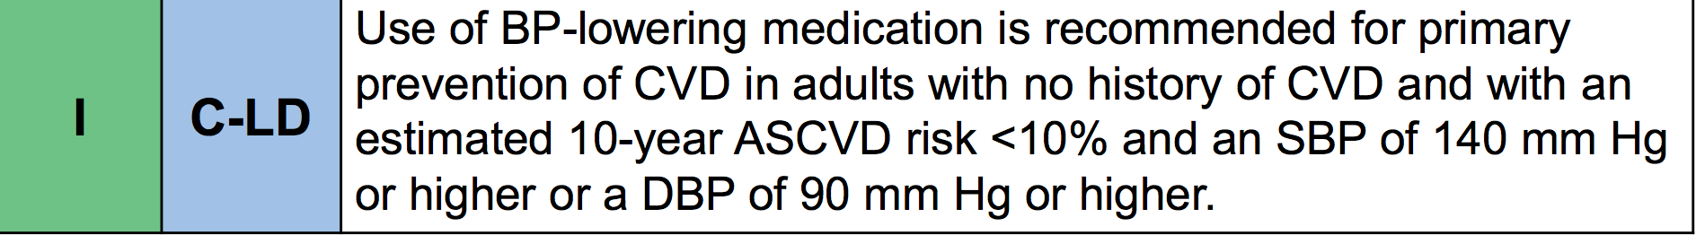
AHA/ACC 2017
HT > 130/80 mmHg
< 130/80 mmHg in High Risk Patients
< 140/90 mmHg in Low Risk Patients
JACC/Circulation 2017
Eur Heart J 2018

Slide 19
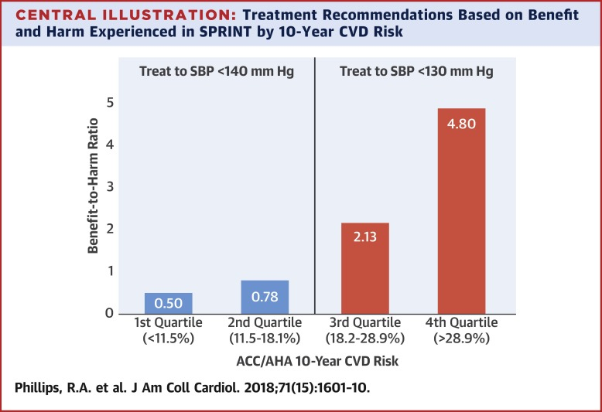
Treatment Recommendations Based on Benefit and Harm Experienced in SPRINT by 10-Year CVD Risk

Slide 20
SBP Goals in High Risk Hypertensive patients. The VALUE Trial
Mancia et al. Eur Heart J 2016; 37: 955–964

Slide 21
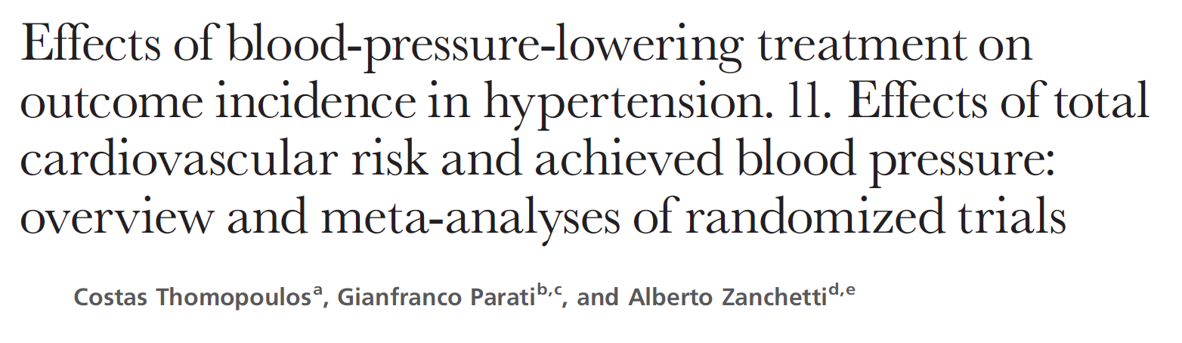
Thomopoulos et al. J Hypertens 2017; 35: 2138-2149
Mancia et al. Eur Heart J 2016; 37: 955–964

Slide 22
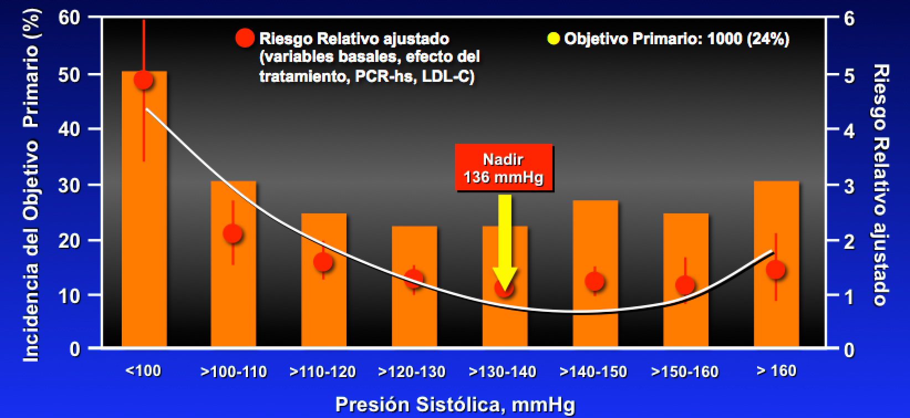
SBP Goals in IHD Patients. The PROVE-IT Trial
Adjusted Relative Risk (Baseline, treatment effect, RCP-hs, LDL-C)
Primary Objective
Primary objective Incidence (%)
SBP, mmHg
Bangalore et al. Circulation 2011; 122: 2142-2151

Slide 23
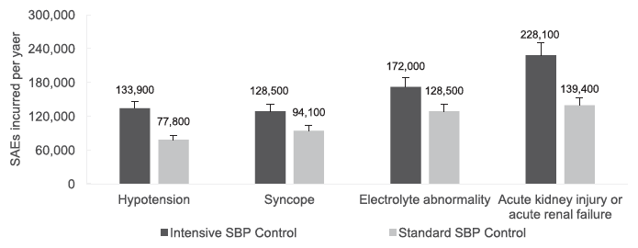
Prognostic Impact From Adoption of the SPRINT Intensive BP Regimen in USA.
Serious Adverse Events per year
Hypotension
Syncope
Electr. abnormality
Acute kidney injury or acute renal failure
Intensive BP Control
Standard BP Control
Bress AP, et al. Circulation 2017; 135: 1617-1628.

Slide 24
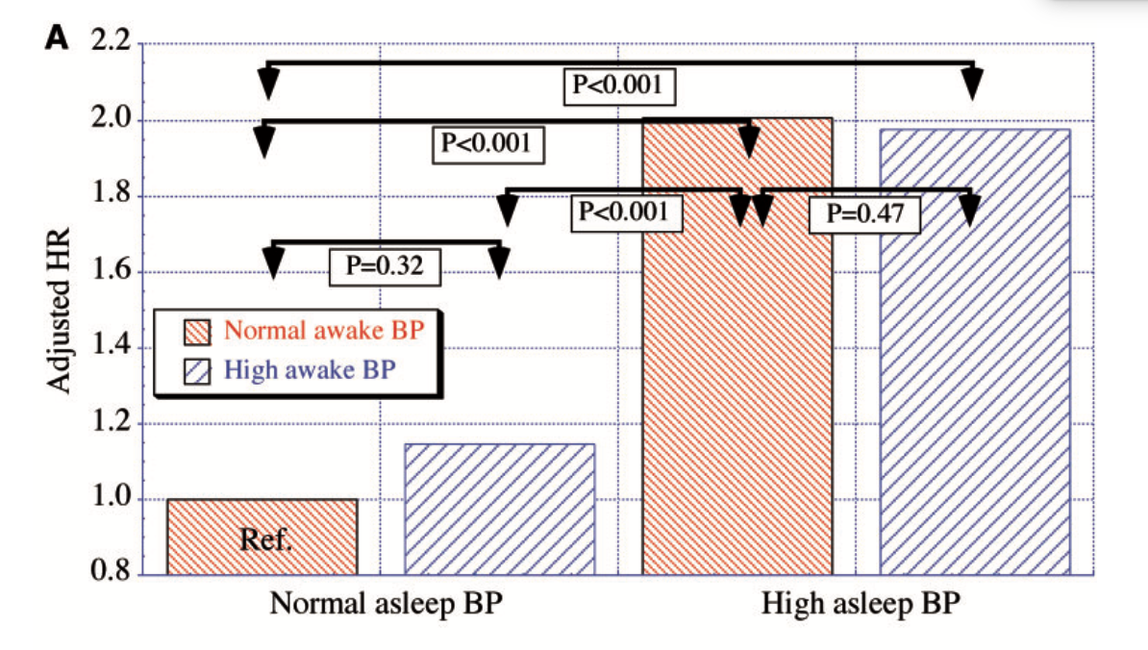
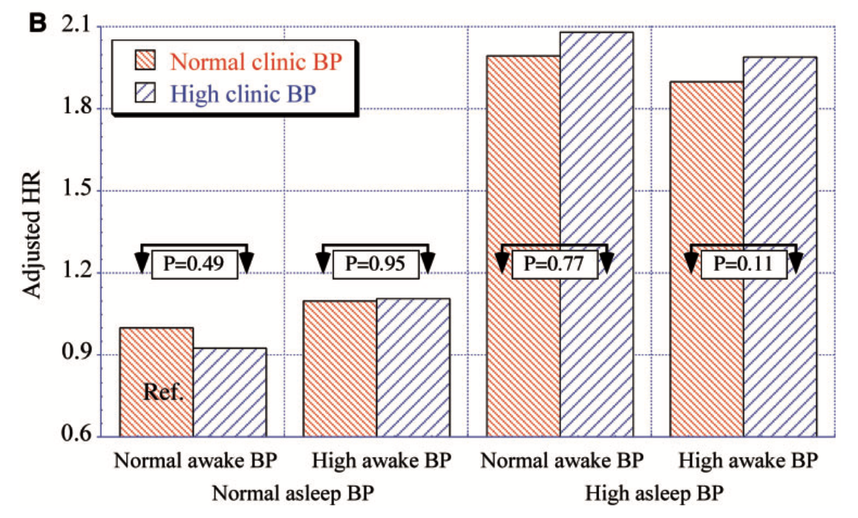
Asleep Blood Pressure: Significant Prognostic Marker of Vascular Risk and Therapeutic Target For Prevention
Normal asleep BP
High asleep BP
Normal asleep BP
High asleep BP
Hermida RC, et al. Eur Heart J 2018; July 20.

Slide 25
GLOBAL RISK
LIPID RISK
INFLAMMATION
THROMBOTIC RISK
LIFE STYLE
GLUCO-METABOLIC RISK
BP RISK

Slide 26






A 60-year-old man with CVD and T2D may die 12 years younger than someone without CVD and T2D
60
yrs
End of life
No diabetes
Diabetes
–6
yrs
Diabetes + MI
–12
yrs
In this case, CV disease is represented by MI or stroke
*Male, 60 years of age with history of MI or stroke
The Emerging Risk Factors Collaboration. JAMA 2015

Slide 27
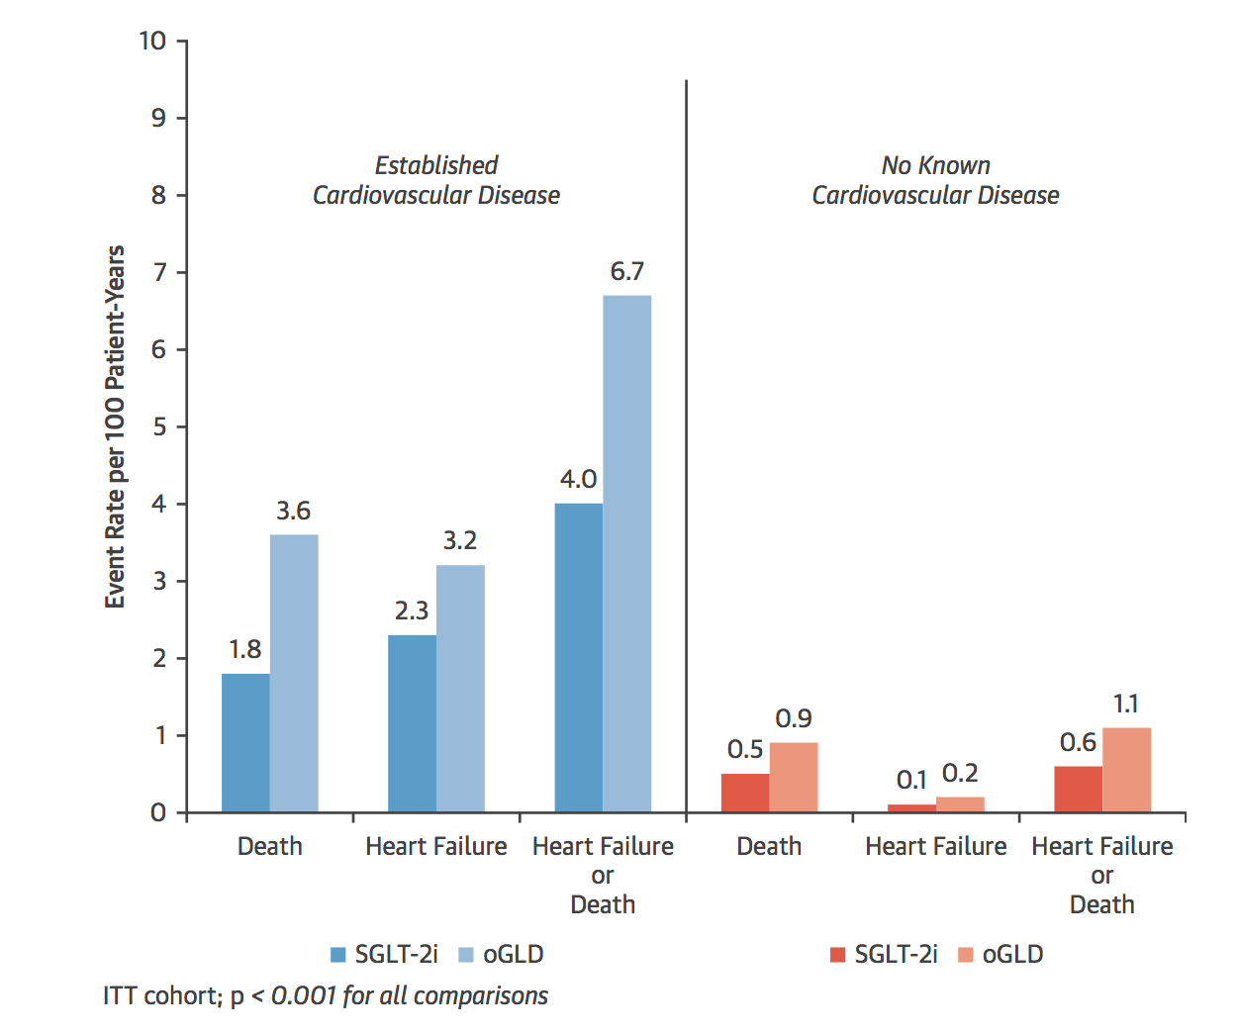
SLGT2 Inhibitors In The “Real World” in patients with and without CV disease. CVD-real
Established CV disease
No known CV disease
EMPA-REG
CANVAS
DECLARE?

Slide 28
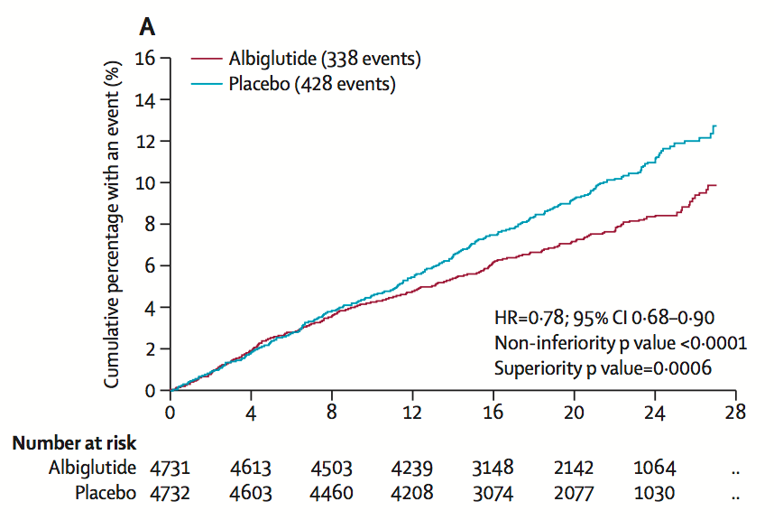
Albiglutide and CV Outcomes in Patients with Type 2 Diabetes and CV Disease (HARMONY OUTCOMES)
Primary Outcome (CV Death, AMI or Stroke)
Hernandez AF, et al. Lancet 2018; 2 October.

Slide 29
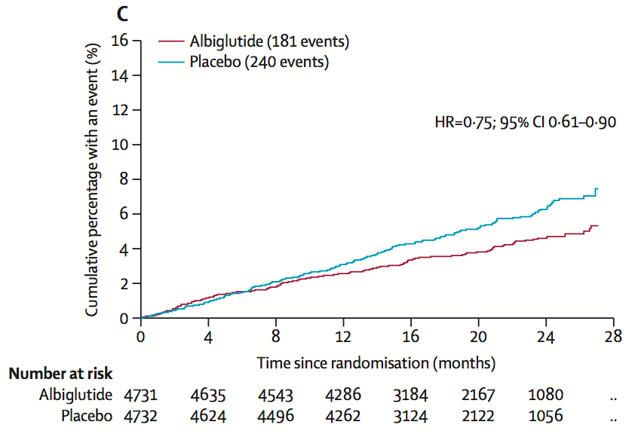
Albiglutide and CV Outcomes in Patients with Type 2 Diabetes and CV Disease (HARMONY OUTCOMES)
Myocardial Infarction
Hernandez AF, et al. Lancet 2018; 2 October.

Slide 30
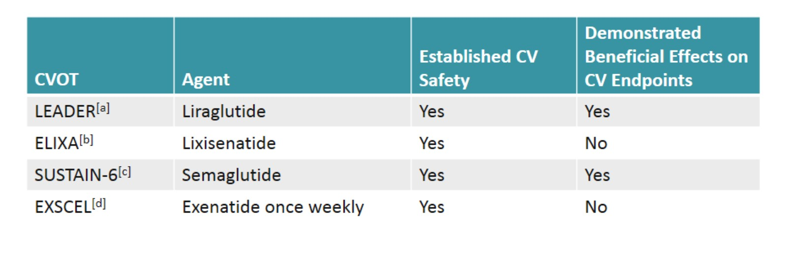
Cardiovascular Outcomes Trials with GLP-1 Agonists
HARMONY Albiglutide Yes Yes
No Reduction in Cardiovascular Outcomes with Lixisenatide, Exenatide
(Not a Class Effect)
Notes:
Broad population of patients with Type 2 diabetes in general practice, the overwhelming majority (87%) of whom did not have known cardiovascular disease –Benefits may extend to those at the lower end of the risk spectrum

Slide 31
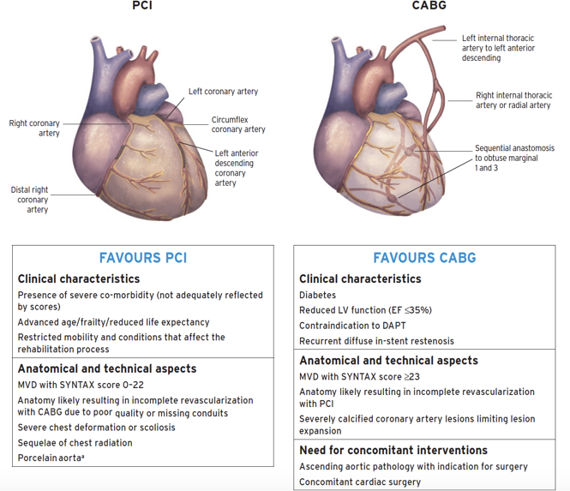
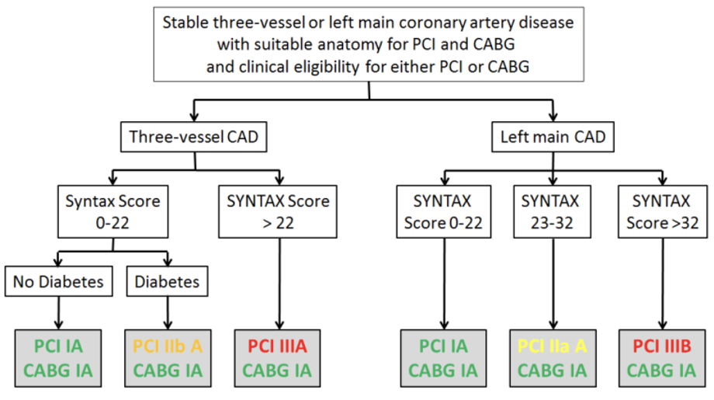
Revascularization in Diabetics

Slide 32
GLOBAL RISK
LIPID RISK
INFLAMMATION
THROMBOTIC RISK
LIFE STYLE
GLUCO-METABOLIC RISK
BP RISK

Slide 33
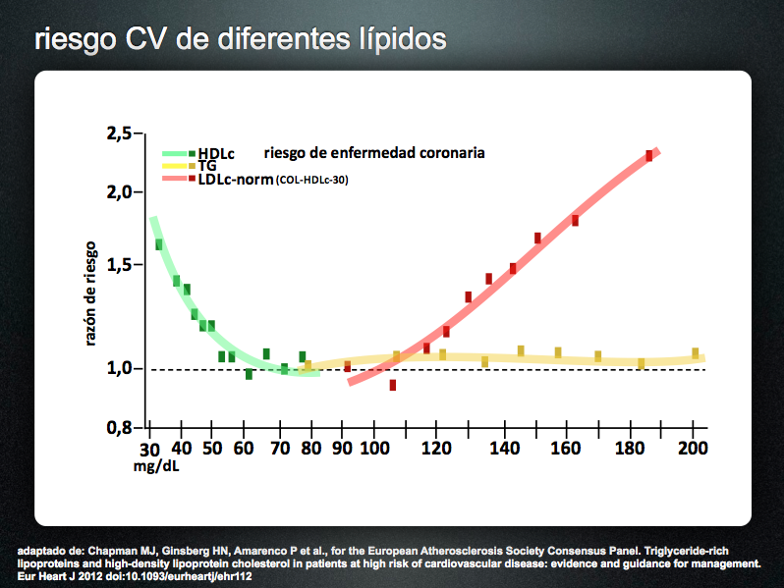
CV Risk and Lipid Profile
Ischemic heart disease risk

Slide 34
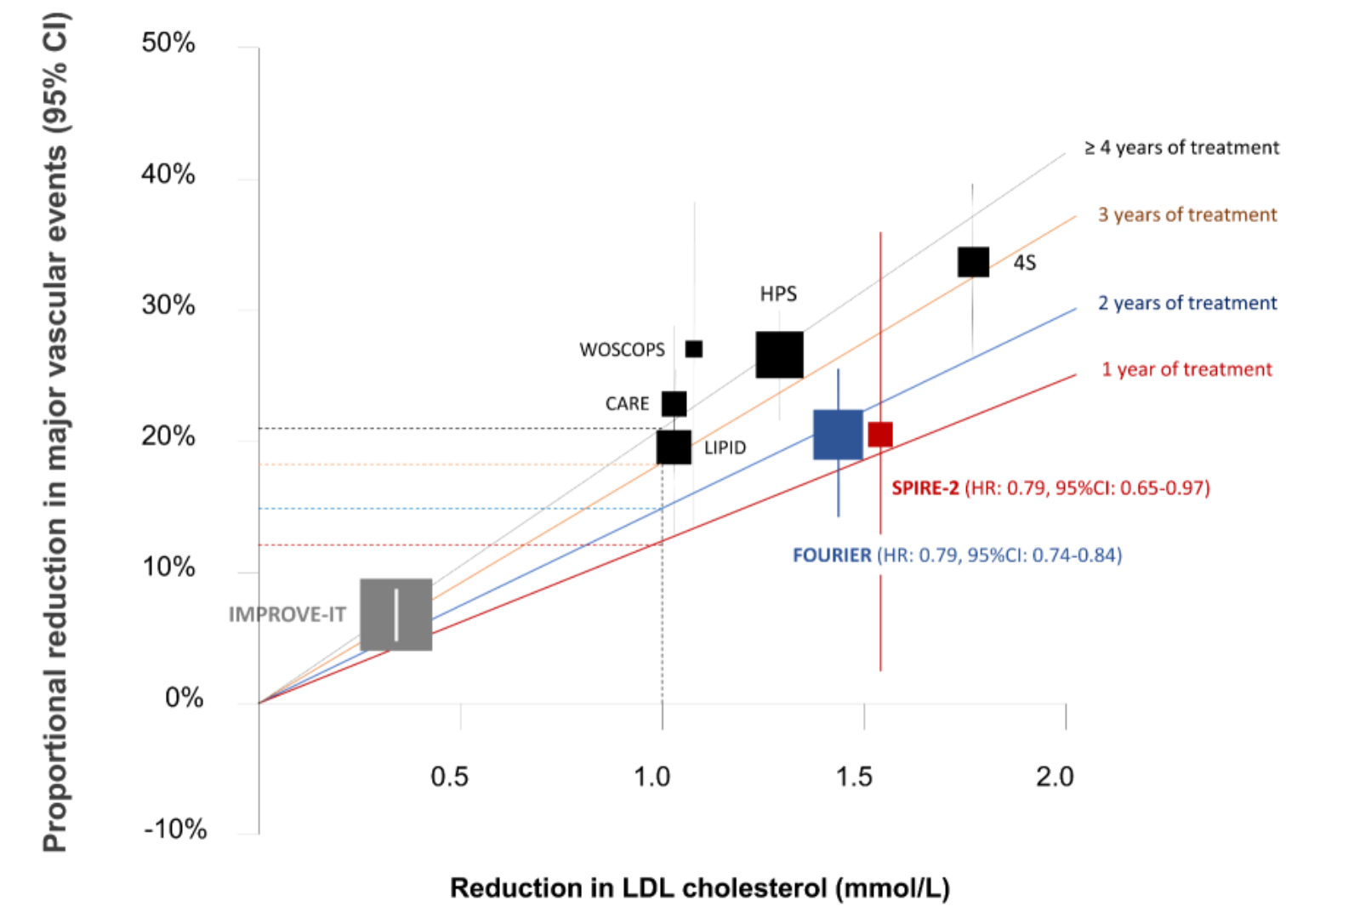

PCSK9 Results. Taking Account Duration of Therapy
PCSK9 (FOURIER/ODYSSEY)
(HR: 0.79, 95%CI: 0.74-0.97)
“Time Dependent” Benefit
Reduction in LDL cholesterol (mm/L)

Slide 35
5-year number-needed-to-treat to prevent one ASCVS event on maximal statin therapy
>30% 10-year ASCVD
Initial LDL-C
190 mg/dL
160 mg/dL
130 mg/dL
100 mg/dL
70 mg/dL
Clinical ASCVD+Diabetes
Clinical ASCVD+CKD
Recent ACS (<3 months)
Clinical ASCVD with multiple recurrent events
Percent LDL-C reduction
Add Ez
Combo Therp
PCSK9inh
PCSK9i Mx Dose
20%
32
38
47
61
88
35%
18
22
27
35
50
50%
13
15
19
25
35
65%
10
12
15
19
27
Robinson J, et al. JACC 2016.

Slide 36
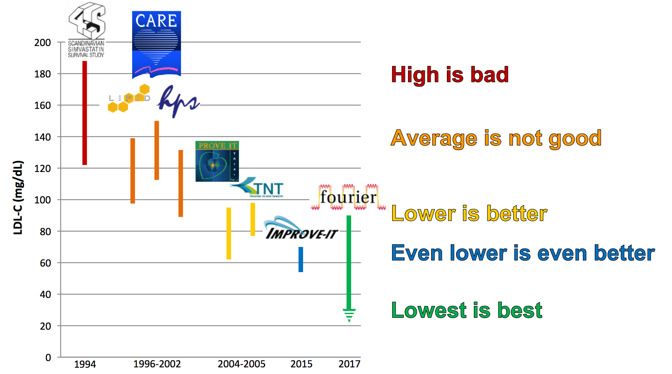
A Quarter of a Century of Treating LDL-C

Slide 37
GLOBAL RISK
LIPID RISK
INFLAMMATION
THROMBOTIC RISK
LIFE STYLE
GLUCO-METABOLIC RISK
BP RISK

Slide 38
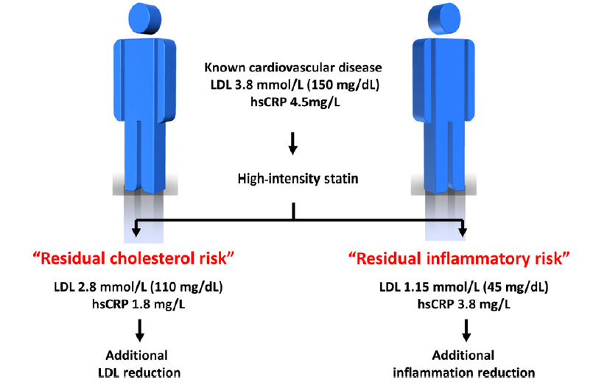
Known cardiovascular disease
Residual cholesterol risk
Residual inflammatory risk
No prior proof of concept
IMPROVE-IT: Ezetimibe 6% RRR
FOURIER: PCSK9i q2w 15% RRR
Additional LDL reduction
Additional inflammation reduction

Slide 39
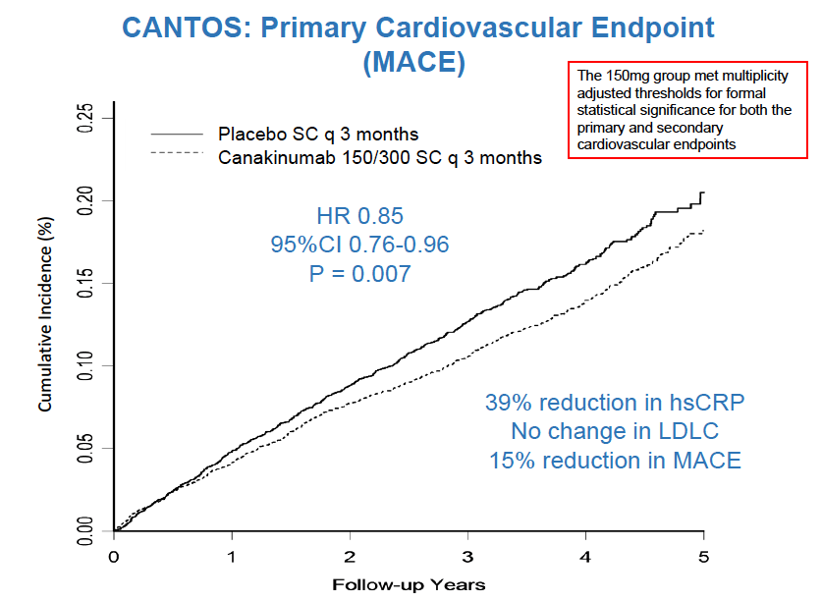
CANTOS: Primary CV Endpoint
(MACE)
Ridker PM, et al. NEJM 2017; August 27.

Slide 40
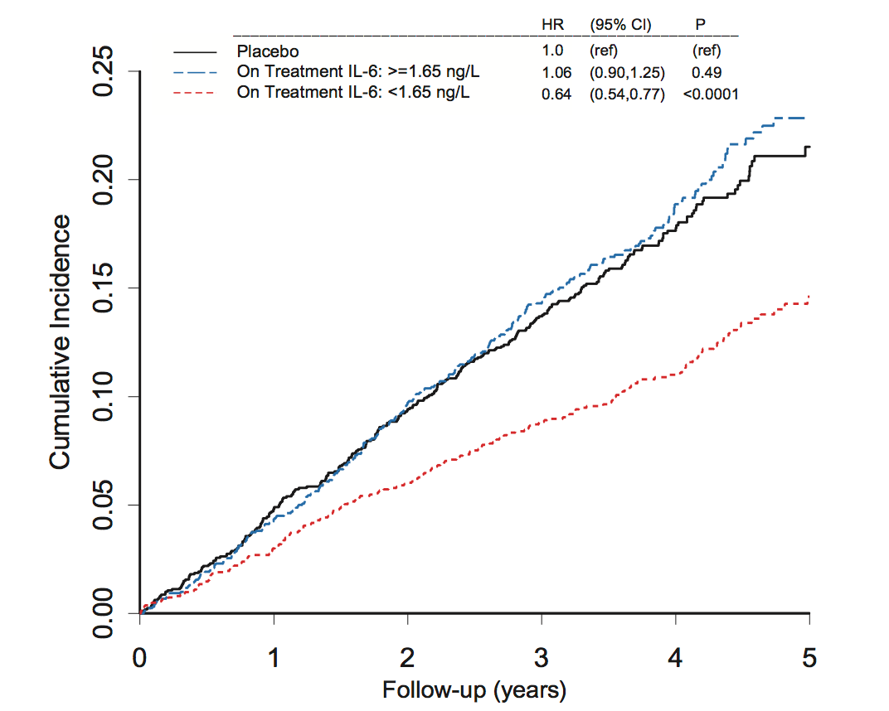
Modulation of the Interleukin-6 signalling pathway and CV events and all-cause mortality. The cantos Trial
36% RRR
Ridker PM, et al. Eur Heart J 2018, 16 May.

Slide 41
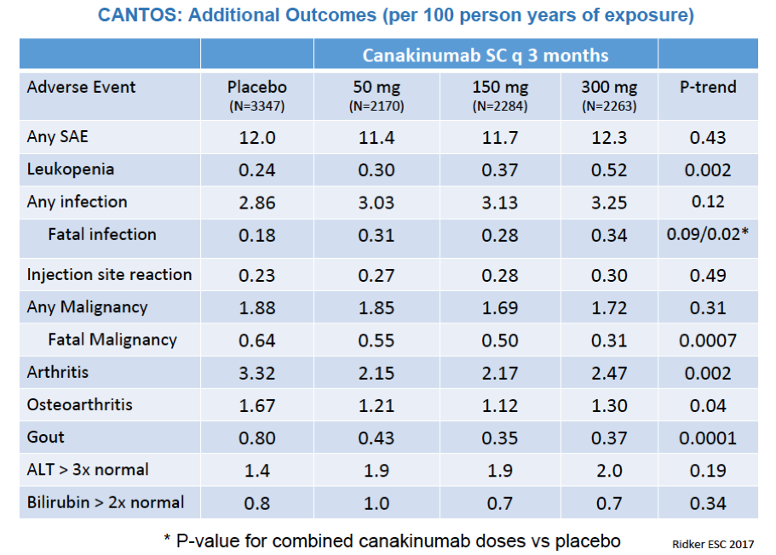
CANTOS: Additional outcomes (per 100 persons years of exposure)

Slide 42
GLOBAL RISK
LIPID RISK
INFLAMMATION
THROMBOTIC RISK
LIFE STYLE
GLUCO-METABOLIC RISK
BP RISK

Slide 43
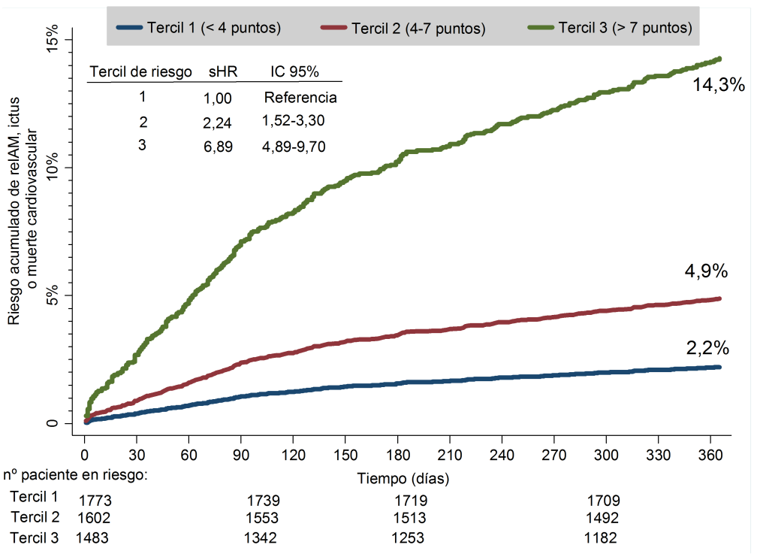
AMI, Stroke or CV Death after an ACS.
CardioCHUS Registry.
From Hospital discharge to 1-year
“Time Dependent” Benefit
Cummulative Risk of AMI, Stroke or CV Death
Early intervention
Abu-Assi E, …, González-Juanatey JR. Rev Esp Cardiol 2015

Slide 44
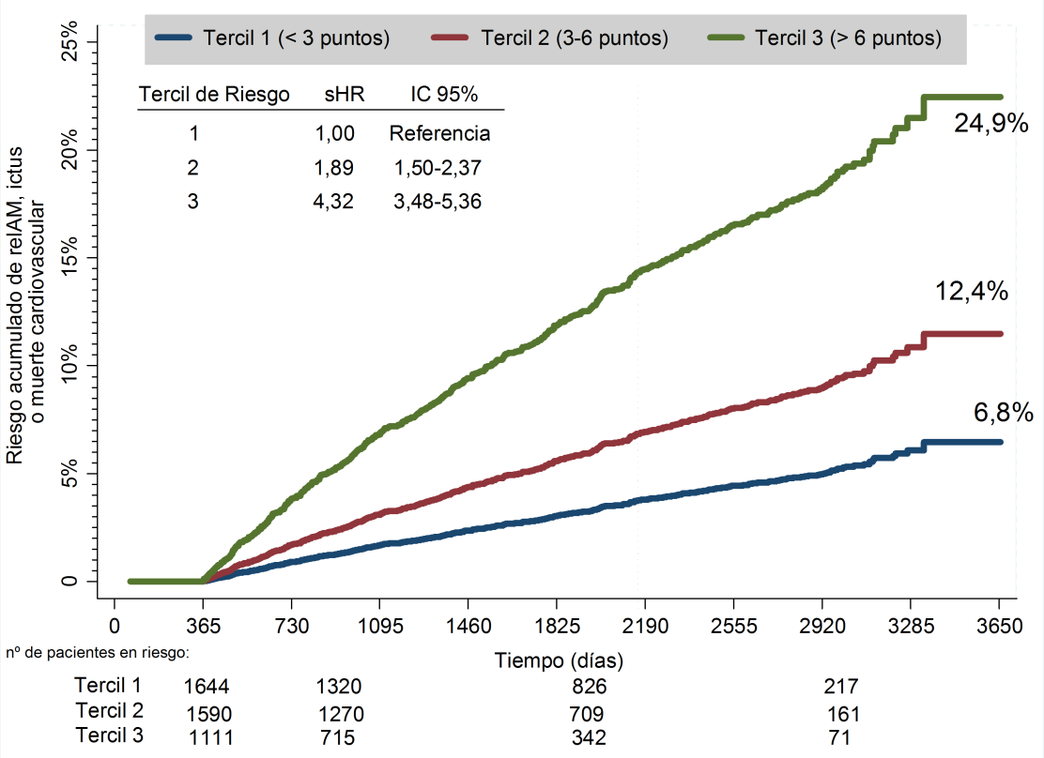
AMI, Stroke or CV Death after an ACS.
CardioCHUS Registry.
From 1-year to the complete follow-up
30% RRR
17.5%
30% RRR
8.7%
“Risk Dependent” Benefit
Cummulative Risk of AMI, Stroke or CV Death
Abu-Assi E, …, González-Juanatey JR. Rev Esp Cardiol 2015

Slide 45

WHY ARE WE FAILING TO IMPLEMENT KNOWLEDGE: A GLOBAL GAP IN TREATMENT OF CARDIVOVASCULAR DISEASE
The Case of SECONDARY PREVENTION
Patients with cardiovascular events. Treatment Efficacy
>75%
ESTIMATED
EFFICACY
Patients accessing health care
Interventions prescribed by
Health care professionals
Patients adherence
21%
REAL
EFFECTIVENESS
CARDIOVASCULAR EVENTS
GLOBAL HEART, VOL. 10, NO. 2, 2015. June 2015: 99-110

Slide 46
SUMMARY / CONCLUSIONS
“Time and Risk Dependent Benefit” in Cardiovascular Risk Reduction. Early and long-term interventions.
Global Risk Assessment and Approach as Clinical Priorities
Life-style changes, Thrombotic Risk, BP, LDL-c, Gluco-metabolic and inflammation as the Main Targets.
“Get with the Guidelines” for Physicians and “Get with the life-style changes and prescriptions” for the Patients as the Main Goal.
SAES.ALI.18.10.1377 Noviembre 2018

