Slide 1
Madrid, 6-7 de abril de 2018
What's Next IN LIPIDS & CV PREVENTION
Xavier Pintó
Unitat de Lípids i Risc Vascular
Servei de Medicina Interna
Hospital Universitari de Bellvitge
CiberObn. Fipec. UB. Idibell.

Slide 2
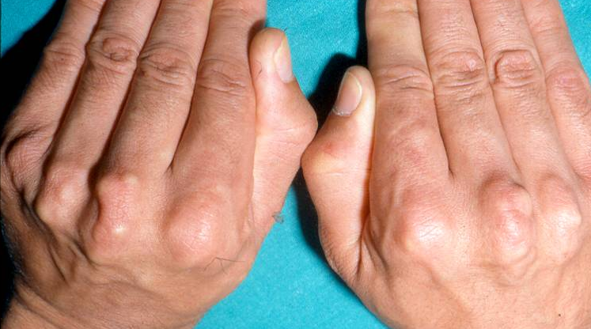
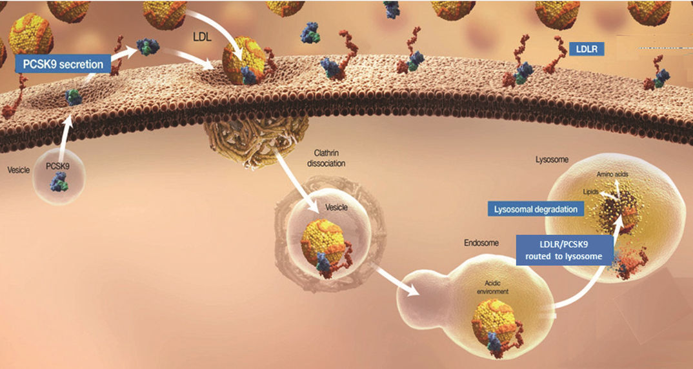
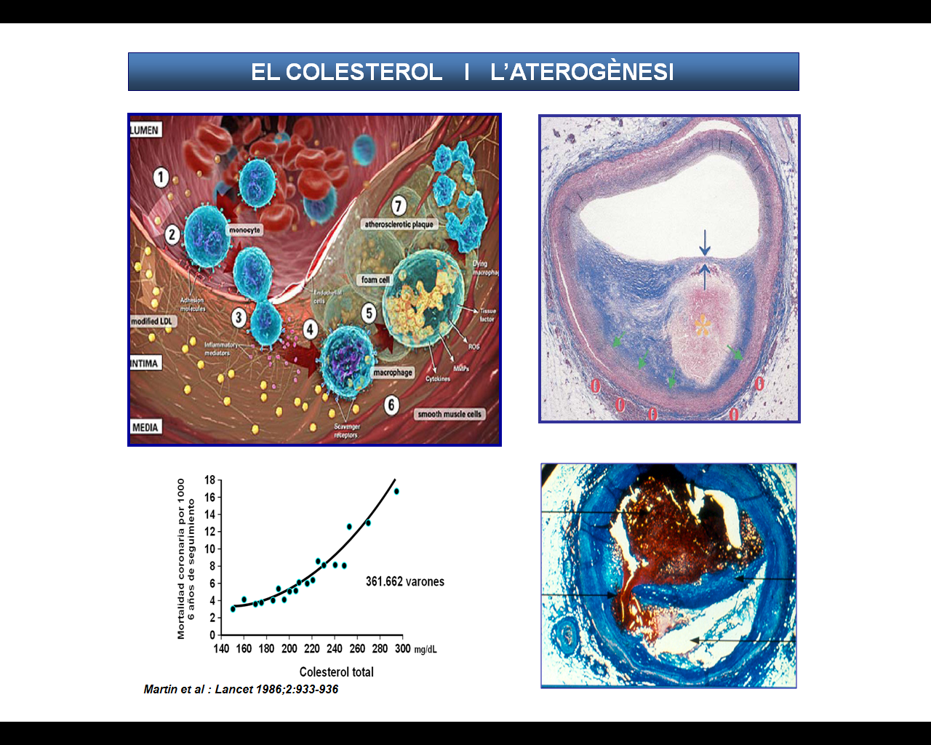
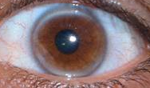
Recomendaciones para el uso de iPCSK9
Documento de posicionamiento de la SEA
Guías ESC/EAS
Actualizaciones NLA y AACE

Slide 4
American Association of Clinical Endocrinologists and American College of Endocrinology Guidelines for Management of Dyslipidemia and Prevention of Cardiovascular Disease
Jellinger PS, et al. Endocr Pract. 2017;23(Suppl.2):1-87
Garber Aj et al. Endocr Pract. 2018 Jan;24(1):91-120

Slide 5
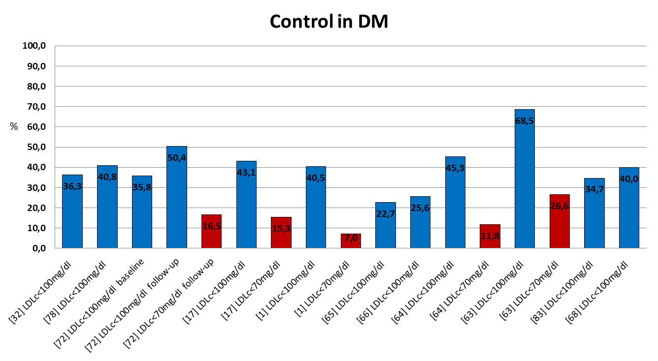
Control de la hipercolesterolemia en pacientes de alto riesgo cardiovascular en España
LDL > 70 85%
LDL > 100 65%
de la Sierra A et al. Adv Ther 2015;32:944-61
Notes:
Introduction: Cardiovascular diseases (CVDs) represent a major Public Health burden. High serum cholesterol levels have been linked to major CV risk. The objectives of this study were to review the epidemiology of hypercholesterolemia in high risk CV patients from Spain, by assessing its prevalence, the proportion of diagnosed patients undergoing pharmacological treatment and the degree of attained lipid control. Methods: A systematic literature review was carried out using Medline and two Spanish databases. Manuscripts containing information on hypercholesterolemia in several high CV risk groups [diabetes mellitus (DM), Systematic COronary Risk Evaluation (SCORE) risk[5, or documented CVD], published between January 2010 and October 2014, were included. Results: Of the 1947 published references initially retrieved, a full-text review was done on 264 manuscripts and 120 were finally included. Prevalence of hypercholesterolemia ranged from 50 to 84% in diabetics, 30–60% in patients with DM or elevated SCORE risk, 64–74% with coronary heart disease, 40–70% in stroke patients, and 60–80% in those with peripheral artery disease. Despite the finding that most of them were on pharmacological treatment, acceptable control of serum lipids was very variable, ranging from 15% to 65%. Among those with heterozygous familial hypercholesterolemia, 95–100% received treatment but less than 50% achieved their therapeutic goals.
Conclusions: An elevated prevalence of hypercholesterolemia can be found in targeted groups at high CV risk. Although most patients are receiving pharmacological treatment, rates of lipid control continue to be low, both in primary and secondary prevention.

Slide 6
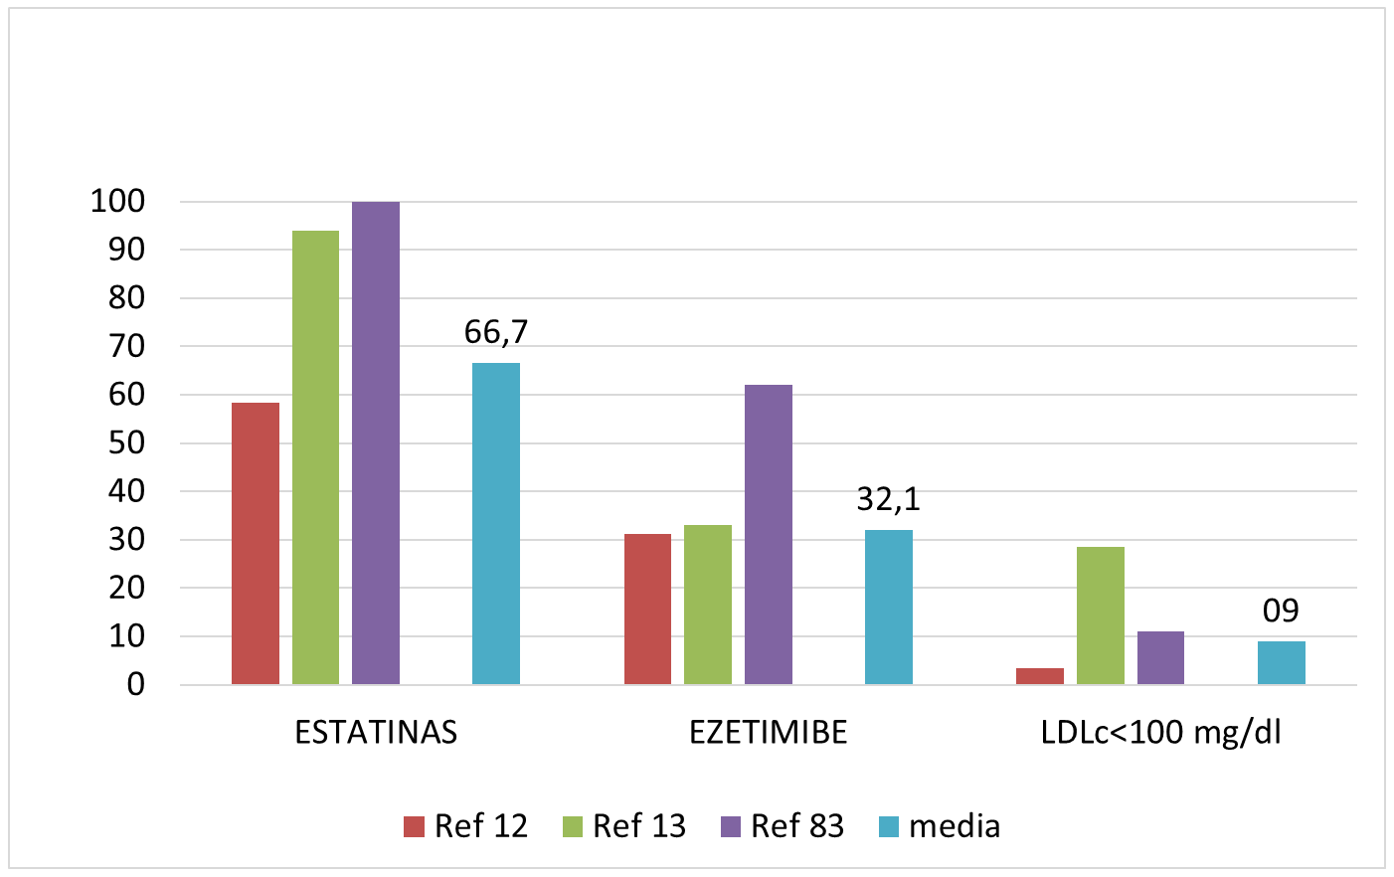
Tratamiento y control de la hipercolesterolemia en los pacientes con hipercolesterolemia familiar en España
de la Sierra A et al. Adv Ther 2015;32:944-61

Slide 7
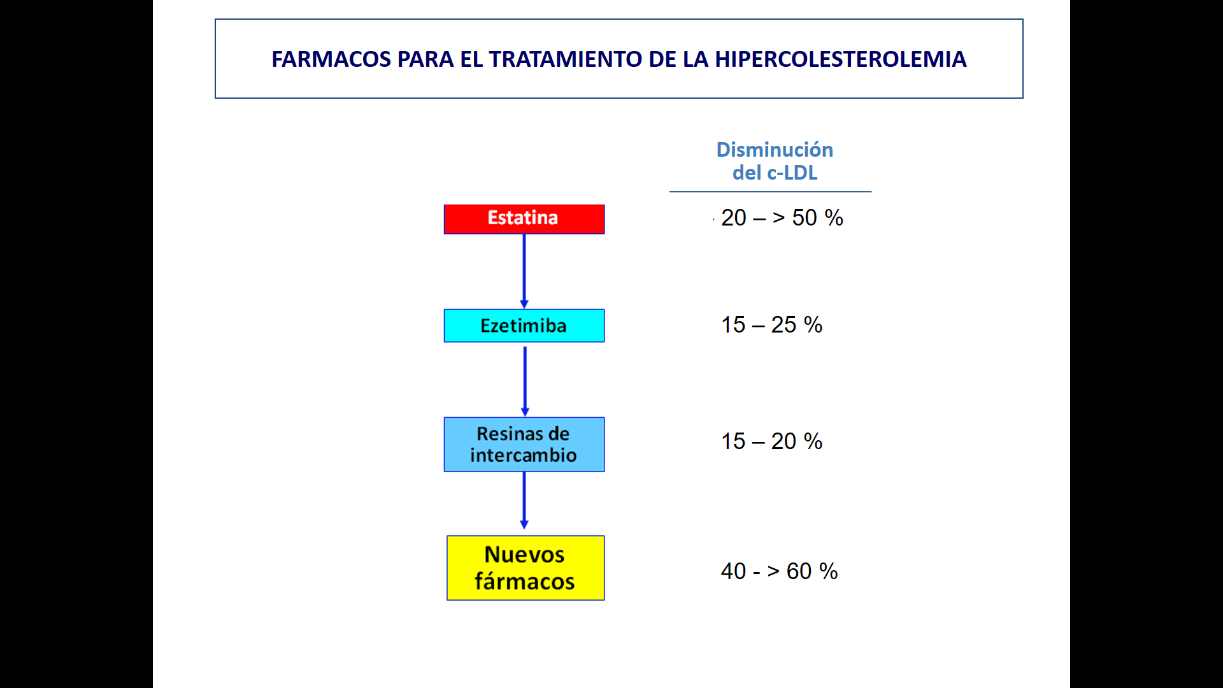
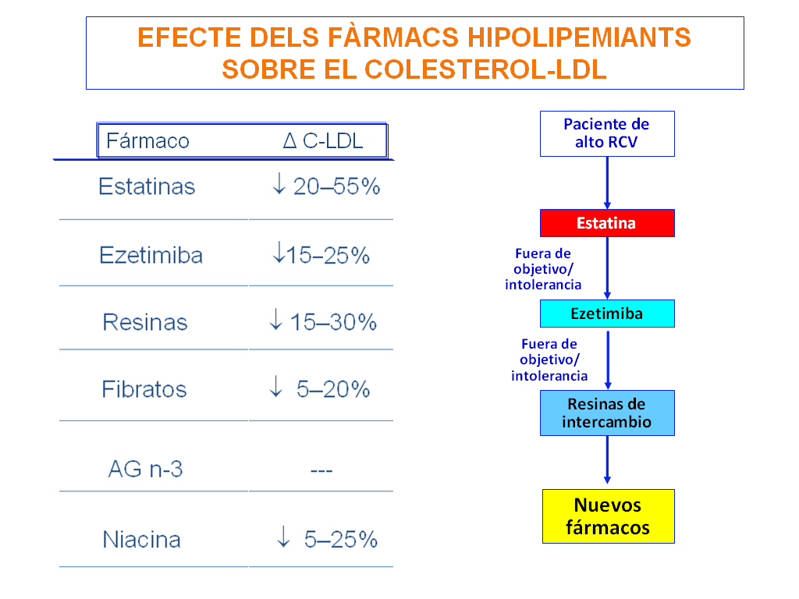
FARMACOS PARA EL TRATAMIENTO DE LA HIPERCOLESTEROLEMIA
Disminución del c-LDL
Monoterapia
Asociación
.
- 20 – 50 %
Fuera de objetivo/ intolerancia
Ezetimiba
Fuera de objetivo/ intolerancia
- 15 – 25 %
60 %
Resinas de intercambio
Anti-
PCSK9
Nuevos fármacos
- 45 – 65 %
> 80 %
Notes:
En la tabla se muestran los principales efectos de los fármacos hipolipemiantes sobre los parámetros lipídicos. Las estatinas son los fármacos más potentes para disminuir el colesterol total y el c-LDL, ya que disminuyen el c-LDL más allá del 50
7

Slide 8
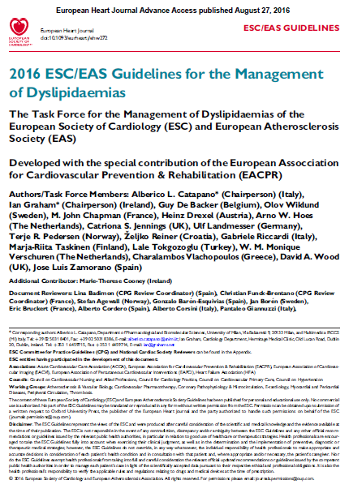

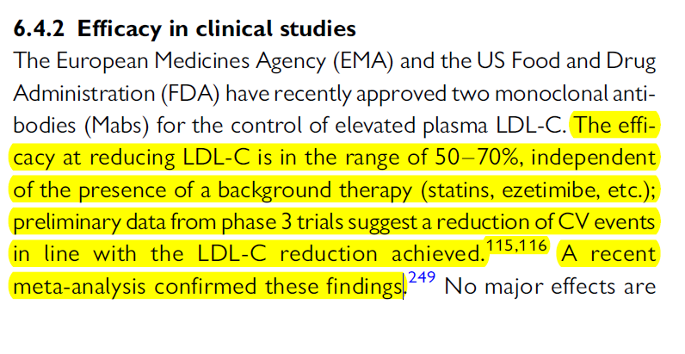
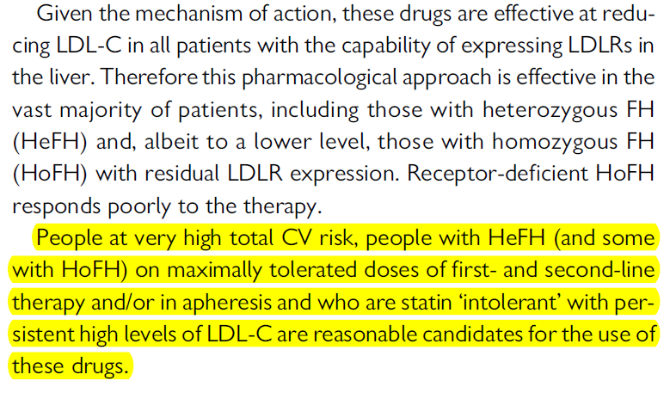
ESC Guidelines – Agosto 2016

Slide 9
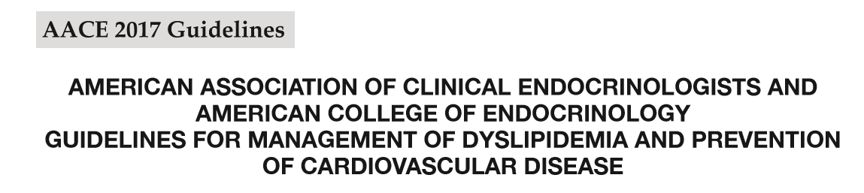
PCSK9 inhibitors should be considered for use in combination with statin therapy for LDL-C lowering in individuals with FH (Grade A; BEL 1).
PCSK9 inhibitors should be considered in individuals with clinical cardiovascular disease who are unable to reach LDL-C/non-HDL-C goals with maximally tolerated statin therapy. They should not be used as monotherapy except in statin-intolerant individuals (Grade A; BEL 1).
Jellinger PS et al. ENDOCRINE PRACTICE Vol 23 (Suppl 2) April 2017

Slide 10
- DOCUMENTO DE CONSENSO DE LA SOCIEDAD ESPAÑOLA DE ARTERIOSCLEROSIS -
INDICACIONES DE LOS INHIBIDORES DE LA PCSK9
C-LDL en tratamiento*
Hipercolesterolemia familiar heterocigótica
Bajo riesgo Edad < 40 a; Sin FRCV ni > 160 mg/dL
ECV isquémica familiar;
Lp(a) < 50 mg/dL
Con ECV ateromatosa > 100 mg/dL
No de bajo riesgo ni ECV > 130 mg/dL
Masana L et al. Clin Invest Arterioscler 2016

Slide 11
- DOCUMENTO DE CONSENSO DE LA SOCIEDAD ESPAÑOLA DE ARTERIOSCLEROSIS -
INDICACIONES DE LOS INHIBIDORES DE LA PCSK9
C-LDL en tratamiento*
Hipercolesterolemia familiar heterocigótica
Bajo riesgo Edad < 40 a; Sin FRCV ni > 160 mg/dL
ECV isquémica familiar;
Lp(a) < 50 mg/dL
Con ECV ateromatosa > 100 mg/dL
No de bajo riesgo ni ECV > 130 mg/dL
Enfermedad cardiovascular ateromatosa
C-LDL en tratamiento*
Estable > 130 mg/dL
Con otras condiciones Clínicamente inestable; > 100 mg/dL
de mayor riesgo Progresiva o recidivante;
Síndrome coronario agudo;
Diabetes; Lp(a) > 100 mg/dL
Masana L et al. Clin Invest Arterioscler 2016

Slide 12
- DOCUMENTO DE CONSENSO DE LA SOCIEDAD ESPAÑOLA DE ARTERIOSCLEROSIS -
INDICACIONES DE LOS INHIBIDORES DE LA PCSK9
C-LDL en tratamiento*
Hipercolesterolemia familiar heterocigótica
Bajo riesgo Edad < 40 a; Sin FRCV ni > 160 mg/dL
ECV isquémica familiar;
Lp(a) < 50 mg/dL
Con ECV ateromatosa > 100 mg/dL
No de bajo riesgo ni ECV > 130 mg/dL
Enfermedad cardiovascular ateromatosa
C-LDL en tratamiento*
Estable > 130 mg/dL
Con otras condiciones Clínicamente inestable; > 100 mg/dL
de mayor riesgo Progresiva o recidivante;
Síndrome coronario agudo;
Diabetes; Lp(a) > 100 mg/dL
C-LDL en tratamiento*
No incluidas en indicaciones oficiales
Diabetes + 2 FRCV; Albuminuria o FG < 45 mL/min/1,73m2 > 100 mg/dL
Intolerancia a estatinas + Prevención primaria > 190 mg/dL
Masana L et al. Clin Invest Arterioscler 2016

Slide 13
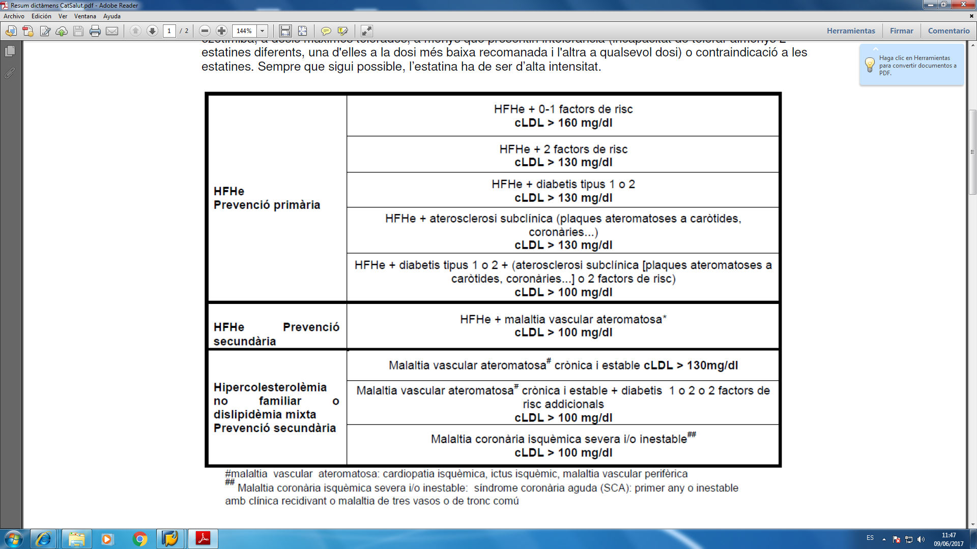
CRITERIOS DEL CATSALUT: INDICACIONES DE TRATAMIENTO DE LA HIPERCOLESTEROLEMIA EN EL PACIENTE DE ALTO RIESGO NO CONTROLADO CON LOS FÁRMACOS HABITUALES

Slide 14
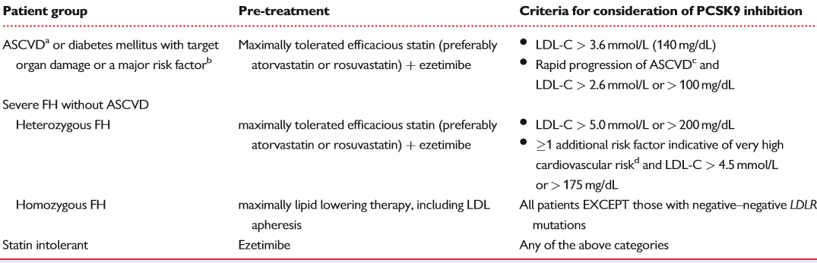
European Society of Cardiology/European Atherosclerosis Society Task Force consensus statement
Very high risk patient groups for whom proprotein convertase subtilisin/kexin type 9 inhibitors may be considered
GRACIAS
Landmesser U et al. European Heart Journal 2016
Notes:
The suggested thresholds for patients with rapid progression of ASCVD and FH are based on the consensus of this Joint ESC/EAS Task Force and represent a compromise between selection of patients at highest risk who are most likely to beneﬁt from PCSK9 inhibition and justiﬁcation of the cost of treatment given the ﬁnancial restraints within healthcare budgets. ASCVD, atherosclerotic cardiovascular disease; FH, familial hypercholesterolaemia. aConsistent with guidelines,4 documented clinical ASCVD includes previous acute myocardial infarction, acute coronary syndrome (ACS), coronary revascularization and other arterial revascularization procedures, stroke and transient ischaemic attack, aortic aneurysm, and peripheral arterial disease. Unequivocally documented ASCVD on imaging includes plaque on coronary angiography or carotid ultrasound. It does not include some increase in continuous imaging parameters such as intima–media thickness of the carotid artery. bConsistent with guidelines,4 diabetes mellitus with target organ damage such as proteinuria, or with a major risk factor such as smoking, marked hypercholesterolaemia, or marked hypertension. cRapid progression of ASCVD deﬁned as repeated ACSs, repeated unplanned coronary revascularizations, or repeated ischaemic strokes within 5 years of the index event. The Task Force recognizes that ASCVD patients with additional factors indicating a particularly high absolute cardiovascular risk (i.e. anticipated absolute risk reduction of>2%/ year), and with LDL-C levels between 2.6 and 3.4mmol/L (100 and 140mg/dL) may be considered for PCSK9 inhibition on an individual basis according to the attending clinician’s judgement of the absolute risk of the patient. This means that in this LDL-C range at present only patients with a 5-year risk of major adverse cardiovascular events >20% would be recommended to be considered for PCSK9 inhibition, so that the anticipated absolute risk reduction can reach >2%/year (based on the relation between absolute LDL-C reduction and prevented major adverse cardiac events in the Cholesterol Treatment Trialists’ Collaboration analysis). Here, both the absence of data from randomized clinical outcome trials at present and considerations for cost-effectiveness had to be taken into account. dRisk factors indicating a very high cardiovascular risk include diabetes mellitus, lipoprotein(a) > 50mg/dL, marked hypertension, premature familial ASCVD (<55 years in males and <60 years in females), as deﬁned by the Sixth Joint Task Force (2016),4 and the European Atherosclerosis Society Consensus Panel on FH.29,30
6 U. Landmesser et al. by guest on October 29, 2016http://eurheartj.oxfordjournals.

Slide 15
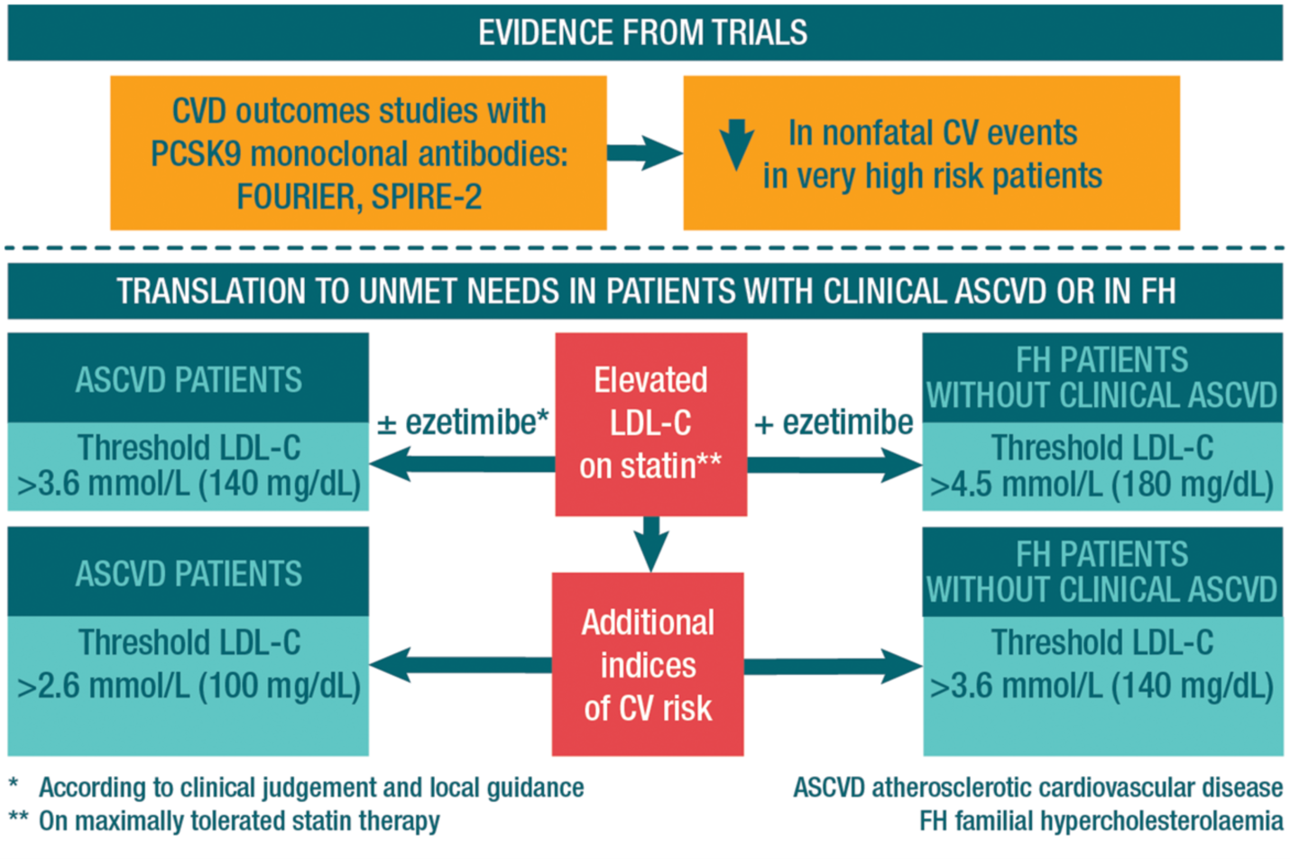
2017 Update of ESC/EAS Task Force: Practical clinical guidance for PCSK9 inhibition in patients with atherosclerotic CVD or in familial hypercholesterolaemia
Eur Heart J. Published online October 16, 2017. doi:10.1093/eurheartj/ehx549
Notes:
Summary Figure. Results of the first cardiovascular outcomes studies with PCSK9 monoclonal antibody therapy (FOURIER with evolocumab and SPIRE-2 with bococizumab) showed that lowering low-density lipoprotein cholesterol (LDL-C), on average by 60%, reduced non-fatal cardiovascular events in very high risk patients on statin therapy (with or without ezetimibe). Translation of these data to the management of very high risk patients with substantially elevated LDL-C levels was based on consideration of absolute cardiovascular risk and the absolute LDL-C reduction required, key determinants of absolute cardiovascular risk reduction, as well as the magnitude of LDL-C reduction to be expected with PCSK9 inhibition. On this basis, the Task Force has identified LDL-C levels (thresholds) for consideration of a PCSK9 inhibitor in very high risk patients not adequately controlled on statin plus ezetimibe, specifically those with clinical atherosclerotic cardiovascular disease (ASCVD), as well as in patients with familial hypercholesterolaemia (FH) without clinical events. Patients with indices of risk severity are at higher risk and therefore the recommended LDL-C thresholds are lower. CVD, cardiovascular disease; FOURIER, Further Cardiovascular Outcomes Research With PCSK9 Inhibition in Subjects With Elevated Risk; SPIRE-2, Evaluation of Bococizumab in Reducing the Occurrence of Major Cardiovascular Events in High Risk Subjects-2.
15

Slide 16
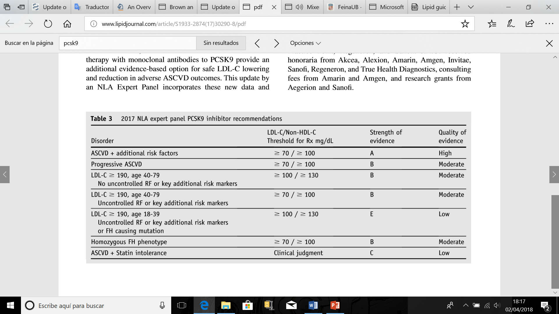
2017 NLA expert panel PCSK9 inhibitor recommendation
Orringer CE et al. Journal of Clinical Lipidology (2017) 11, 880–890

Slide 17
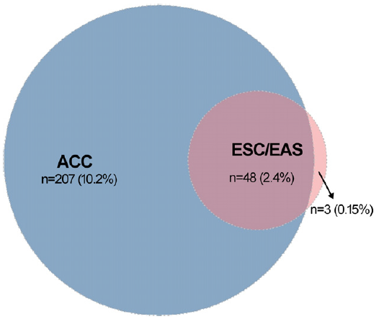
Number of ACS patients eligible for PCSK9 inhibitors according to the ACC and EAS/ESCconsensus documents
The proportions below the absolute numbers pertain to the entire cohort (n=2023). ACC indicates
American College of Cardiology; ACS, acute coronary syndromes; EAS, European Atherosclerosis Society; ESC, European Society of Cardiology;
Genzer B et al. J Am Heart Assoc. 2017;6:e006537. DOI: 10.1161/JAHA.117.006537
Notes:
Background-—The American College of Cardiology (ACC) and European Society of Cardiology/European Atherosclerosis Society (ESC/EAS) have recently published recommendations for the use of proprotein convertase subtilisin/kexin-9 (PCSK9) inhibitors in situations of very high risk. We aim to assess in the real world the suitability of PCSK9 inhibitors for acute coronary syndromes.
Methods and Results-—We analyzed a prospective Swiss cohort of 2023 patients hospitalized for acute coronary syndromes between 2009 and 2014 with available data for low-density lipoprotein cholesterol and lipid-lowering therapy at 1 year. Clinical
familial hypercholesterolemia was defined using the Dutch Lipid Clinic Network algorithm as unlikely, possible, probable, or definite. We simulated a fixed relative reduction of 24% in low-density lipoprotein cholesterol levels at 1 year in all patients not
treated with ezetimibe, irrespective of the low-density lipoprotein cholesterol levels and statin regimen. At 1 year, 94.3% of patients were treated with statin, 5.8% with ezetimibe, and 35.8% of patients had on-target low-density lipoprotein cholesterol
levels (<1.8 mmol/L); 25.6% met criteria for possible or probable/definite familial hypercholesterolemia. After a simulation of the lipid-lowering effect of ezetimibe, the proportion of patients who would be eligible for PCSK9 inhibitors at 1 year was 13.4% using American College of Cardiology criteria and 2.7% using European Society of Cardiology/European Atherosclerosis Society criteria.
Patients with possible or probable/definite familial hypercholesterolemia were more eligible for PCSK9 inhibitors compared with their non–familial hypercholesterolemia counterparts: 27.6% versus 8.8% according to American College of Cardiology criteria and 6.6% versus 1.8% according to European Society of Cardiology/European Atherosclerosis Society criteria (P<0.001).
Conclusions-—Recommendations made by the American College of Cardiology guidelines would lead to 5-fold higher eligibility rates for PCSK9 inhibitors compared to the European Society of Cardiology/European Atherosclerosis Society consensus
statement in acute coronary syndrome patients. ( J Am Heart Assoc. 2017;6:e006537. DOI: 10.1161/JAHA.117.006537.)

Slide 18
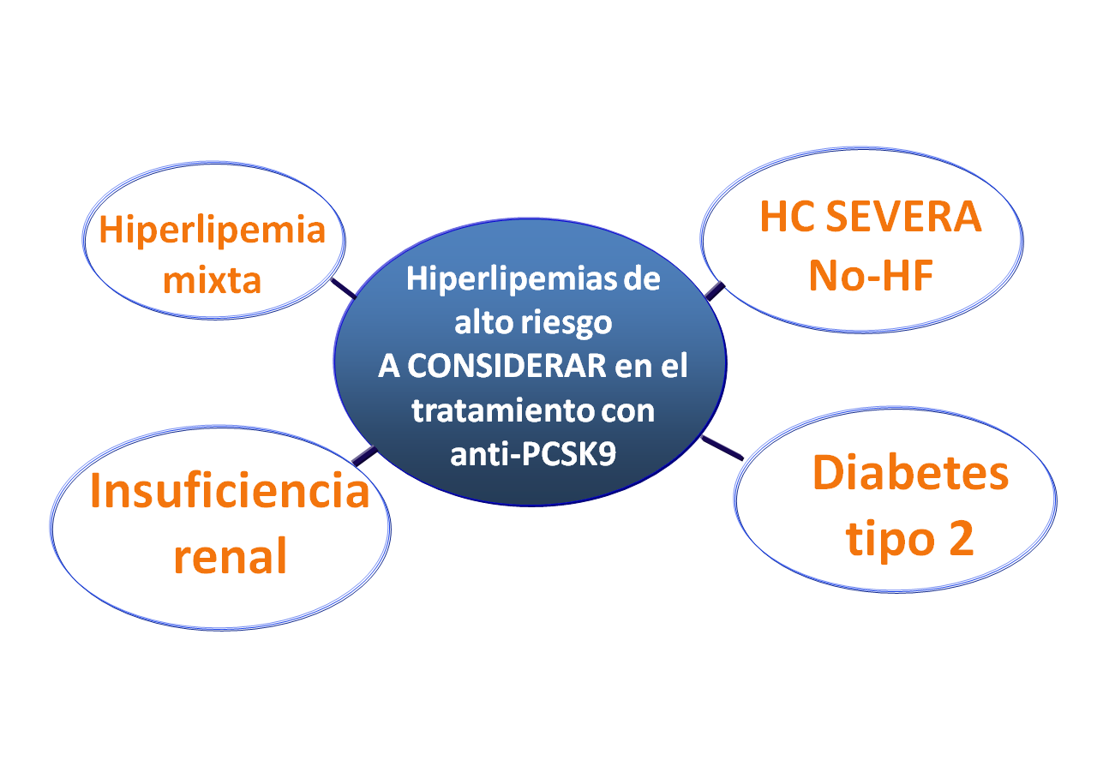
HC SEVERA No-HF
Hiperlipemia mixta
Hiperlipemias de
alto riesgo
A CONSIDERAR en el tratamiento con anti-PCSK9
Diabetes tipo 2
Insuficiencia
renal

