Slide 1
Efectos lipídicos y disminución de episodios isquémicos con Alirocumab.
¿Son diferentes los pacientes diabéticos en cuanto a su respuesta hipolipemiante y a los efectos en prevención secundaria? ¿Existen otros subgrupos a considerar?
Dr. Antonio Pérez
Servicio Endocrinología
Hospital Sant Pau. Barcelona
aperez@santpau.cat

Slide 2
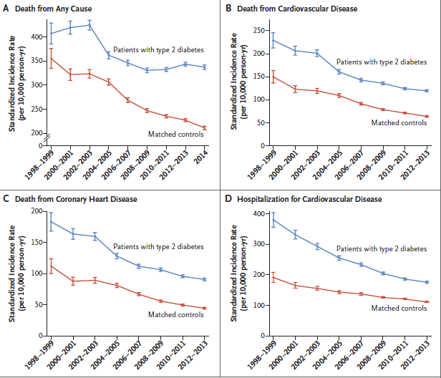
El escenario
T2DM and CV Events Over Time
Swedish National Diabetes Register from 1998 through 2012 and followed through 2014
Mejora, pero insuficiente
Rawshani A, et al. N Engl J Med. 2017;376:1407-1418.
N Engl J Med 2017; 376:1407-1418
Notes:
BACKGROUND:
Long-term trends in excess risk of death and cardiovascular outcomes have not been extensively studied in persons with type 1 diabetes or type 2 diabetes.
METHODS:
We included patients registered in the Swedish National Diabetes Register from 1998 through 2012 and followed them through 2014. Trends in deaths and cardiovascular events were estimated with Cox regression and standardized incidence rates. For each patient, controls who were matched for age, sex, and county were randomly selected from the general population.
RESULTS:
Among patients with type 1 diabetes, absolute changes during the study period in the incidence rates of sentinel outcomes per 10,000 person-years were as follows: death from any cause, -31.4 (95% confidence interval [CI], -56.1 to -6.7); death from cardiovascular disease, -26.0 (95% CI, -42.6 to -9.4); death from coronary heart disease, -21.7 (95% CI, -37.1 to -6.4); and hospitalization for cardiovascular disease, -45.7 (95% CI, -71.4 to -20.1). Absolute changes per 10,000 person-years among patients with type 2 diabetes were as follows: death from any cause, -69.6 (95% CI, -95.9 to -43.2); death from cardiovascular disease, -110.0 (95% CI, -128.9 to -91.1); death from coronary heart disease, -91.9 (95% CI, -108.9 to -75.0); and hospitalization for cardiovascular disease, -203.6 (95% CI, -230.9 to -176.3). Patients with type 1 diabetes had roughly 40% greater reduction in cardiovascular outcomes than controls, and patients with type 2 diabetes had roughly 20% greater reduction than controls. Reductions in fatal outcomes were similar in patients with type 1 diabetes and controls, whereas patients with type 2 diabetes had smaller reductions in fatal outcomes than controls.
CONCLUSIONS:
In Sweden from 1998 through 2014, mortality and the incidence of cardiovascular outcomes declined substantially among persons with diabetes, although fatal outcomes declined less among those with type 2 diabetes than among controls. (Funded by the Swedish Association of Local Authorities and Regions and others.).

Slide 3
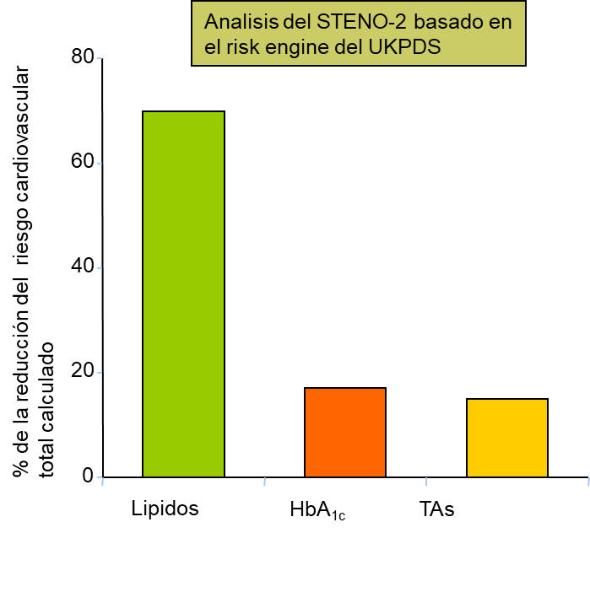
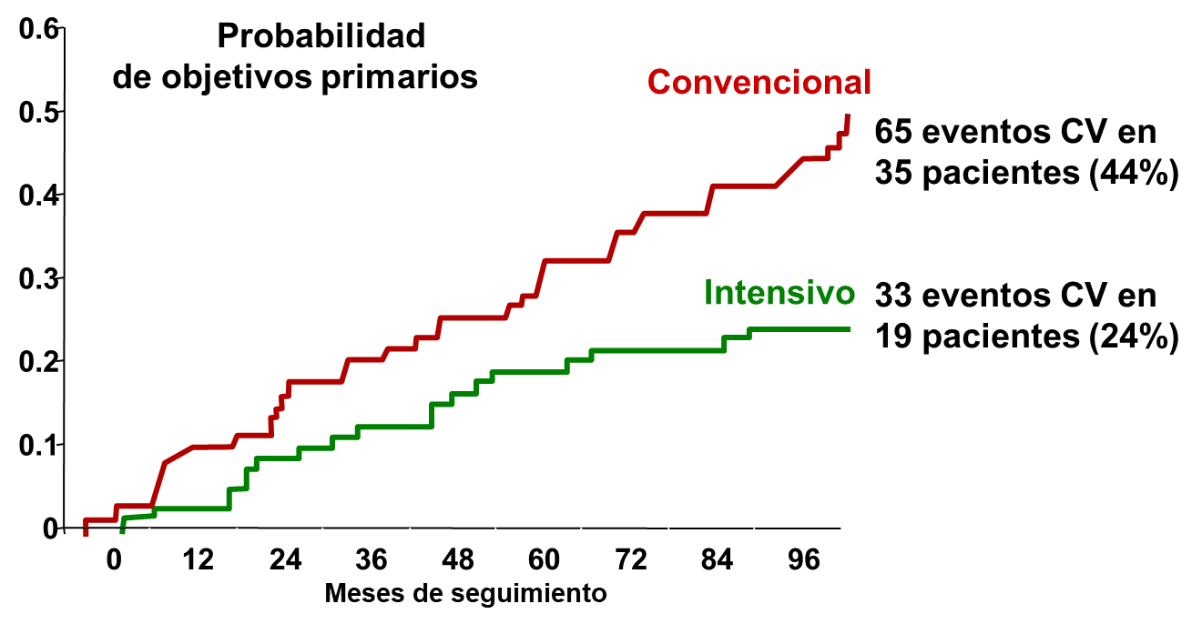
Steno 2:
Objetivos CV después de 8 años de intervención
Gaede P, Pederson O. Diabetes.2004;53:S39−S47.

Slide 4
Las estatinas reducen eventos CV,
pero Riesgo Residual > Riesgo Total de no DM
CTT Meta-Analysis of 14 Statin Trialsª
40
Riesgo CV mayor que en
pacientes sin DM con Placebo
Control
34,9
Tratamiento^{c}
29,6
30
24,8
Tasa Eventos CV
Mayores^{b}, %
19,4
20
Riesgo Residual
Riesgo Residual
10
0
Diabetes
No Diabetes
^{A} Seguimiento medio de 4.3 años de 18 686 pacientes con DM, n = 71 370 pacientes sin DM
^{bI} IM no fatal, muerte coronaria o revascularización coronaria
^{C} Tasa de eventos por reducción de 1 mmol/L (39 mg/dL) de C-LDL
CTT Collaborators. Lancet. 2008;371:117-125.

Slide 5
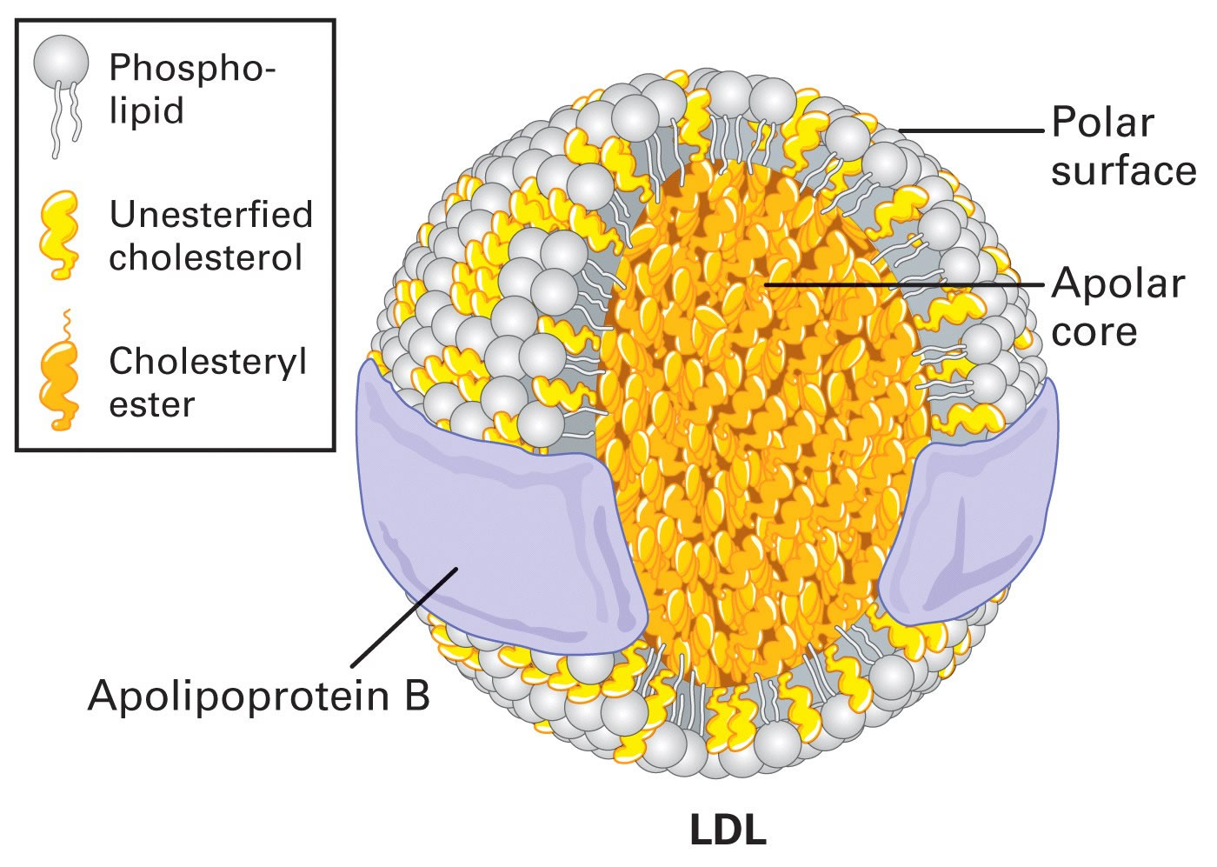
Dislipemia diabética
C-LDL “normal”
Triada Aterogénica
Aumento número de
partículas aterógenas
LDL modificadas
HDL modificadas
Aumento de TG
Reducción de c-HDL
LDL pequeñas-densas
HiperTG-HiperApo B
Triglyceride

Slide 6
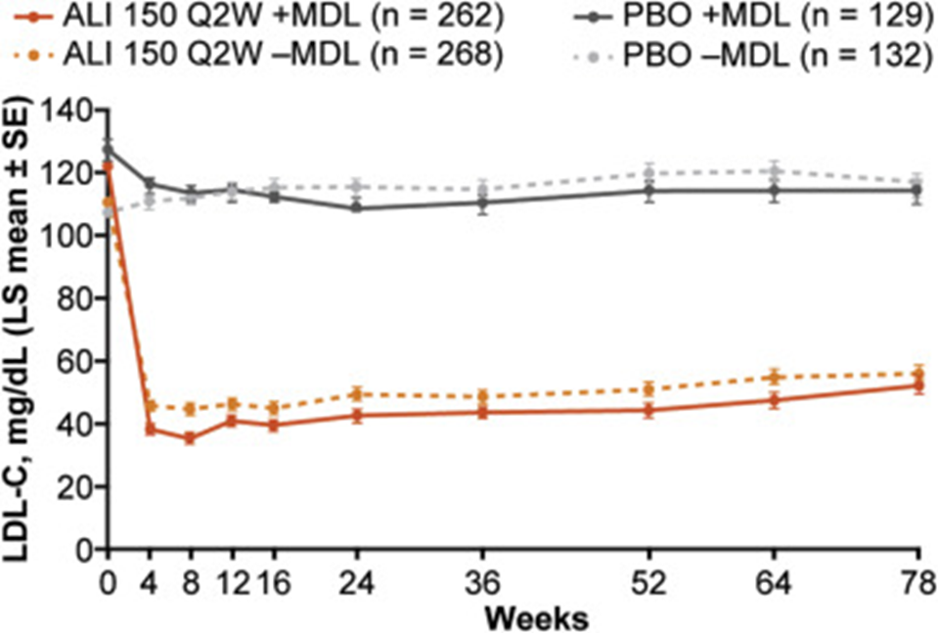
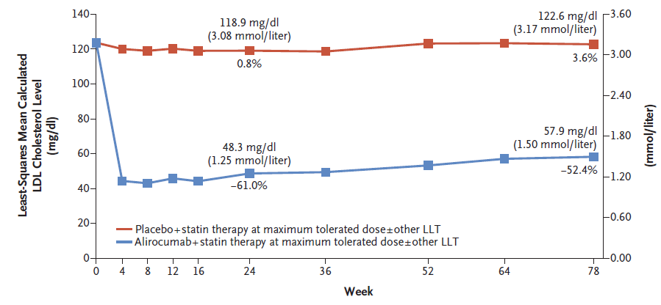
Eficacia Alirocumab: cLDL
ODYSSEY LONG TERM Study
All patients
(N=2341)
Patients with Diabetes
(n= 812)
J. Robinson et al., N Engl J Med 2015;372(16):1489-1499
Taskinen MR, Atherosclerosis. 2018 Sep;276:124-130.

Slide 7
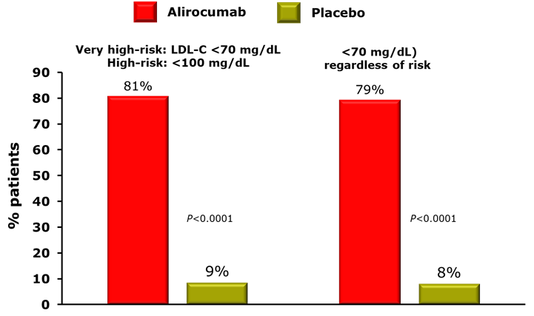
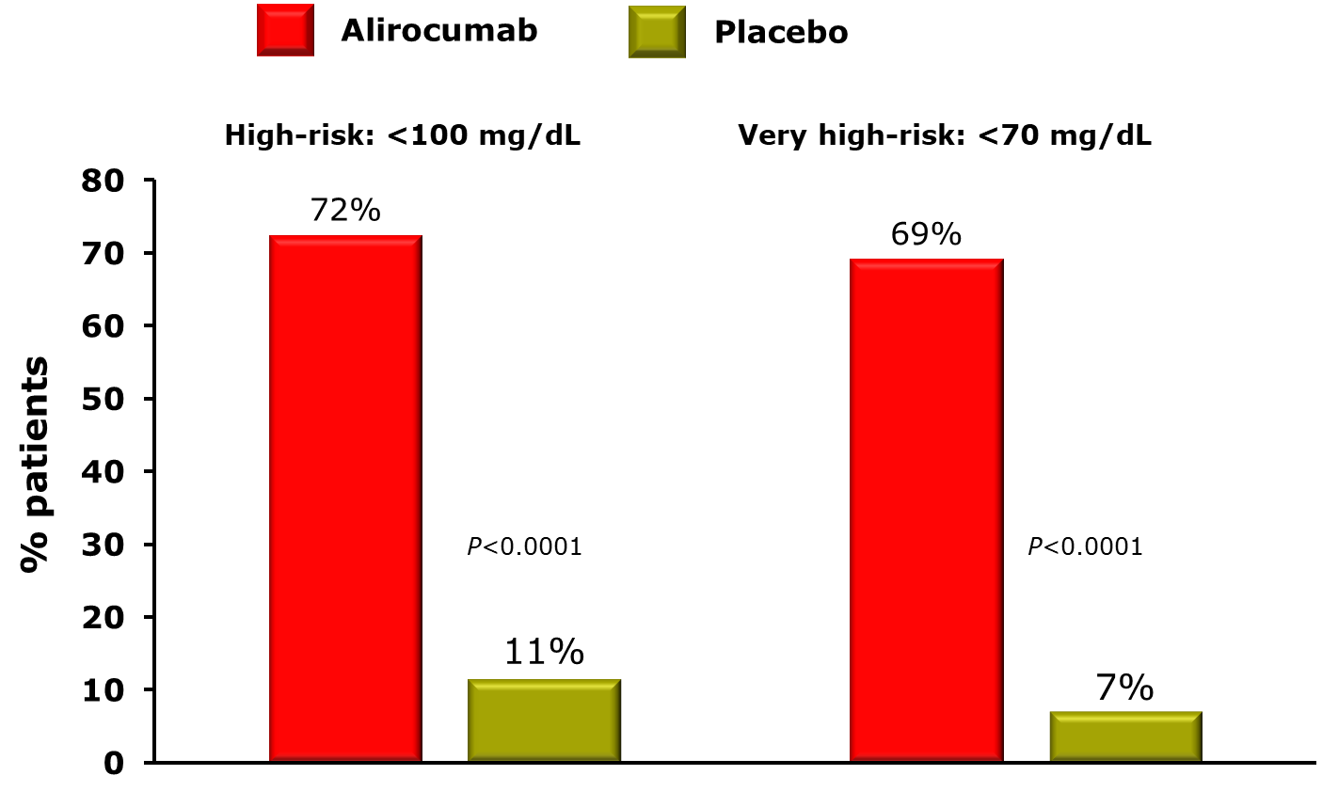
Eficacia Alirocumab: Objetivos cLDL
ODYSSEY LONG TERM Study
All patients
(N=2341)
Patients with Diabetes
(n= 812)
J. Robinson et al., N Engl J Med 2015;372(16):1489-1499
Taskinen MR, Atherosclerosis. 2018 Sep;276:124-130.

Slide 8
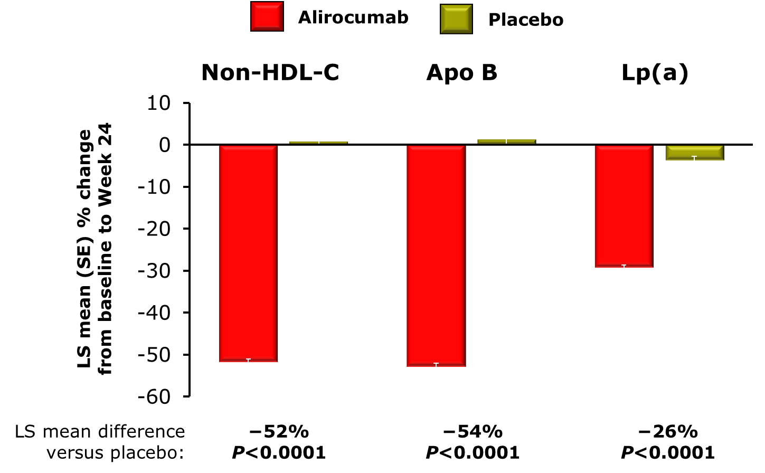
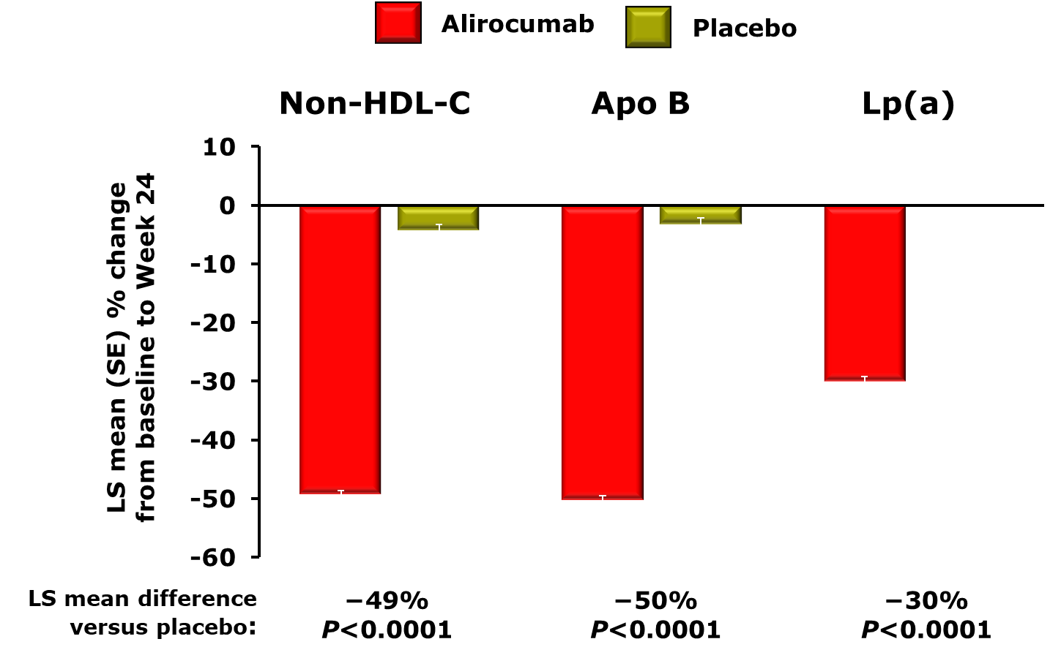
Eficacia Alirocumab: Otros parámetros lipídicos
ODYSSEY LONG TERM Study
All patients
(N=2341)
Patients with Diabetes
(n= 812)
J. Robinson et al., N Engl J Med 2015;372(16):1489-1499
Taskinen MR, Atherosclerosis. 2018 ;276:124-130.

Slide 9
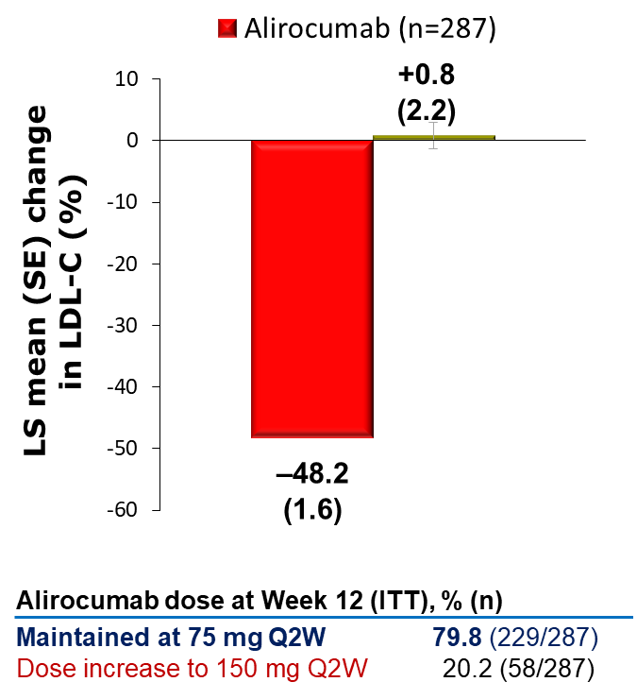
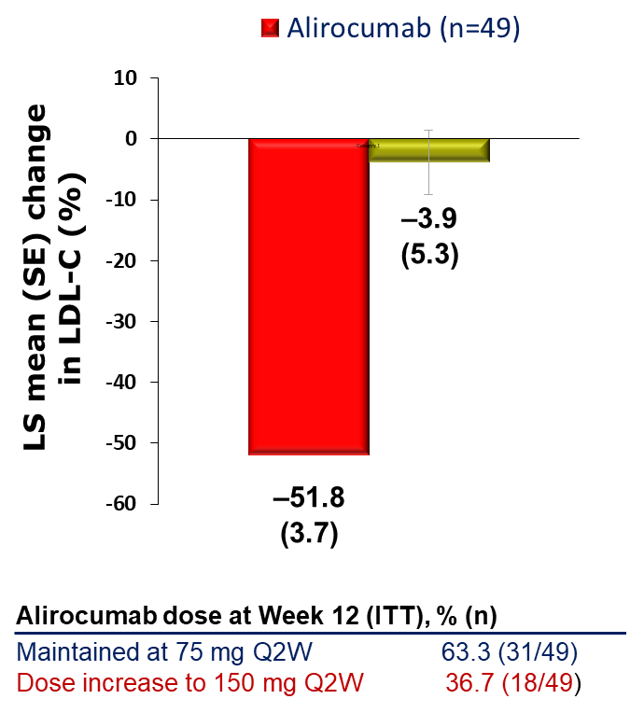
ODYSSEY DM-INSULIN:
Reducción c-LDL semana 24
DM2
DM1
Leiter LA. Diabetes Obes Metab. 2017;19:1781–1792.

Slide 10
ODYSSEY DM-INSULIN:
Objetivos cLDL semana 24
Participants (%)
T2DM
LDL-C <70 mg/dL
T1DM
76.4
70.2
P<0.0001
P<0.0001
7.4
5.1
T2DM
T1DM
Alirocumab (n=284)
Alirocumab (n=49)
Placebo (n=140)
Placebo (n=24)
Participants (%)
T2DM
Non-HDL-C <100 mg/dL
T1DM
79.0
70.9
P<0.0001
P<0.0001
22.9
13.8
Leiter LA. Diabetes Obes Metab. 2017;19:1781–1792.

Slide 11
ODYSSEY DM-DYSLIPIDEMIA:
Cambio en c-noHDL
‡
LS mean (SE) change
in non-HDL-C (%)
LS mean (SE) change
in non-HDL-C (%)
–4.7
–8.5
–37.3
P<0.0001
P<0.0001
–41.7
Alirocumab dose at Week 12, % (n)
Maintained at 75 mg Q2W
Dose increase to 150 mg Q2W
63.6 (164/258)
36.4 (94/258)
Alirocumab dose at Week 12, % (n)
Maintained at 75 mg Q2W
Dose increase to 150 mg Q2W
63.6 (28/44)
36.4 (16/44)
Müller-Wieland D et al. Cardiovasc Diabetol. 2017;16:70.

Slide 12
ODYSSEY DM-DYSLIPIDEMIA:
Cambio en otros parámetros lipídicos
LS mean (SE) change from
baseline to Week 24 (%)
Measured
LDL-C
LDL-P
number
Apo B
TC
Lp(a)
TGs
HDL-C
14.5
8.2
3.7
–0.3
–1.6
–2.8
–3.9
–13.0
–8.8
–23.7
–27.4
–33.8
–43.3
–41.6
LS mean difference
vs usual care
–43.0%
P<0.0001
–32.3%
P<0.0001
–24.6%
P<0.0001
–27.4%
P<0.0001
–4.2%
P=0.2191
6.2%
P=0.0026‡
–37.8%
P<0.0001‡
Müller-Wieland D et al. Cardiovasc Diabetol. 2017;16:70.

Slide 13
ODYSSEY DM-DYSLIPIDEMIA:
Cambio en otros parámetros lipídicos vs fenofibrato
LS mean (SE) change from
baseline to Week 24 (%)
‡
Measured
LDL-C
LDL-P
number
Apo B
TC
Lp(a)
TGs
HDL-C
8.7
13.5
12.3
3.9
–3.8
–5.7
–2.9
–18.9
–15.4
–30.9
–24.4
–38.9
–47.0
–45.4
LS mean difference
vs fenofibrate
–55.7%
P<0.0001
–35.2%
P<0.0001
–25.3%
P<0.0001
–22.8%
P=0.004
9.0%
P=0.2651
1.1%
P=0.8183§
–42.4%
P<0.0001§
Müller-Wieland D et al. Cardiovasc Diabetol. 2017;16:70.

Slide 14
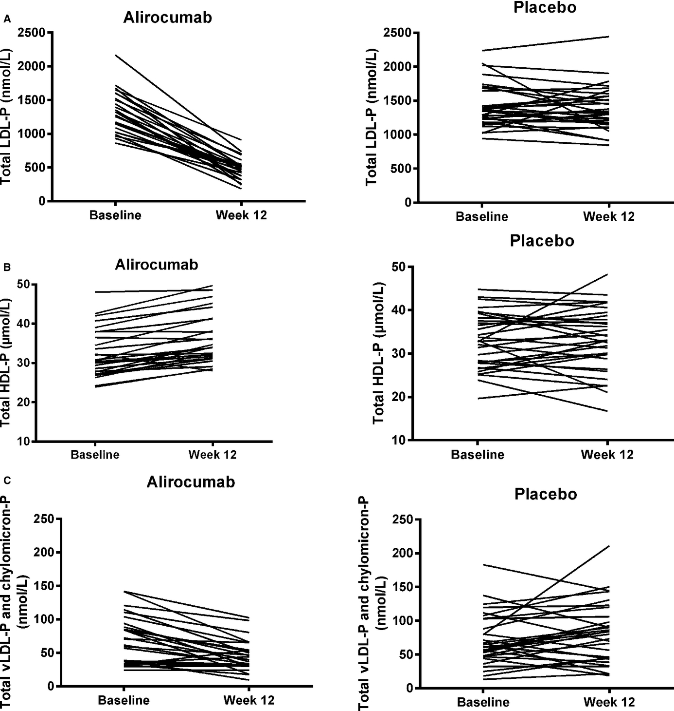
Concentration partículas lipoproteicas por RNM
Efecto Alirocumab
−63.3%
+11.2%
−36.4%
Koren MJ. J Am Heart Assoc. 2015;4(11) pii: e002224
Notes:
Effect of PCSK9 Inhibition by Alirocumab on Lipoprotein Particle Concentrations Determined by Nuclear Magnetic Resonance Spectroscopy
Michael J. Koren , Dean Kereiakes , Ray Pourfarzib , Deborah Winegar , Poulabi Banerjee , Sara Hamon , Corinne Hanotin , and James M. McKenney
Originally published19 Nov 2015Journal of the American Heart Association. 2015;4:e002224
Abstract
Background
In patients with discordance between low‐density lipoprotein (LDL) cholesterol and LDL particle (LDL‐P) concentrations, cardiovascular risk more closely correlates with LDL−P.
Methods and Results
We investigated the effect of alirocumab, a fully human monoclonal antibody to proprotein convertase subtilisin/kexin type 9, on lipoprotein particle concentration and size in hypercholesterolemic patients, using nuclear magnetic resonance spectroscopy. Plasma samples were collected from patients receiving alirocumab 150 mg every 2 weeks (n=26) or placebo (n=31) during a phase II, double‐blind, placebo‐controlled trial in patients (LDL cholesterol ≥100 mg/dL) on a stable atorvastatin dose. In this post hoc analysis, percentage change in concentrations of LDL−P, very‐low‐density lipoprotein particles, and high‐density lipoprotein particles from baseline to week 12 was determined by nuclear magnetic resonance. Alirocumab significantly reduced mean concentrations of total LDL‐P (−63.3% versus −1.0% with placebo) and large (−71.3% versus −21.8%) and small (−54.0% versus +17.8%) LDL‐P subfractions and total very‐low‐density lipoprotein particle concentrations (−36.4% versus +33.4%; all P<0.01). Total high‐density lipoprotein particles increased with alirocumab (+11.2% versus +1.4% with placebo; P<0.01). There were greater increases in large (44.6%) versus medium (17.7%) or small high‐density lipoprotein particles (2.8%) with alirocumab. LDL‐P size remained relatively unchanged in both groups; however, very‐low‐density and high‐density lipoprotein particle sizes increased to a significantly greater extent with alirocumab.
Conclusions
Alirocumab significantly reduced LDL‐C and LDL‐P concentrations in hypercholesterolemic patients receiving stable atorvastatin therapy. These findings may be of particular relevance to patients with discordant LDL‐C and LDL‐P concentrations.
Koren MJ, Kereiakes D, Pourfarzib R, Winegar D, Banerjee P, Hamon S, Hanotin
C, McKenney JM. Effect of PCSK9 Inhibition by Alirocumab on Lipoprotein Particle
Concentrations Determined by Nuclear Magnetic Resonance Spectroscopy. J Am Heart
Assoc. 2015 Nov 19;4(11). pii: e002224. doi: 10.1161/JAHA.115.002224.
Clinical Trial Registration
URL: https://clinicaltrials.gov. Unique identifier: NCT01288443.

Slide 15
Alirocumab and Cardiovascular Outcomes in Patients with Acute Coronary Syndrome (ACS) and Diabetes:
Prespecified Analyses of ODYSSEY OUTCOMES
En este análisis se compara la eficacia CV y la seguridad glucometabólica de alirocumab o placebo entre las personas con diabetes, prediabetes o normoglucemia
Kausik K. Ray,
American Diabetes Association 2018 (Orlando, FL)

Slide 16
ODYSSEY OUTCOMES: diabetes
Características basales
 | Normoglucemia (n=5234) | Prediabetes (n=8246) | Diabetes (n=5444)
Edad (años) | 56 (50, 63) | 59 (52, 65) | 59 (53, 66)
Sexo femenino | 20.6% | 23.6% | 31.9%
IMC, kg/m², media (Q1, Q3) | 27 (25, 30) | 28 (25, 31) | 29 (26, 33)
NSTEMI/STEMI/UA | 47.4/36.8/15.8% | 47.6/36.1/16.3% | 51.1/30.3/18.6%
Valores de laboratorio, media(Q1, Q3)
C-LDL, mg/dL | 86 (74, 104) | 88 (74, 104) | 85 (71, 104)
C- No−HDL, mg/dL | 112 (97, 134) | 115 (100, 136) | 117 (101, 140)
C-HDL, mg/dL | 44 (38, 52) | 43 (37, 51) | 41 (35, 48)
Triglicéridos, mg/dL | 117 (87, 164) | 127 (93, 177) | 147 (106, 205)
HbA1c, % | 5.4 (5.3, 5.5) | 5.9 (5.7, 6.0) | 7.0 (6.5, 8.2)
Glucemia en ayunas, mg/dL | 93.7 (88.3, 99.1) | 100.9 (93.7, 108.1) | 133.3 (111.7, 169.4)

Slide 17
ODYSSEY OUTCOMES: Diabetes
Lipids at 16 Weeks After Randomization*
Median percent change from baseline presented below each bar
*Intention-to-treat analysis
American Diabetes Association 2018 (Orlando, FL)

Slide 18
Incidence of CV Events in Placebo Group was Greater in Patients With vs Without Diabetes
*
*
*
*
Median (Q1, Q3) follow-up: 2.8 (2.3, 3.4) years
*P<0.0001 for comparison of hazard in people with diabetes vs that in people with normoglycemia or prediabetes

Slide 19
ODYSSEY OUTCOMES: Diabetes
Relative and Absolute Risk Reduction with Alirocumab By Glucometabolic Status
Relative risk reduction
Treatment × baseline glucometabolic status: P_{interaction} = 0.98
Absolute risk reduction
P_{interaction} = 0.0019
x
Median (Q1, Q3) follow-up: 2.8 (2.3, 3.4) years
American Diabetes Association 2018 (Orlando, FL)

Slide 20
Post-randomization A1c, Fasting Glucose, and New-onset Diabetes by Baseline Glucometabolic Status
Analysis method for A1c and fasting glucose: repeated-measures mixed effects model; random effects = slope, intercept; fixed effects = treatment, baseline value, and time. Only post-randomization values prior to initiation of diabetes medication were included in the analysis.
*Without diabetes = prediabetes or normoglycemia.

Slide 21
ODYSSEY DM-DYSLIPIDEMIA:
Cambio en HbA1c y glucemia basal
Alirocumab (n=273)
Usual care (n=136)
A1C
FPG
Weeks
Weeks
Mean (SD) change from baseline to Week 24:
A1C (%):
Alirocumab: 0.26 (0.74)
Usual care: 0.22 (0.75)
Mean (SD) change from baseline to Week 24:
FPG (mmol/L):
Alirocumab: 0.68 (2.54)
Usual care: 0.03 (2.54)
Número de fármacos hipoglucemiantes, media (Q1:Q3) | Alirocumab (n=273) | Usual care (n=136)
Basal | 2.0 (1.0:2.0) | 2.0 (1.0:2.0)
Semana 12 | 2.0 (1.0:3.0) | 2.0 (1.0:3.0)
Semana 24 | 2.0 (1.0:3.0) | 2.0 (1.0:2.0)
Müller-Wieland D et al. Cardiovasc Diabetol. 2017;16:70.

Slide 22
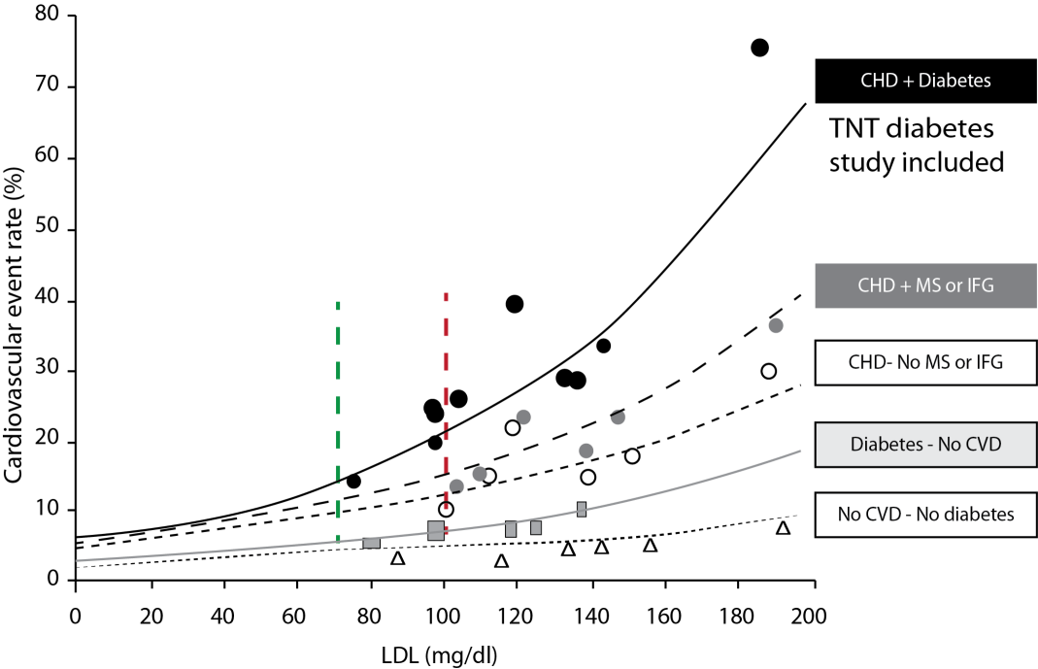
Mayor reducción de riesgo de ECV absoluto en pacientes con alto riesgo y niveles más altos de cLDL
Robinson JG, et al. Am J Cardiol. 2006;98:1405-1408.

