Slide 1
The potential efficacy and safety of targeting lower low-density lipoprotein cholesterol (LDL-C) levels
Date of Preparation: December 2015
PROES008063

Slide 2
Contents
Current guideline recommendations for the management of hypercholesterolemia
What are ‘normal’ LDL-C levels?
  Data from humans and other mammals
  Genetic mutations data
Benefits and risks of lowering LDL-C with pharmacotherapy
  Data from statin trials
  Data from IMPROVE-IT: adding ezetimibe to statins
  Data from PCSK9 inhibitor trials
Safety of low LDL-C levels (50–80 mg/dL)
  Data from statin trials
  Data from IMPROVE-IT
Safety of very low LDL-C levels (<25 mg/dL)
  Recent data from PCSK9 inhibitor trials
Summary and references

Slide 3
Current guideline recommendations for the management of hypercholesterolemia
Notes:
3

Slide 4
Guideline recommendations: Overview
Guideline LDL-C targets are generally based on the CV risk profile of the patient (very high to low risk groups)
  However, the AHA/ACC in US have now adopted a more individualised “treat to risk” approach
  The individual patient’s risk profile is the driver for treating multiple risk factors and the selection of therapies
There is still inconsistency around the use of the term ‘low LDL-C’
Guidelines from around the world use different LDL-C cut-offs to define CV risk

Slide 5

2011 ESC/EAS dyslipidaemia guidelines
Risk category | Targets | Class* | Level† | Studies used to support targets
Very high risk (established CVD, type 2 diabetes, type 1 diabetes with target organ damage, moderate to severe CKD or SCORE level ≥10%) | LDL-C <1.8 mmol/L (~70 mg/dL) and/or ≥50% LDL-C reduction when target level cannot be reached | I | A | CTT meta-analysis 2010 TNT IDEAL
High risk (markedly elevated single RFs, or SCORE ≥5 to <10%) | LDL-C goal <2.5 mmol/L (~100 mg/dL) should be considered | IIa | A | CTT meta-analysis 2010 Brugts et al, meta-analysis 2009 Mills et al, meta-analysis 2008
Moderate risk (SCORE >1 to ≤5%) | LDL-C goal <3.0 mmol/L (~115 mg/dL) should be considered | IIa | C | –
  Guidelines state that for very high risk patients “an absolute reduction to an LDL-C level <1.8 mmol/L (~70 mg/dL) or at least a 50% relative reduction in LDL-C, provides the best beneﬁt in terms of CVD reduction”
Reiner Z, et al. Eur Heart J. 2011;32:1769-818.
*Class I = evidence and/or agreement that a treatment or procedure is beneficial, useful, effective; IIa = weight of evidence/opinion is in favour of usefulness/efficacy. †Level of evidence: A = data derived from multiple randomized trials or meta-analyses.; C = consensus opinion and/or small studies, retrospective studies, registries.
Notes:
5

Slide 6
2012 ESC CVD prevention guidelines
Risk category | Targets | Class* | Level† | Studies used to support targets
Very high risk Documented CVD, previous MI, revascularisation, ischaemic stroke or peripheral artery disease Diabetes with ≥1 CV risk factor and/or organ damage Severe CKD SCORE‡ ≥10 | LDL-C <1.8 mmol/L (~70 mg/dL) or a ≥50% LDL-C reduction when the target level cannot be reached | I | A | CTT meta-analysis 2010 TNT, IDEAL
High risk Familial HC Severe HTN Diabetes without other risk factors Moderate CKD SCORE 5–10 | LDL-C <2.5 mmol/L (~100 mg/dL) is recommended | I | A | CTT meta-analysis 2010 Brugts et al, meta-analysis 2009 Mills et al, meta-analysis 2008
Low (SCORE <1) or Moderate (SCORE 1–5) risk | TC <5 mmol/L (~190 mg/dL) and LDL-C <3 mmol/L (~115 mg/dL) | I | A | MRFIT Smith et al, 1992
‡SCORE predicts the 10-year risk of fatal cardiovascular disease (CVD) based on the following risk factors: age, sex, smoking, systolic blood pressure, and total cholesterol.
1. Perk JA, et al. Atherosclerosis. 2012;223:1–68.
*Class I = evidence and/or agreement that a treatment or procedure is beneficial, useful, effective. †Level of evidence. A = data derived from multiple randomized trials or meta-analyses.
Notes:
6

Slide 7

2007 German Society for Cardiology (DGK) guidelines on statins
Risk category | Targets
Very high risk (post-ACS) | LDL-C <70 mg/dL (~1.8 mmol/L) is a therapeutic option
High risk (CHD or CHD risk equivalent [diabetes mellitus, aortic aneurysm]) | LDL-C goal of <100 mg/dL (~2.6 mmol/L)
Moderate risk (with RFs, 10-year risk 10-20%) | LDL-C goal of <130 mg/dL (~3.4 mmol/L)
Low risk (without additional RFs, 10 - year risk of heart attack <10%) | LDL-C goal of <160 mg/dL (~4.1 mmol/L)
Secondary targets: HDL-C >35 mg/dL; TG <200 mg/dL
Böhm M, et al. Clin Res Cardiol Suppl 2007;2:8–15
RFs, risk factors
Notes:
7
.

Slide 8

2014 Joint British Societies guidelines on CVD prevention
Risk category | Primary target
High risk: Atherosclerotic CVD Diabetes over 40 years CKD stages 3–5 Familial HC Asymptomatic with high 10-y risk (threshold to be set by NICE) Asymptomatic with high lifetime risk, where lifestyle changes alone are considered insufficient | LDL-C <2.0 mmol/L (~77 mg/dL)
Heart 2014;100:ii1-ii67 doi:10.1136/heartjnl-2014-305693
http://www.jbs3risk.com/
Notes:
8

Slide 9

2013 AHA/ACC guidelines on ASCVD risk
Risk category¹ | LDL-C targets | Studies used to support targets
High risk: Clinical ASCVD Untreated LDL-C >190 mg/dL without secondary cause Aged 40–75 years, with diabetes and LDL-C 70–189 mg/dL and 10-y ASCVD risk of ≥7.5% | High-intensity statin therapy (Daily dose lowers LDL-C by approx. ≥50%) | RCTs of statins
Moderately high risk: Aged 40–75 years, with diabetes and LDL-C 70–189 mg/dL and 10-y ASCVD risk of <7.5% Without diabetes but LDL-C 70–189 mg/dL and ASCVD risk of ≥5% | Moderate-intensity statin therapy (Daily dose lowers LDL-C by approx. 30 to <50%)
Low risk: Aged <40 and LDL-C <190 mg/dL without clinical ASCVD or diabetes 10-y ASCVD risk of <5% LDL-C <70 mg/dL | Lifestyle modification and monitor ASCVD risk
These guidelines recommend the new Pooled Cohort Risk Assessment Equations developed by the Risk
Assessment Work Group² to estimate the 10-year ASCVD risk (defined as first-occurrence non-fatal and fatal MI and non-fatal and fatal stroke)
ACC/AHA 2013 guidelines have shifted the emphasis from defined to individual treatment goals, although LDL-C levels >70 mg/dL are still considered a risk factor for individuals with other risk factors present
Adapted from 1. Stone NJ , et al. J Am Coll Cardiol. 2013;63(25):2889–934. 2. http://www.cardiosource.org/en/Science-And-Quality/Practice-Guidelines-and-Quality-Standards/2013-Prevention-Guideline-Tools.aspx
Notes:
9
.

Slide 10
2012 AACE guidelines on dyslipidaemia and atherosclerosis prevention
Risk category | LDL-C targets | Grade * | Evidence Level † | Studies used to support targets
Very high risk: established or recent hospitalisation for coronary, carotid and peripheral vascular disease plus ≥1 additional RF(s) | <70 mg/dL (~1.8 mmol/L) | A | 1 | HPS PROSPER ASCOT PROVE-IT TIMI 22 IDEAL MRFIT
High risk: ≥2 RFs and 10-y risk >20% or CHD risk equivalents including diabetes with no other RFs | <100 mg/dL (~2.6 mmol/L) | A | 1
Moderately high risk: ≥2 RFs and 10-y risk 10-20% | <130 mg/dL (~3.4 mmol/L) | – | –
Moderate risk: ≥2 RFs and 10-y risk <10% | <130 mg/dL (~3.4 mmol/L) | – | –
Low risk: ≤1 RF | <160 mg/dL (~4.1 mmol/L) | – | –
Jellinger PS, et al. Endocr Pract. 2012;18 Suppl 1:1–78.
*Grade: A = Highest level of evidence, based on https://www.aace.com/files/gl-standards.pdf. †Evidence level: 1 = data derived from randomized controlled trials or meta-analyses of such.
RFs, risk factors
Notes:
10
.

Slide 11

2012 Canadian guidelines on dyslipidaemia and CVD prevention
Risk category | Primary target | Strength† | Quality† | Studies used to support targets
High risk Clinical atherosclerosis Abdominal aortic aneurysm FRS ≥20% Diabetes >15 y duration + age >30 y Diabetes + age >40 y Microvascular disease High risk kidney disease High risk hypertension | LDL-C <2 mmol/L (~77 mg/dL) or ≥50% reduction Alternate primary targets: apoB ≤0.80 g/L (80 mg/dL) or Non-HDL-C ≤2.6 mmol/L (100 mg/dL)* | Strong | High | CTT meta-analysis TNT, IDEAL, PROVE-IT TIMI 22, A to Z, SEARCH, SHARP
Intermediate risk FRS 10–19% |  | Strong | Moderate | TNT, IDEAL, PROVE-IT TIMI 22, A to Z, SEARCH
Low risk FRS <10% | ≥50% LDL-C reduction | Strong | Moderate | JUPITER
  *Because apoB and non-HDL-C have been suggested to be more accurate markers than LDL-C of CVD risk, particularly during pharmacotherapy, apoB or non-HDL-C can be substituted for LDL-C.
Anderson TJ, et al. Can J Cardiol. 2013;29:151-67. † Based on GRADE scoring: http://www.gradeworkinggroup.org/publications/Grading_evidence_and_recommendations_BMJ.pdf
FRS: Framingham Risk Score.
Notes:
11

Slide 12

2007 Brazilian Society of Cardiology guidelines
Risk category | LDL-C | Non-HDLC
Significant atherosclerosis (FRS >20%) | <70 mg/dL (~1.8 mmol/L) | <100 mg/dL (~2.6 mmol/L)
High risk (Diabetic or FRS >20%) | <100 mg/dL (~2.6 mmol/L) option: <70 mg/dL (~1.8 mmol/L) | <130 mg/dL (~3.4 mmol/L) option: <100 mg/dL (~2.6 mmol/L)
Intermediate risk (FRS 10-20%) | <130 mg/dL (~3.4 mmol/L) | <160 mg/dL (~4.1 mmol/L)
Low risk (FRS <10%) | <160 mg/dL (~4.1 mmol/L) | <190 mg/dL (~5.0 mmol/L)
HDL-C goal is ≥40 mg/dL for men and ≥50 mg/dL for women and diabetics. TG goal is <150 mg/dL
Sposito AC, et al. Arq Bras Cardiol. 2007;88 Suppl 1:2–19.
FRS: Framingham Risk Score.
Notes:
12

Slide 13

2007 Japan Atherosclerosis Society atherosclerotic CVD guidelines
Risk category | Primary target
Secondary prevention
With history of CAD | LDL-C <100 mg/dL (~2.6 mmol/L)
Primary prevention
High risk (≥3 RFs*) | LDL-C <120 mg/dL (~3.1 mmol/L)
Intermediate risk (1-2 RFs*) | LDL-C <140 mg/dL (~3.6 mmol/L)
Low risk (0 RF*) | LDL-C <160 mg/dL (~4.1 mmol/L)
*Risk factors (RF) other than LDL-C ≥140 mg/dL. These include age (male ≥45 y; female ≥55 y), hypertension, diabetes, smoking, family history of CAD and low HDL-C (<40 mg/dL).
HDL-C goal is ≥40 mg/dL and TG goal is <150 mg/dL at all risk categories.
Teramoto T, et al. J Atheroscler Thromb. 2007;14:45–50
Notes:
13

Slide 14
Summary of guideline-recommended LDL-C targets
CVD risk* | 2011 ESC/EAS¹ | 2012 ESC² | 2007 German³ | 2014 UK⁴ | 2013 AHA/ACC⁵ | 2012 AACE⁶ | 2012 Canada⁷ | 2007 Brazil⁸ | 2007 Japan⁹
Very high | <1.8 mmol/L (70 mg/dL) and/or a ≥50% reduction | <1.8 mmol/L (70 mg/dL) or a ≥50% reduction | Option: <1.8 mmol/L (70 mg/dL | – | ≥50% reduction <1.8 mmol/L (70 mg/dL) implied | <1.8 mmol/L (70 mg/dL) | – | <1.8 mmol/L (70 mg/dL) | –
High | <2.5 mmol/L (~100 mg/dL) should be considered | <2.5 mmol/L (~100 mg/dL) | <2.6 mmol/L (100 mg/dL) | 2.0 mmol/L (77 mg/dL) |  | <2.6 mmol/L (100 mg/dL) | <2.0 mmol/L (77 mg/dL) or ≥50% reduction | <2.6 mmol/L (100 mg/dL) Option: 1.8 mmol/L (70 mg/dL) | <2.6 mmol/L (100 mg/dL)
Moderately high | – | – | – | – | <30 to <50% reduction | <3.4 mmol/L (130 mg/dL) | – | – | <3.1 mmol/L (120 mg/dL)
Moderate | <3 mmol/L (115 mg/dL) should be considered | <3 mmol/L (115 mg/dL) & TC <5 mmol/L (190 mg/dL) | <3.4 mmol/L (130 mg/dL) | – |  | <3.4 mmol/L (130 mg/dL) | <2.0 mmol/L (77 mg/dL) or ≥50% reduction | <3.4 mmol/L (130 mg/dL) | <3.6 mmol/L (140 mg/dL)
Low | – | <3 mmol/L (115 mg/dL) & TC <5 mmol/L (190 mg/dL) | <4.1 mmol/L (160 mg/dL) | – | – | <4.1 mmol/L (160 mg/dL) | ≥50% reduction | <4.1 mmol/L (160 mg/dL) | <4.1 mmol/L (160 mg/dL)
Canada, Japan and UK do not advocate a target of 70 mg/dL and do not specify a “very high risk group”. UK and US (AHA/ACC) recommendations adopt “Treat to Risk” approach
*Definition of risk varies between guidelines: not necessarily directly comparable.
1. Reiner Z, et al. Eur Heart J. 2011;32:1769–818. 2. Perk JA, et al. Atherosclerosis. 2012;223:1–68. 3. Böhm M, et al. Clin Res Cardiol Suppl 2007;2:8–15. 4. Heart 2014;100:ii1-ii67 doi:10.1136/heartjnl-2014-305693 5. Stone NJ, et al. J Am Coll Cardiol. 2013;63(25): 2889–934. 6. Jellinger PS, et al. Endocr Pract. 2012;18 Suppl 1:1–78. 7. Anderson TJ, et al. Can J Cardiol. 2013;29:151–67. 8. Sposito AC, et al. Arq Bras Cardiol. 2007;88 Suppl 1:2–19. 9. Teramoto T, et al. J Atheroscler Thromb. 2007;14:45–50.
Notes:
14

Slide 15
Guideline recommendations: Summary [1]
There appear to be 2 main approaches to LDL-C reductions:
  Treat to target (specific LDL-C targets in many countries)^{1–8}
  Treatment based on CV risk (no specific LDL-C targets, ACC/AHA only)⁹
Professional organisations have, historically, adopted a target-based approach
Targets have become more stringent over the last 10 years as meta-analyses have demonstrated a linear relationship between LDL-C reduction and CV outcomes
LDL-C targets are generally based on the CV risk profile of the patient (very high to low risk groups)
  Very high risk groups typically have a target of 70 mg/dL^{1–4,6}
  Low risk groups typically have a target of 160 mg/dL^{3,5–7}
1. Reiner Z, et al. Eur Heart J. 2011;32:1769–818. 2. Perk JA, et al. Atherosclerosis. 2012;223:1–68. 3. Böhm M, et al. Clin Res Cardiol Suppl 2007;2:8–15. 4. Jellinger PS, et al. Endocr Pract. 2012;18 Suppl 1:1–78. 5. Anderson TJ, et al. Can J Cardiol. 2013;29:151–67. 6. Sposito AC, et al. Arq Bras Cardiol. 2007;88 Suppl 1:2–19. 7. Teramoto T, et al. J Atheroscler Thromb. 2007;14:45–50. 8. Heart 2014;100:ii1–ii67 doi:10.1136/heartjnl-2014-305693 9. Stone NJ et al. J Am Coll Cardiol. 2013;63(25): 2889–934.

Slide 16
Guideline recommendations: Summary [2]
Definitions of risk vary from country to country and where there are multiple guidelines in any country, the definitions of risk may vary further
  Countries such as Japan have less stringent targets (<100 mg/dL for secondary prevention)¹
  The AHA/ACC in US have adopted a more individualised approach to care (“treat to risk approach”)
  The individual patient’s risk profile is the driver for treating multiple risk factors and the selection of therapies²
1. Teramoto T, et al. J Atheroscler Thromb. 2007;14:45–50. 2. Stone NJ, et al. J Am Coll Cardiol. 2013;63(25): 2889–934.

Slide 17
What are ‘normal’ LDL-C levels?
Data from humans and other mammals

Slide 18
Potential effects of low LDL-C levels: Human data
Average population LDL-C levels, or even levels considered ‘normal’ by international guidelines are not necessarily optimal^{1–2}
  Data from infants and hunter-gatherer societies suggest much lower LDL-C levels (48–83 mg/dL) may be healthier and are not associated with atherosclerosis^{1,2}
Genetic disorders resulting in long-term exposure to low LDL-C levels are also associated with a reduced risk of CHD³
1. LaRosa JC, et al. Am J Cardiol. 2012;111:1221–1229. 2. O’Keefe JH, et al. J Am Coll Cardiol. 2004;43(11):2142–2146. 3. Ference BA, et al. J Am Coll Cardiol. 2012;60:2631–2639.
CHD, coronary heart disease

Slide 19
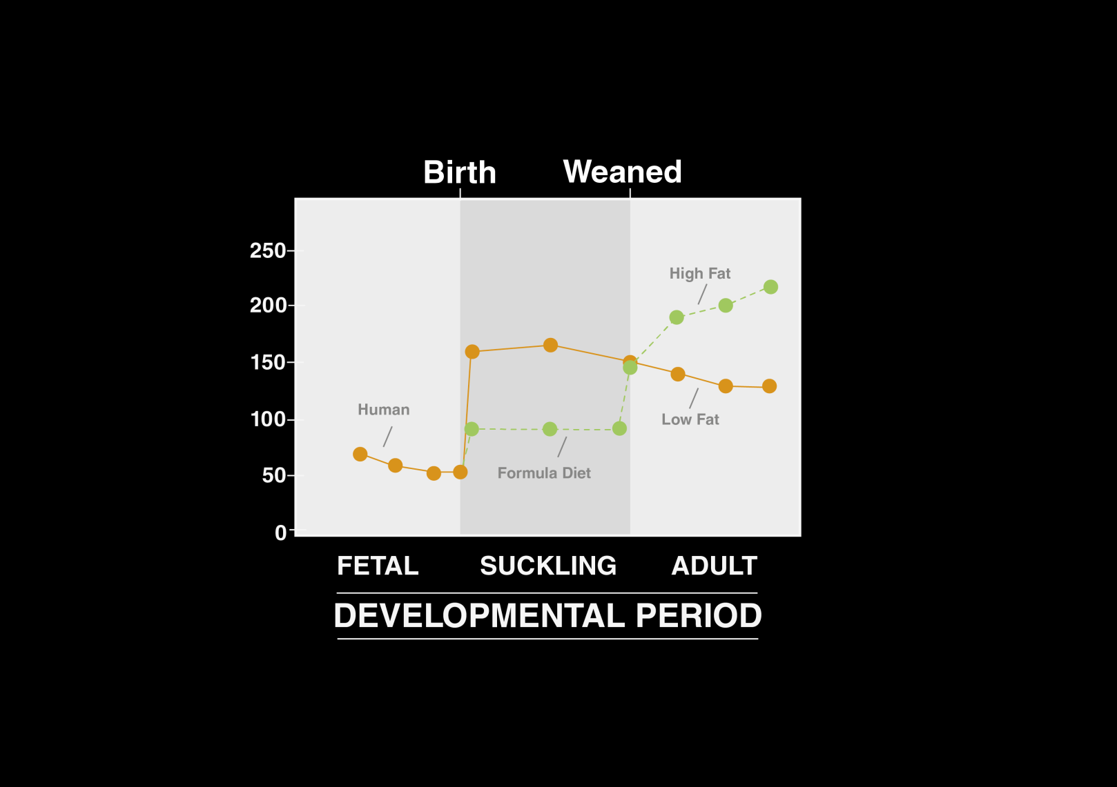
Low birth LDL-C levels rise with breastfeeding and in adulthood with exposure to Western diet
140
Newborn data from premature (n=38) and term (n=41) neonates; infant data based on a small series (n=18); adult data from NHANES III database¹
120
100
Plasma TC (mg/dL)
80
Mean LDL-C (mg/dL)
60
40
20
0
33-34
41-42
4–5 ff*
4–5 bf*
20–39
40–59
60–74
Weeks in utero (n=79)
Months (n=18)
Years (n=8,174)
Data from a variety of sources, see ².
Figures adapted from: 1. LaRosa JC, et al. Am J Cardiol. 2012;111:1221–1229. 2. Dietschy JM, Turley SD. J Lipid Res. 2004;45:1375–1397.
*formula-fed †breastfed TC, total cholesterol
Notes:
Total cholesterol and LDL cholesterol change as humans age. During late gestation in utero, the total cholesterol and LDL cholesterol levels reach approximately 55 and 30 mg/dl, respectively, and these levels increase during breastfeeding. A similar pattern has been observed in pigs and sheep though after weaning, the total cholesterol levels decrease dramatically in pigs and sheep but not in humans. This phenomenon might result from the Western diet.

Slide 20
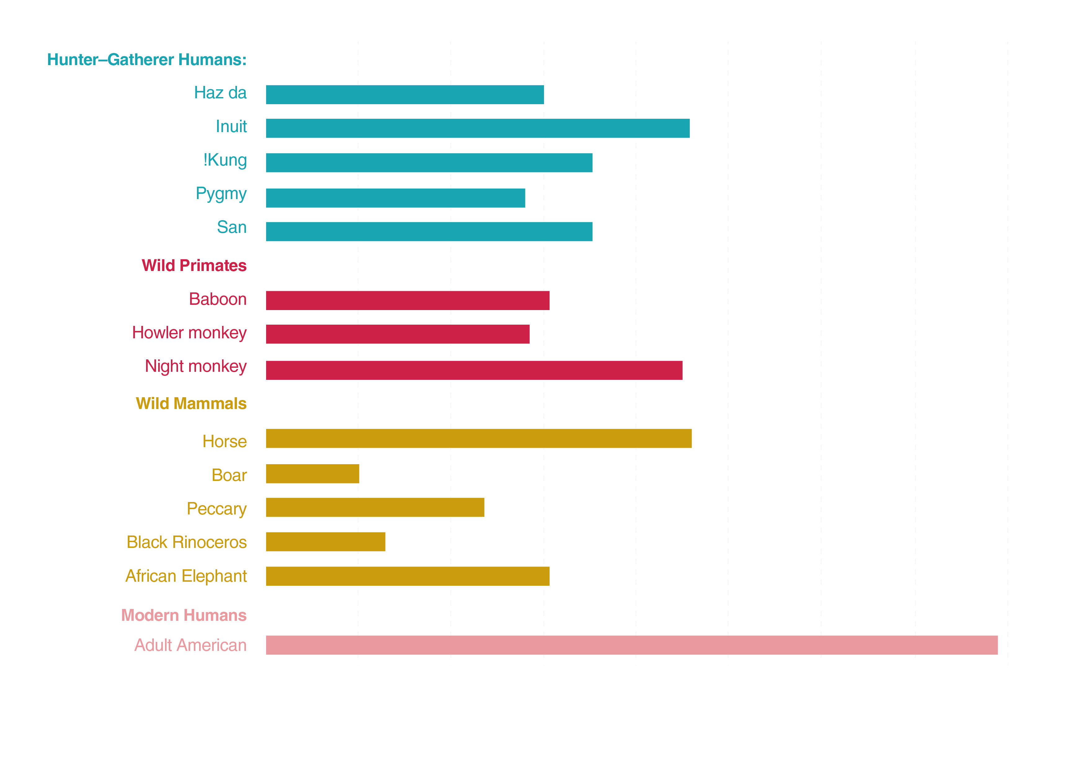
Westernized humans are the only mammals with total cholesterol >160 mg/dL (and LDL-C >80 mg/dL)
Field observations of hunter-gatherer populations showed them to be generally free of symptoms of CVD even when living beyond 70. These populations had total cholesterol levels of 100 to 150 mg/dL with estimated LDL cholesterol levels of approximately 50 to 75 mg/dL. Healthy, wild, adult primates show LDL-C levels of approximately 40 to 80 mg/dL.¹
Hunter-Gatherers:
Haz da
Inuit
!Kung
Pygmy
San
Wild Primates:
Baboon
Howler monkey
Night monkey
Wild Mammals:
Horse
Boar
Peccary
Black rhinoceros
African Elephant
Modern Humans:
Adult American
0
70
90
110
130
150
170
190
210
Mean total cholesterol (mg/dL)
Figure adapted from 1. O’Keefe JH, et al. J Am Coll Cardiol. 2004;43(11):2142–2146.
Notes:
Hunter-gatherer populations include cultures following their indigenous, pre-agricultural lifestyle. They typically have a low-carbohydrate/high-protein diet, including lean meat from game, rather than the Western diet, which includes greater consumption of grains and farm animal meat, which is higher in saturated fat.

Slide 21
Life-long low LDL-C is associated with lower CHD risk
A meta-analysis of 312,321 subjects with long-term exposure to naturally low levels of LDL-C, resulting from 9 different single nucleotide polymorphisms (SNPs) in 6 genes, compared with the general population
Nearby Gene
SNP
LDL effect* (mg/dL)
Sample Size (n)
OR (95% CI)
SORT1
PCSK9
LDLR
HMGCR
ABCG8
APOE
rs599839
rs646776
rs11206510
rs11591147
rs65111720
rs2228671
rs12916
rs4299376
rs4420638
(-6.00)
(-5.71)
(-2.93)
(-16.68)
(-7.50)
(-5.70)
(-2.63)
(-2.86)
(-7.10)
141,565
111,900
186,582
127,651
77,041
82,880
49,160
118,842
75,487
0.88 (0.86—0.90)
0.88 (0.86—0.91)
0.94 (0.92—0.96)
0.72 (0.62—0.84)
0.87 (0.83—0.92)
0.89 (0.86—0.93)
0.94 (0.90—0.98)
0.94 (0.92—0.96)
0.86 (0.83—0.89)
(l-squared = 91.8%, p<0.001)
0.70
0.80
0.90
1.0
Life-long exposure to low LDL-C due to single nucleotide polymorphisms (SNPs) reduces the risk of CHD by 54.5% for each mmol/L lower of LDL-C¹
1. Ference BA, et al. J Am Coll Cardiol. 2012;60:2631–2639. CHD, coronary heart disease
*In comparison to the general population
Notes:
Boxes A meta-analysis of 312,321 subjects showed that long-term exposure to naturally low levels of LDL-C, resulting from 9 different polymorphisms in 6 genes, was associated with a 54.5% reduction in the risk of CHD for each mmol/L lower of LDL-C
represent the summary point estimate of odds ratio (OR) for the association between each exposure allele and risk of coronary heart disease (CHD). Bars represent 95% CI. (Unlike the other SNPs, the APOE-C1-C2 SNP rs4420638 is associated with LDL-C, HDL-C, triglycerides, and C-reactive protein. This SNP was included specifically to assess for heterogeneity of effect on the risk of CHD.)

Slide 22
Life-long low LDL-C is associated with lower CHD risk
A meta-analysis of 312,321 subjects with long-term exposure to naturally low levels of LDL-C and reduced CHD risk compared to normal subjects*, resulting from 9 different polymorphisms in 6 genes
30%
LDL effect* (mg/dL)
rs11591147
SNP
rs599839
rs646776
rs11206510
rs11591147
rs65111720
rs2228671
rs12916
rs4299376
rs4420638
(-6.00)
(-5.71)
(-2.93)
(-16.68)
(-7.50)
(-5.70)
(-2.63)
(-2.86)
(-7.10)
20%
Proportional risk reduction (SE)
rs4420638
rs646776
rs6511720
rs2228671
rs599839
10%
rs12916
rs11206510
rs4299376
0%
0
1.0
3.0
5.0
7.0
9.0
11.0
13.0
15.0
17.0
Reduction in LDL-C (mg/dL)
There is a log-linear relationship between long-term (life long) LDL-C level and risk of CHD¹
1. Ference BA, et al. J Am Coll Cardiol. 2012;60:2631–2639.
*In comparison to the general population
CHD, coronary heart disease

Slide 23
PCSK9 gain-of-function (GoF) and loss-of-function (LoF) mutations and their effect on LDL-C metabolism and CV risk
PCSK9 GoF mutations are a rare cause of familial hypercholesterolaemia (FH)¹
  PCSK9 GoF mutations were first found in 2003 through genotype sequencing of two French families with FH²
  Patients with PCSK9 GoF mutations are characterised by high levels of LDL-C, premature atherosclerosis, coronary artery disease (CAD) and other CV complications^{1,3,4}
    Reported LDL-C levels for patients with GoF mutations ranged from 196–420 mg/dL; TC, 259–521 mg/dL^{1,2}
PCSK9 LoF mutations are a rare cause of familial hypobeta-lipoproteinaemia (FHBL)³
  PCSK9 LoF mutations were first found in 2005 in African Americans with FHBL during genetic sequencing of 128 individuals with low LDL-C from the Dallas Heart study⁵
  A large prospective study revealed that patients with LoF mutations have lower plasma LDL-C levels and a consistent reduction in CAD⁶
    Average LDL-C levels for patients with LoF mutations were 100–116 mg/dL (vs 137–138 mg/dL in the general population, p<0.001)⁶
1. Abifadel M, et al. Atherosclerosis. 2012;223:394–400. 2. Abifadel M, et al. Nat Genet. 2003;34:154–156. 3. Tibolla G, et al. Nut Met Cardiovasc Dis. 2011;21:835–843. 4. Norata GD ,et al. Atherosclerosis 2010;208:177–82. 5. Cohen J, et al. Nat Genetics 2005;37:161–165. 6. Cohen J, et al. New Eng J Med. 2006;354:1264–72.
Notes:
PCSK9 GoF mutations are a rare cause of ADH and more than 20 such mutations have already been found¹
- Patients with PCSK9 GoF mutations have familial hypercholesterolaemia with high levels of LDL-C, tendon xanthomas, premature atherosclerosis with CAD and other CV complications¹⁻⁴
PCSK9 LoF mutations are a rare cause of hypocholesterolaemia and low LDL-C levels²
⁻ Patients with PCSK9 LoF mutations have low plasma LDL-C levels and a consistent reduction in CAD⁶
Ref 1/Tibolla et al 2011/ p836/ col 1
Ref 1/Tibolla et al 2011/ p838/ col 1
Ref2/ Abifadel 2003/ 155/ col2
Ref 3/ Abifadel 2012/ p398/ discussion
Ref 4/ Norata 2010/ p181 first line of discussion
Ref 1/ Tibolla et al. p838/ column 1/ line 14
Ref 5/ Cohen et al 2005/ p162/ col 1/ lines 5 and 25
Ref 6/ Cohen et al 2006/ p1267/ col 2 lines 5 and 14
Ref 2/ Abifadel et al 2003/ p154/ col 1 and 2

Slide 24
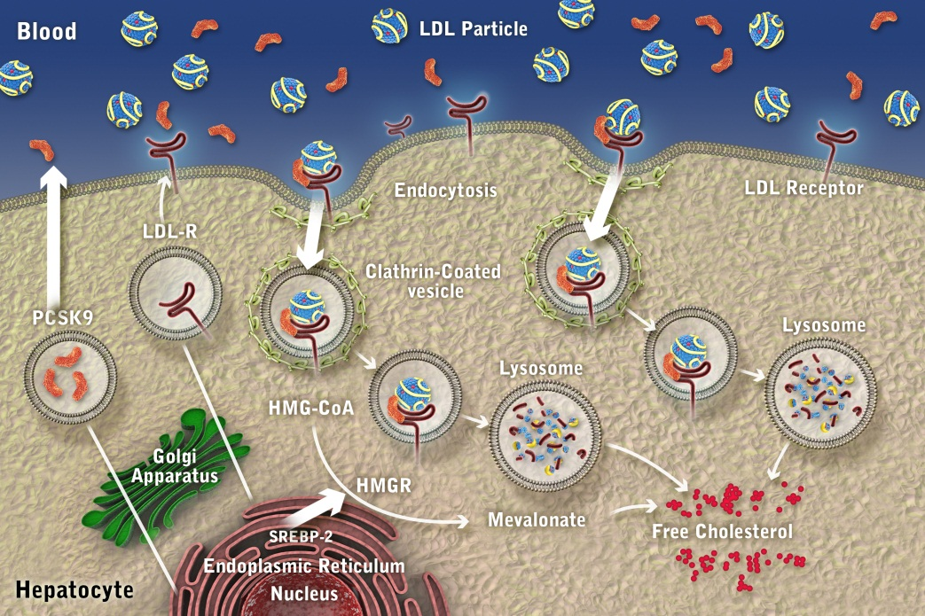
PCSK9 GoF mutations and effect on LDL metabolism
PCSK9 Gain of Function
PCSK9 tags the LDL-R for lysosomal degradation
GoF mutations increase activity in this pathway
↓ LDL-R levels
↓ LDL clearance
↑ Plasma LDL
High risk for atherosclerosis and CHD
Adapted from: 1. Catapano AL and Papadopoulos N. Atherosclerosis. 2013;228(1):18–28. 2. Soufi M, et al. Gene. 2013;521(1):200-203.
CHD, coronary heart disease
Notes:
Purpose
To review the effects of mutations of the gene coding for proprotein convertase subtilisin/kexin type 9 (PCSK9)
Take-Away
There are 2 types of PCSK9 mutations: those that result in gain of function and those that result in loss of function
For gain-of-function mutations, low-density lipoprotein (LDL) levels are increased, which puts patients at high risk for atherosclerosis and coronary heart disease (CHD), similar to cases of LDL receptor gene mutations
Conversely, loss-of-function mutations lead to decreased LDL levels, which confers protection from atherosclerosis and CHD.
Note Additional comments
Green PCSK9 denotes loss in function
Note decrease in LDLR with gain-of-function
Note increase in LDLR with loss-of-function
Catapano 2013
p 23/Fig. 2A
Soufi 2013
p 4/para 2
Soufi 2013
p 4/para 2
Soufi 2013
p 4/para 2
p 5/para 1
Catapano 2013
p 23/Fig. 2A
Soufi 2013
p 4/para 2
p 5/para 1
Catapano 2013
p 23/Fig. 2A
Soufi 2013
p 4/para 2
p 5/para 1

Slide 25
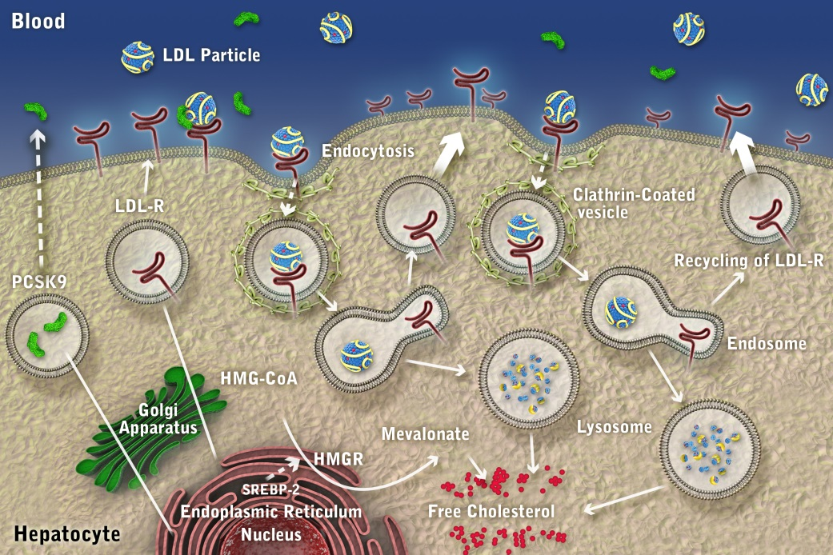
PCSK9 LoF mutations and effect on LDL metabolism
PCSK9 Loss of Function
PCSK9 tags the LDL-R for lysosomal degradation
LoF mutations decrease activity in this pathway
More LDL-Rs are recycled to the cell surface
↑ LDL-R levels
↑ LDL clearance
↓ Plasma LDL
Protection from atherosclerosis and CHD
Adapted from: 1. Catapano AL and Papadopoulos N. Atherosclerosis. 2013;228(1):18–28. 2. Soufi M, et al. Gene. 2013;521(1):200-203.
CHD, coronary heart disease
Notes:
Purpose
To review the effects of mutations of the gene coding for proprotein convertase subtilisin/kexin type 9 (PCSK9)
Take-Away
There are 2 types of PCSK9 mutations: those that result in gain of function and those that result in loss of function
For gain-of-function mutations, low-density lipoprotein (LDL) levels are increased, which puts patients at high risk for atherosclerosis and coronary heart disease (CHD), similar to cases of LDL receptor gene mutations
Conversely, loss-of-function mutations lead to decreased LDL levels, which confers protection from atherosclerosis and CHD.
Note Additional comments
Green PCSK9 denotes loss in function
Note decrease in LDLR with gain-of-function
Note increase in LDLR with loss-of-function
Catapano 2013
p 23/Fig. 2A
Soufi 2013
p 4/para 2
Soufi 2013
p 4/para 2
Soufi 2013
p 4/para 2
p 5/para 1
Catapano 2013
p 23/Fig. 2A
Soufi 2013
p 4/para 2
p 5/para 1
Catapano 2013
p 23/Fig. 2A
Soufi 2013
p 4/para 2
p 5/para 1

Slide 26
PCSK9 LoF mutations provide supportive evidence for the safety of low LDL-C levels and the potential therapeutic benefit of PCSK9 inhibition
Subjects with loss-of-function mutations in PCSK9:
  Have naturally low levels of LDL-C and a reduced prevalence of CAD relative to the general population (see below table)^{1,2}
  These LoF mutations have not been associated with any detectable clinical abnormalities^{1,2}
 | PCSK9 mutation | LDL-C reduction vs. non-carriers | CAD reduction vs. non-carriers
Benn et al. JACC 2010¹ | R46L | 13% (111 vs 131 mg/dL, p<0.0001) | 30%
Cohen et al. NEJM 2006² | R46L Y142X or C679X | 15% (116 vs 137 mg/dL, p<0.001) 28% (100 vs 138 mg/dL, p<0.001) | 47% 88%
1. Benn M, et al. J Am Coll Cardiol. 2010; 55:2833–2842. 2. Cohen JC, et al. N Engl J Med. 2006;354:1264–1272.
CAD, coronary artery disease
Notes:
Ref 1/Benn et al. p2834/column 1/line 3; Ref 2/Cohen et al. p 1264/column 1/line 22
Ref 1/Benn et al. p2834/column 1/line 3; Ref 2/Cohen et al. p 1264/column 1/line 22
Ref 3/Tibolla et al p840/column 1/line 4
Ref 1/Benn et al. p2836/colum6/line 6; p2837/column 2/line 1; Ref 2/Cohen et al. p 1267/column 2/line 6; p1269/column 1/line 13; p1264/column 1/ line 12

Slide 27


PCSK9 LoF mutations are associated with low LDL-C
A large prospective study of the incidence of CAD over 15 years in the Atherosclerosis Risk in Communities study, in relation to the presence of PCSK9 LoF mutations¹
LDL-C levels in black and white subjects without PCSK9 LoF mutations follow an approximately normal distribution
In subjects with LoF mutations, LDL-C levels are skewed towards the lower end of the scale
This effect is more pronounced for black subjects (nonsense mutations vs. substitution mutations in white subjects)
Figure from 1. Cohen JC, et al. N Engl J Med. 2006;354:1264–1272. Reprinted with permission from Massachusetts Medical Society.
*Nonsense mutations include PCSK9^{142X} PCSK9^{679X} PCSK9^{46L} is a substitution mutation
CAD, coronary artery disease
Notes:
Bar charts show:
- frequency of different plasma LDL-C levels in the normal population, in black v white
- frequency of different plasma LDL-C levels in populations with PCSK9^{142x} and PCSK9^{579x} showing lower LDL-C levels
- lower prevalence of CAD in people with above PCSK9 LoF mutations
1. Cohen JC, et al. N Engl J Med. 2006;354:1264-1272.
This was a large prospective study which investigated the incidence of CHD (myocardial infarction, fatal CHD, or coronary revascularisation) in 15,972 participants over a 15-year interval in the Atherosclerosis Risk in Communities study, according to the presence or absence of sequence variants in the proprotein convertase subtilisin/kexin type 9 serine protease gene (PCSK9) that are associated with reduced plasma levels of LDL cholesterol.
Ref 1/Cohen et al. p 1268/figure 1A and B; p1270/figure 2A and B

Slide 28
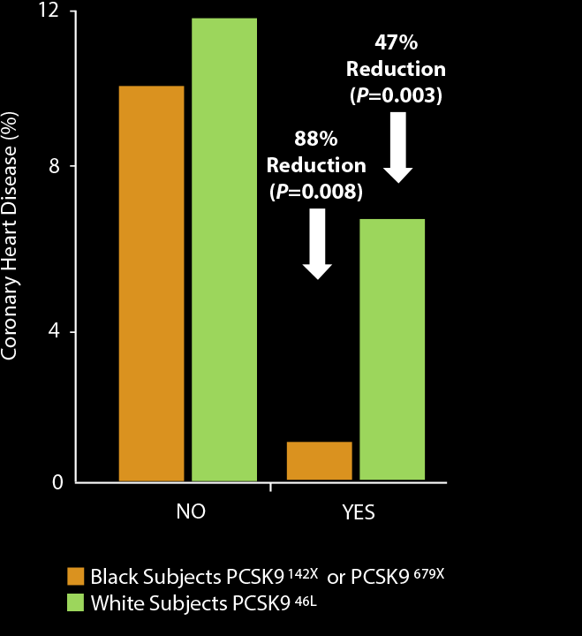
PCSK9 LoF mutations are associated with lower risk of CHD
A large prospective study of the incidence of CHD over 15 years in the Atherosclerosis
Risk in Communities study, in relation to the presence of PCSK9 LoF mutations
Both black and white subjects with PCSK9 LoF mutations show reduced rates of CHD
The effect is greater for black subjects, who carry 142X or 679X nonsense mutations
White subjects in this study carried the R46L substitution in PCSK9
  The 142X and 679X mutations are rarer in this population
Mutation:
Figure from 1. Cohen JC, et al. N Engl J Med. 2006;354:1264–1272. Reprinted with permission from Massachusetts Medical Society.
CHD, coronary heart disease
Notes:
Bar charts show:
- frequency of different plasma LDL-C levels in the normal population, in black v white
- frequency of different plasma LDL-C levels in populations with PCSK9^{142x} and PCSK9^{579x} showing lower LDL-C levels
- lower prevalence of CAD in people with above PCSK9 LoF mutations
1. Cohen JC, et al. N Engl J Med. 2006;354:1264-1272.
This was a large prospective study which investigated the incidence of CHD (myocardial infarction, fatal CHD, or coronary revascularisation) in 15,972 participants over a 15-year interval in the Atherosclerosis Risk in Communities study, according to the presence or absence of sequence variants in the proprotein convertase subtilisin/kexin type 9 serine protease gene (PCSK9) that are associated with reduced plasma levels of LDL cholesterol.
Ref 1/Cohen et al. p 1268/figure 1A and B; p1270/figure 2A and B

Slide 29
Inactivating mutations of the Niemann-Pick C1-like 1
(NPC1L1) gene are associated with lower CHD risk
Niemann-Pick C1-like 1 (NPC1L1) protein
  Located primarily on the epithelial brush border of the GI tract
  Functions as a sterol transporter to mediate intestinal cholesterol absorption
  Inhibited by ezetimibe resulting in reduced cholesterol absorption
A sequencing/genotyping cohort study of 113,094 people with or without CHD disease identified inactivating mutations of the NPC1L1 gene¹
Carriers of the 15 different inactivating mutations on average had a 53% reduction in CHD risk compared with non-carriers (OR=0.47; 95% CI=0.25–0.87; p=0.008)
Carriers of NPC1L1 mutations (vs non-carriers) also had significantly lower levels of:
  Total cholesterol (mean adjusted difference, -13 mg/dL; p=0.03)
  LDL-C (mean adjusted difference, -12 mg/dL; p=0.04)
1. The Myocardial Infarction Genetics Consortium Investigators. N Engl J Med. 2014; 371;22: 2072–82.
CHD, coronary heart disease

Slide 30
Log-linear effect of LDL-C on CHD risk reduction is independent of genetic mechanism
Meta-analysis of 108,376 patients from 14 studies¹
Investigated the effects of exposure to lower LDL-C mediated by polymorphisms in:
  NPC1L1 (inhibited by ezetimibe)
  HMGCR (inhibited by statins)
  Both
The effect of polymorphisms in NPC1L1 and HMGCR on risk of CHD (vs non-carriers) was approximately the same per unit lowering of LDL-C
The log-linear effect of LDL-C on CHD risk reduction is independent of genetic mechanism, with combined polymorphisms having an additive effect
30%
11
20%
Proportional risk reduction (SE)
NPC1L1 – rs217386
PCSK9 – rs2479409
HMGCR – rs12916
ABCG5/8 – rs4299376
PCSK9 – rs11206510
NPC1L1 LDL-C score
HMGCR LDL-C score
LDLR – rs2228671
Combined NPC1L1 & HMGCR LDL-C score
LDLR – rs6511720
PCSK9 46L – rs11591147
8
7
10
10%
6
9
1
2
5
3
4
0%
0
1.0
3.0
5.0
7.0
9.0
11.0
13.0
15.0
17.0
Reduction in LDL-C (mg/dL)
Graph adapted from Ference BA, et al. J Am Coll Cardiol 2015;65:1552–1561.
1. Ference BA, et al. J Am Coll Cardiol 2015;65:1552–1561.

Slide 31
Effects of NPC1L1 and HMGCR polymorphisms on CHD risk
Lower LDL-C levels mediated by polymorphisms in the NPC1L1 gene are associated with lower risk of CHD^{1,2}
No biological difference in on risk of CHD for lower LDL-C levels mediated by inhibition of NPC1L1 vs HMGCR²
These data suggest that lowering LDL-C by inhibiting NPC1L1 with ezetimibe, inhibiting HMGCR with a statin, or both could be expected to reduce the risk of CHD proportionally to the achieved reduction in LDL-C, regardless of which treatment is used²
1. The Myocardial Infarction Genetics Consortium Investigators. N Engl J Med 2014; 371;22: 2072–82. 2. Ference BA, et al. J Am Coll Cardiol 2015;65:1552–1561.

Slide 32
Is lower LDL-C earlier better?
In a Mendelian randomisation analysis, long-term early genetic exposure to 1 mmol/L
(39 mg/dL) lower LDL-C was associated with a 55% reduction in the risk of CHD¹
  Statins later in life would require a 3-fold greater LDL-C reduction of 3 mmol/L (116 mg/dL) to achieve this same magnitude of risk reduction
Lower LDL-C | Meta-Analysis | Sample Size (N) |  | OR (95% CI) | p (difference)
1.0 mmol/L | Genetic Studies | 312,321 |  | 0.46 (0.41-0.51) | 8.4x10⁻¹⁹
(38.7 mg/dL) | Statin Trials | 169,138 |  | 0.76 (0.74-0.78)
0.5 mmol/L | Genetic Studies | 312,321 |  | 0.67 (0.64-0.72) | 8.4x10-19
(19.3 mg/dL) | Statin Trials | 169,138 |  | 0.87 (0.86-0.88)
0.25 mmol/L | Genetic Studies | 312,321 |  | 0.82 (0.80-0.85) | 8.4x10⁻¹⁹
(9.7 mg/dL) | Statin Trials | 169,138 |  | 0.93 (0.93-0.94)
0.125 mmol/L | Genetic Studies | 312,321 |  | 0.91 (0.89-0.92) | 8.4x10⁻¹⁹
(4.8 mg/dL) | Statin Trials | 169,138 |  | 0.96 (0.96-0.97)
0.40
0.50
0.60
0.70
0.80
0.90
1.0
Prolonged exposure to lower LDL-C levels beginning early in life may dramatically reduce CHD, but a RCT is needed to assess the beneﬁts and risks of long-term exposure to LLT
1. Ference BA, et al. J Am Coll Cardiol. 2012;60:2631–9.
LLT, lipid lowering therapy
Notes:
32
.

Slide 33
Life-long low LDL-C is associated with significant reduction in CV risk: Summary
Field observations of modern hunter-gatherer populations with life-long LDL-C levels of approximately 50–75 mg/dL (1.3–1.9 mmol/L) showed them to be generally free of symptoms of CVD¹
A meta-analysis of 312,321 subjects showed that long-term exposure to naturally low levels of LDL-C, resulting from 9 different polymorphisms in 6 genes, was associated with a 54.5% reduction in the risk of CHD for each mmol/L lower of LDL-C²
  This study suggests a 3-fold greater reduction in the risk of CHD per unit lower LDL-C than observed during statin treatment started later in life²
Life-long low LDL-C levels due to PCSK9 LoF mutations, and NPC1L1 or HMGCR inactivating mutations, are associated with low CHD risk, regardless of mechanism^{4–6}
1. O’Keefe JH, et al. J Am Coll Cardiol. 2004;43(11):2142–2146. 2. Ference BA, et al. J Am Coll Cardiol. 2012;60:2631–2639. 3. Benn M, et al. J Am Coll Cardiol. 2010;55:2833–2842. 4. Cohen JC, et al. N Engl J Med. 2006;354:1264–1272. 5. The Myocardial Infarction Genetics Consortium Investigators. N Engl J Med 2014; 371;22: 2072–82 6. Ference BA, et al. American Heart Association Scientific Sessions, Presentation 19754, November 2014, Chicago.

Slide 34
CV risk reduction benefits of treatment-induced
low LDL-C levels
Data from statin, ezetimibe and PCSK9 inhibitor trials
Treating to target and LDL-C <50 mg/dL

Slide 35
Potential effects of low LDL-C levels: Statin data
Meta-analyses of data from statin treatment trials have demonstrated a linear relationship between reduction in LDL-C levels and in CV events¹
  No lower safety ‘limit’ for LDL-C has to date been identified
Although statin studies have demonstrated clear CV risk reduction, some studies have suggested an increased risk, with lower LDL-C levels (average 55–75 mg/dL), of:
  Cancer^{2,3}
  Haemorrhagic stroke^{4–6}
  Diabetes⁷
However, these associations are not consistent and confounding factors have been present^{1–7}
The overall benefit:risk ratio of statin treatment is considered to remain favourable^{1–5,7}
1. LaRosa JC, et al. Am J Cardiol. 2012;111:1221–1229. 2. Cholesterol Treatment Trialists’ (CTT) Collaboration, Lancet 2010;376:1670–1681. 3. Cholesterol Treatment Trialists’ (CTT) Collaboration. Lancet. 2012;380:581–590. 4. Amarenco P, et al. N Engl J Med. 2006;355(6):549–559. 5. Baigent C, et al. Lancet. 2011;377(9784):2181–2192. 6. SHARP Collaborative Group. Am Heart J. 2010;160(5):785–794. 7. Preiss D, et al. JAMA 2011;305(24):2556–2564.

Slide 36
RCT data support a direct linear relationship between LDL-C levels and CHD event rates
Primary prevention
Meta-analysis of 3 trials, N=23,505
Secondary prevention
Meta-analysis of 5 trials, N=42,315
10
30
9
y=0.0599x-3.3952
R²=0.9305
p<0.0019
y=0.1629x-4.6776
R²=0.9029
p<0.0001
4S-P
WOSCOPS-P
25
8
7
20
6
WOSCOPS-S
HPS-P
LIPID-P
5
AFCAPS-P
4S-S
CARE-P
CHD Events (%)
CHD Events (%)
HPS-S
AFCAPS-S
15
4
LIPID-S
3
ASCOT-P
10
PROVE-IT-AT
CARE-S
2
ASCOT-S
PROVE-IT-PR
1
5
0
-1
0
55
75
95
115
135
155
175
195
30
50
70
90
110
130
150
170
190
210
LDL-C (mg/dL)
LDL-C (mg/dL)
There is no clear lower ‘limit’ for LDL-C reduction and the related benefits to CHD reduction
Figure adapted from 1. O’Keefe JH, et al. J Am Coll Cardiol. 2004;43(11):2142–2146. 4S, Scandinavian Simvastatin Survival Study; AFCAPS, Air Force Coronary Atherosclerosis Prevention Study; ASCOT, Anglo-Scandinavian Cardiac Outcomes Trial; AT, atorvastatin arm; CARE, Cholesterol and Recurrent Events Trial; HPS, Heart Protection Study; LIPID, Long-term intervention with Pravastatin in ischaemic Disease Trial; P, placebo arm; PR, pravastatin arm; PROVE-IT, Pravastatin or Atorvastatin Evaluation and Infection Trial; S, statin arm; WOSCOPS, West of Scotland Cardiac Outcomes Study

Slide 37
CTT meta-analysis showed reducing LDL-C decreased risk of major vascular events
Cholesterol Treatment Trialists’ (CTT) Collaboration showed efficacy and safety of intensive LDL-C lowering by statins: a meta-analysis of data from 170,000 participants in 26 randomised trials
RR (CI) per 38.5mg/dL reduction in LDL-C
Events (% per annum)
Trend Test
Baseline LDL-C
<77mg/dL
≥77 to <97 mg/dL
≥97 to <116 mg/dL
≥116 to <135 mg/dL
≥135 mg/dL
Total
Statin/more
910 (4.1%)
1528 (3.6%)
1866 (3.3%)
2007 (3.2%)
4508 (3.0%)
10973 (3.2%)
Control/less
1012 (4.6%)
1729 (4.2%)
2225 (4.0%)
2454 (4.0%)
5736 (3.9%)
13350 (4.0%)
0.78 (0.61—0.99)
0.77 (0.67—0.89)
0.77 (0.70—0.85)
0.76 (0.70—0.82)
0.80 (0.76—0.83)
0.78 (0.76—0.80)
Χ²₁=1.08
(p=0.3)
99% or
95% CI
0.45
0.75
1.0
1.3
Statin/more
better
Control/less
better
All patients benefited from further reductions in LDL-C, with each 1.0 mmol/L (39 mg/dL) reduction decreasing major vascular events by 22%
Figure adapted from 1. Cholesterol Treatment Trialists’ (CTT) Collaboration, Lancet 2010;376:1670–1681. CTT evaluated statin therapy vs controls (usual treatment/ less statin/placebo). Effects on major vascular events (MVE) per 1.0 mmol/L reduction in LDL-C, by baseline LDL-C level on the less intensive or control regimen. MVE = coronary death, non-fatal myocardial infarction, coronary revascularisation or ischaemic stroke

Slide 38
JUPITER post-hoc analysis: Time to major CV events
JUPITER was a primary prevention trial of 17,802 patients with LDL-C <130 mg/dL and no prior history of CVD or diabetes. Patients were randomized to rosuvastatin 20 mg daily or placebo. Primary endpoint (shown below) was time to first occurrence of CV death, myocardial infarction, arterial revascularisation, stroke or unstable angina¹
0.08
Placebo
0.06
Cumulative Incidence
No LDL-C <50 Rosuvastatin
0.04
LDL-C <50 Rosuvastatin
0.02
0.00
0
1
2
3
4
Follow-up (years)
Major CV events were reduced further among patients achieving LDL-C levels <50 mg/dL (p<0.0001) with statin therapy
1. Hsia J, et al. J Am Coll Cardiol. 2011;57(16):1666–1675.

Slide 39
JUPITER post-hoc analysis: Decreased risk of CV events or death for patients with lower LDL-C
JUPITER was a primary prevention trial of 17,802 patients with LDL-C <130 mg/dL and no prior history of CVD or diabetes. Patients were randomised to rosuvastatin 20 mg daily or placebo.
LDL-C <50 vs. ≥50 mg/dL
Adjusted HR (95% CI)
p
Primary endpoint*
0.39 (0.26-0.59)
<0.0001
MI/stroke/CV death
0.29 (0.16-0.52)
<0.0001
All-cause mortality
0.45 (0.29-0.70)
0.0004
Primary endpoint/VTE/death
0.44 (0.33-0.60)
<0.0001
0.1
1
10
Patients achieving LDL-C <50 mg/dL had significantly reduced risk of CV events and all-cause mortality compared to statin-treated patients with LDL-C ≥50 mg/dL
1. Hsia J, et al. JACC 2011;57(16):1666–1675.
*Primary endpoint, time to first occurrence of CV death, myocardial infarction, arterial revascularisation, stroke or unstable angina

Slide 40
PROVE-IT: Intensive LDL-C lowering reduced risk of death or major CV event in ACS patients
PROVE-IT was a secondary prevention trial of 4,162 patients with a recent history of ACS. Patients were randomised to high-dose atorvastatin (80 mg/day) or moderate-dose pravastatin (40 mg/day). Primary endpoint was a composite of death, MI, unstable angina requiring hospitalisation, revascularisation at >30 days or stroke.
30
25
40mg pravastatin
Mean LDL-C 95 mg/dL
20
80mg atorvastatin
Mean LDL-C 62 mg/dL
Death or major cardiovascular event (%)
15
10
HR=0.84
(95% CI: 5-26%) p=0.005
5
0
0
3
6
9
12
15
18
21
24
27
30
Months of follow up
More intensive lowering of LDL-C with statins led to a 16% further reduction in major CV events in post-ACS patients
1. Cannon CP, et al. N Engl J Med. 2004;350:1495–1504.
ACS, acute coronary syndrome; MI, myocardial infarction

Slide 41
TNT: Intensive LDL-C lowering reduced risk of major CV event in CAD patients
TNT was a secondary prevention trial of 10,001 patients with stable CAD and hyperlipidaemia. Patients were randomized to atorvastatin, 80 mg or 10 mg daily. Primary endpoint was a composite of CAD mortality, non-fatal MI, resuscitation after cardiac arrest and stroke.
0.15
HR=0.78
(CI: 0.69—0.89) p<0.001
10mg atorvastatin
Mean LDL-C 101 mg/dL
0.10
Major cardiovascular event (%)
80mg atorvastatin
Mean LDL-C 77 mg/dL
0.05
0.00
0
1
2
3
4
5
6
Years
More intensive lowering of LDL-C (to mean of 77 mg/dL) led to a 22% further reduction in major CV in CAD patients
1. LaRosa JC, et al. N Engl J Med. 2005;352:1425-1435.
CAD, coronary artery disease; MI, myocardial infarction

Slide 42
Very low levels of LDL-C (<50 mg/dL) and the risk for cardiovascular events
A meta-analysis including individual patient data (N=38,153) from 8 randomised controlled statin trials; conventional lipids and apolipoproteins were determined for each participant at baseline and at 1-year follow-up
1.00
40
Distribution of LDL-C levels
achieved on statins
0.75
30
Risk of major CV events
Hazard ratio
Percent (%)
0.50
20
0.25
10
0
0
0
30
50
100
150
200
250
(mg/dL)
1.3
2.6
3.9
5.2
6.5
(mmol/L)
LDL-C
Patients who achieve very low LDL-C levels (<50 mg/dL) have a lower risk for major cardiovascular events than those achieving moderately low levels (50–75 mg/dL or 75–100 mg/dL)¹
1. Boekholdt SM, et al. J Am Coll Cardiol 2014; 64:485–94.
Notes:
The risk of CV risk increases as LDL-C levels increase. Very low LDL-C levels display a lower risk of major CV events compared to moderate levels of LDL-C
1. Boekholdt 2014: pg490/col2/Central illustration
1. Boekholdt 2014: pg485/para5

Slide 43
Is lower LDL-C over a longer period of time better?
In the Heart Protection Study (HPS)¹ 20 536 patients at high risk of vascular and non-vascular outcomes were allocated to simvastatin 40 mg or placebo. Prolonged follow-up in the HPS showed that reduction of about a quarter in vascular mortality and morbidity, produced by an average 1 mmol/L reduction in LDL-C with 5 years of statin therapy, persisted largely unchanged during the subsequent 6 years
50
45
40
35
30
Participants suffering vascular events (%)
25
20
15
10
Placebo
5
Simvastatin 40mg
0
0
1
2
3
4
5
6
7
8
9
10
11
Follow-up (years)
More prolonged LDL-C lowering statin treatment produced greater absolute reductions in CV events, and even after study treatment stopped, benefits persisted for at least 5 years without any evidence of emerging hazards¹
1. HPS Collaborative Group. Lancet. 2011;378:2013–20.
Notes:
43

Slide 44
IMPROVE-IT study design: Does adding ezetimibe to statin therapy reduce CV risk?
Patients stabilised post ACS ≤10 days:
LDL-C 50–125*mg/dL (or 50–100**mg/dL if prior lipid-lowering Rx)
N=18,144
90% power to detect
~9% difference
Standard Medical & Interventional Therapy
Simvastatin
40 mg
Uptitrated to
simvastatin 80 mg
if LDL-C >79 mg/dL
Ezetimibe / Simvastatin
10 / 40 mg
Follow-up visit day 30, then every 4 months
Duration: Minimum 2.5-year follow-up (at least 5250 events)
Primary Endpoint: CV death, MI, hospital admission for UA,
coronary revascularisation (≥30 days after randomisation), or stroke
1. Cannon CP, et al. American Heart Association Scientific Sessions, Session LBCT.02 November 17, 2014, Chicago.
*3.2mM **2.6mM

Slide 45
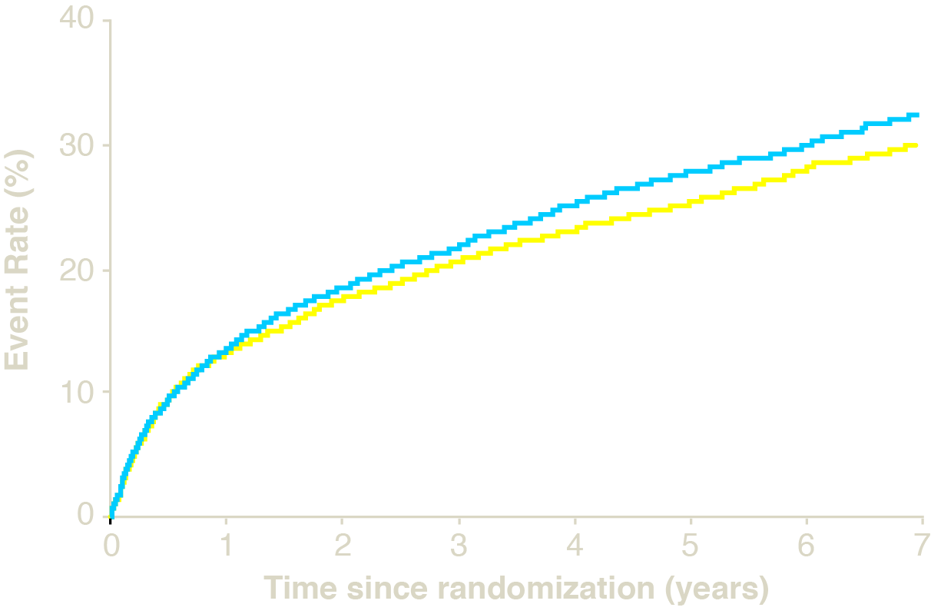
IMPROVE-IT: Adding ezetimibe to statin therapy reduced CV risk
IMPROVE-IT was a large PRCT evaluating the efficacy of adding ezetimibe to statins vs statin therapy alone in reducing CV risk in 18,144 post-ACS patients with LDL-C levels of ≤125 mg/dL
Primary endpoint: Cardiovascular death, MI, documented unstable angina
requiring rehospitalisation, coronary revascularisation (≥30 days), or stroke
RRR 6.4%
(HR 0.936; CI 0.887, 0.988)
p=0.016
Simva: 34.7%
(2742 events)
NNT= 50
EZE+Simva: 32.7%
(2572 events)
7-year event rates
1. Cannon CP, et al. American Heart Association Scientific Sessions, Session LBCT.02 November 17, 2014, Chicago.

Slide 46
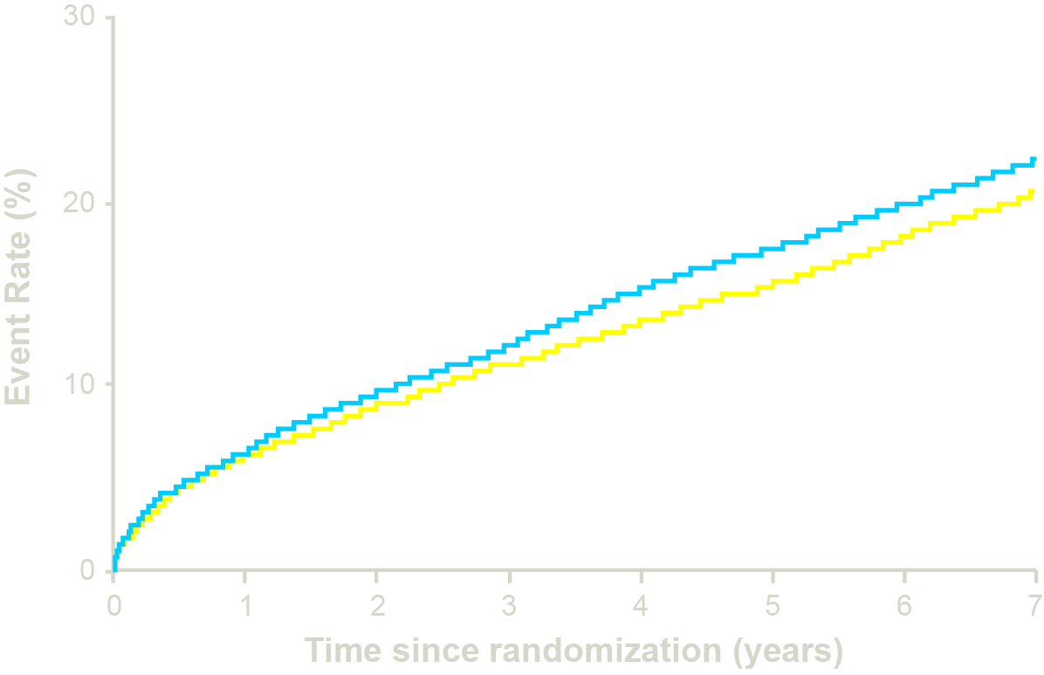
IMPROVE-IT: Adding ezetimibe to statin therapy reduced CV risk
IMPROVE-IT was a large PRCT evaluating the efficacy of the addition of ezetimibe to statin v statin therapy alone in reducing CV risk in 18,144 post-ACS patients with LDL-C levels of ≤125 mg/dL
MACE EP: CV Death, non-fatal MI, or non-fatal stroke
Simva: 22.2%
1704 events
RRR 10.0%
(HR 0.90; CI 0.84, 0.97)
p=0.003
NNT= 56
EZE+Simva: 20.4%
1544 events
7-year event rates
1. Cannon CP, et al. American Heart Association Scientific Sessions, Session LBCT.02 November 17, 2014, Chicago.

Slide 47
Safety of low LDL-C levels
Data from statin and ezetimibe trials

Slide 48
Safety of low LDL-C levels: Overview
Low LDL-C levels resulting from statin treatment have been linked to:
  Increased cancer risk in some epidemiological studies¹
    However, large clinical trials have not found an association²
  Numerical increase in haemorrhagic stroke in statin trials^{3–6}
    Further analysis of SPARCL study showed that this risk was not related to LDL-C levels in statin-treated patients⁷
    Risk factors for haemorrhagic stroke were male sex, hypertension, advanced age or history of haemorrhagic or small vessel stroke at study entry
    A greater number of patients with history of haemorraghic stroke in the statin-treated group may have had a confounding effect⁷
  Higher incidence of new-onset diabetes in statin trials⁸
    However, guidelines state that the benefits of statins outweigh the risk of diabetes⁹
    The increased risk may be limited to patients with a prior risk factors for developing diabetes¹⁰ and may also be partially explained by the effects of statins on HMGCR¹¹
Increased risk of neurocognitive issues have been raised as a concern with low LDL-C levels
  However, a post-hoc analysis of patients achieving LDL-C <30 mg/dL in the JUPITER trial showed a small non-significant increase in risk of memory impairment and a small increase in risk of psychiatric disorders (largely driven by increases in insomnia) vs patients with LDL-C ≥30 mg/dL¹²
1. LaRosa JC, et al. Am J Cardiol. 2013;111:1221–1229. 2. Cholesterol Treatment Trialists’ (CTT) Collaboration. Lancet. 2012;380:581–590. 3. Amarenco P, et al. N Engl J Med. 2006;355(6):549–559. 4. Baigent C, et al. Lancet. 2011;377(9784):2181–2192. 5. SHARP Collaborative Group. Am Heart J. 2010;160(5):785–794. 6. Cholesterol Treatment Trialists’ (CTT) Collaboration, Lancet 2010;376:1670–1681. 7. Goldstein LB, et al. Neurology 2008; 70:2364–2370. 8. Preiss D, et al. JAMA 2011;305(24):2556–2564. 9. Heart 2014;100:ii1-ii67 doi:10.1136/heartjnl-2014-305693. 10. Ridker PM, et al. Lancet. 2012 ;380:565-71. 11. Swerdlow DI, et al. Lancet 2014. doi:10.1016/S0140-6736(14)61183-1. [Epub ahead of print] 12. Everett BM, et al. Am J Cardiol. 2014;114:1682–1689.

Slide 49
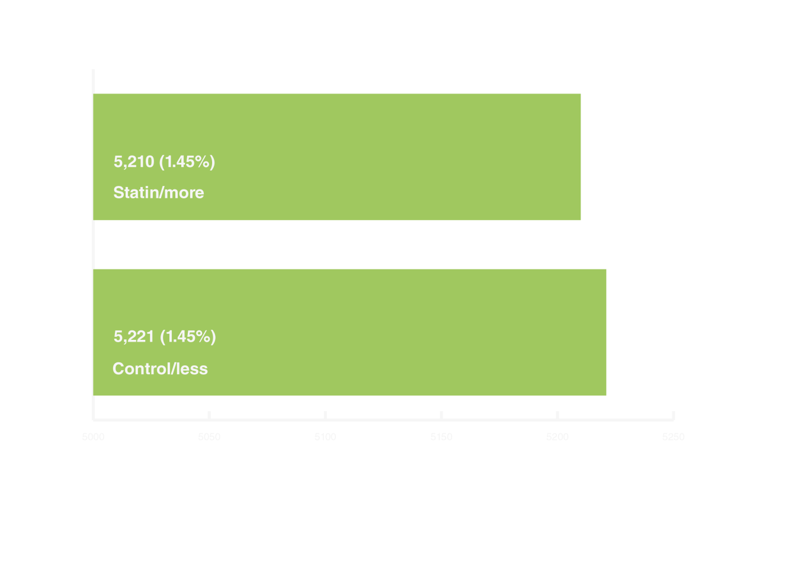
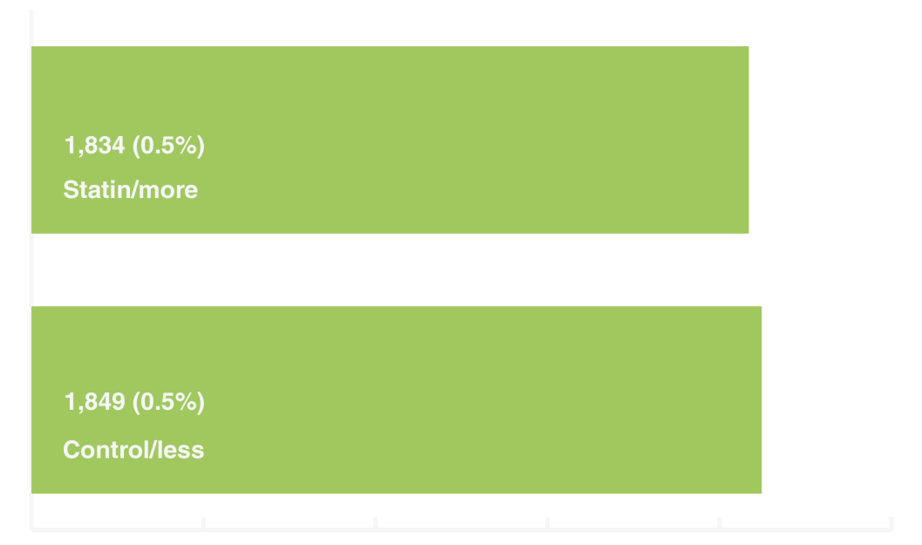
No difference in cancer risk or mortality in CTT meta-analysis
The Cholesterol Treatment Trialists’ (CTT) Collaboration evaluated the efficacy and safety of intensive LDL-C lowering by statins: a meta-analysis of data from 174,149 participants in 27 randomised trials
5000
5050
5100
5150
5200
5250
1000
1200
1400
1600
1800
2000
Overall cancer incidence¹
RR 1.00, CI 0.96–1.04, p=0.99
Overall cancer mortality¹
RR 0.99, CI 0.93–1.06, p=0.86
1. Cholesterol Treatment Trialists’ (CTT) Collaboration. Lancet. 2012;380:581–590.
CTT evaluated statin therapy vs controls (usual treatment/ less statin/placebo) in 174,149 patients in 27 RCTs. Effects on cancer incidence and cancer mortality per 1.0 mmol/L reduction in LDL-C
Notes:
The Cholesterol Treatment Trialists’ meta-analysis of 27 trials involving 174,149 participants showed that statin therapy reduces the risk of major vascular events (non-fatal myocardial infarction, coronary death, coronary revascularisation, or stroke) in people with 5-year risk of such an event lower than
10% (and, separately, in those at 5-year risk <5%), and in these people each 1.0 mmol/L reduction in LDL cholesterol produces 11 fewer major vascular events per 1000 treated over 5 years, a benefit that greatly exceeds any known hazards of statin therapy. There was no evidence of an increase in cancer incidence (RR per 1.0 mmol/L LDL reduction 1.00, 95% CI 0.96–1.04) or of cancer death (RR 0.99, 95% CI 0.93–1.06) at any level of major vascular event risk.

Slide 50
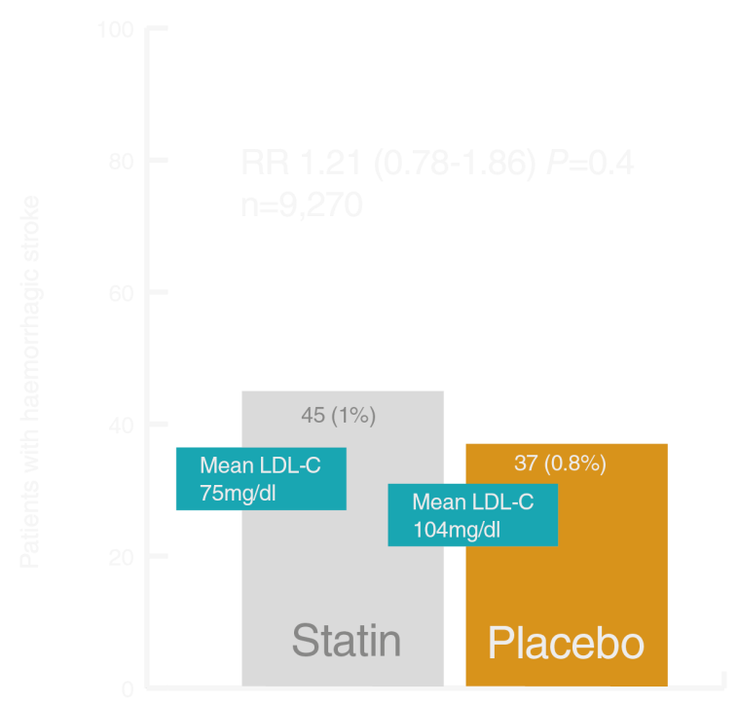
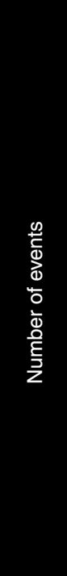
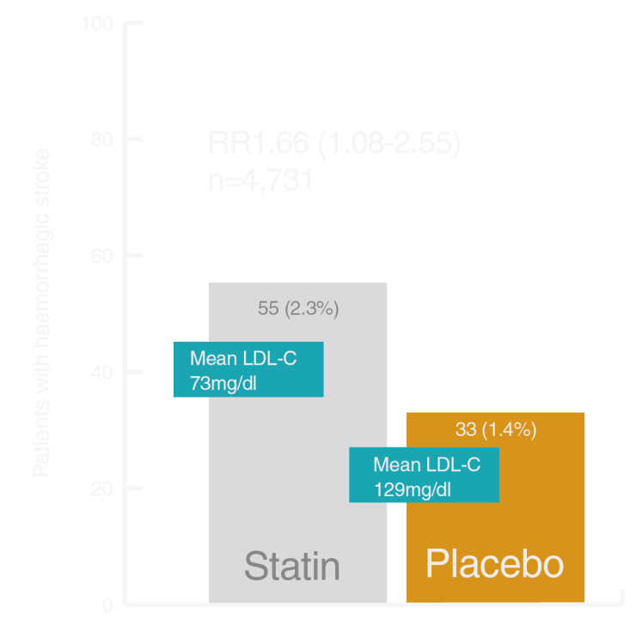

Haemorrhagic stroke incidence slightly increased with more intensive statin therapy
P=0.01
SPARCL¹
Prospective study of patients with stroke, TIA, LDL-C 100–190 mg/dL, and no known CHD
SHARP^{2,3}
Prospective study of patients with CKD and no known history of MI or coronary revascularisation
CTT⁴
Meta-analyses of statin trials with >1,000 patients and duration >2 years
SPARCL – Only study showing a significant effect had a greater number of patients with history of haemorraghic stroke in the statin-treated group which may have had a confounding effect⁵
1. Amarenco P, et al. N Engl J Med. 2006;355(6):549–559. 2. Baigent C, et al. Lancet. 2011;377(9784):2181–2192. 3. SHARP Collaborative Group. Am Heart J. 2010;160(5):785–794. 4. Cholesterol Treatment Trialists’ (CTT) Collaboration, Lancet 2010;376:1670–1681. 5. Goldstein LB, et al. Neurology 2008; 70:2364–2370.
CKD, chronic kidney disease; TIA, transient ischaemic attack

Slide 51
Risk of diabetes increases with more intensive statin therapy
A meta-analysis of 5 trials (N=39,612) to investigate the risk of new-onset diabetes comparing intensive- with moderate-dose statin therapy, including more than 1000 participants who were followed up for more than 1 year, showed a 12% increased risk of new-onset diabetes¹
Cases/Total, No. (%)
Incident Diabetes
Intensive Dose
Moderate Dose
OR (95% CI)
PROVE IT-TIMI 22, 2004
A to Z, 2004
TNT, 2005
IDEAL, 2005
SEARCH, 2010
Pooled odds ratio
101/1707 (5.9)
65/1768 (3.7)
418/3798 (11.0)
240/3737 (6.4)
625/5398 (11.6)
1449/16408 (8.8)
99/1688 (5.9)
47/1736 (2.7)
358/3797 (9.4)
209/3724 (5.6)
587/5399 (10.9)
1300/16344 (8.0)
1.01 (0.76-1.34)
1.37 (0.94-2.01)
1.19 (1.02-1.38)
1.15 (0.95-1.40)
1.07 (0.95-1.21)
1.12 (1.04-1.22)
Heterogeneity: l²=0%; p=0.60
0.5
1.0
2.0
Odds ratio (95% CI)
    A meta-analysis of 5 trials showed a 12% increased risk of new-onset diabetes in intensively-treated statin patients¹, although this increased risk was largely limited to patients with a prior higher risk of developing diabetes²
1. Preiss D, et al. JAMA 2011;305(24):2556–2564. 2. Ridker PM, et al. Lancet. 2012;380:565–71.

Slide 52
Diabetes risk related to statin therapy may be limited to patients with existing risk factors
In an analysis of JUPITER, the small risk of developing diabetes on statins was limited to participants who had biochemical evidence of impaired fasting glucose or multiple components of metabolic syndrome (i.e. groups already at high risk of developing diabetes)¹
0.15
No major risk factor for diabetes
0.15
One or more major risk factors for diabetes
Rosuvastatin
0.10
Placebo
0.10
Incident diabetes
Incident diabetes
0.05
0.05
0
1
2
3
4
0
1
2
3
4
Follow-up (years)
Follow-up (years)
No. diabetes RFs | HR diabetes | 95% CI | p
0 | 0.99 | 0.45–2.21 | 0.99
1 | 1.2 | 0.65–2.1 | Overall HR for patients with diabetes RFs (1.25, 1.05–1.49, p=0.01)
2 | 1.2 | 0.82–1.9
3 | 1.4 | 1.1–1.9
4 | 1.4 | 1.0–2.0
    The increased risk of diabetes in intensive statin treated patients may largely be limited to patients with a prior higher risk of developing diabetes¹ and guidelines state that the CV prevention benefits of statins outweigh the risk of diabetes²
1. Ridker PM, et al. Lancet. 2012 ;380:565-71. 2. Heart 2014;100:ii1-ii67 doi:10.1136/heartjnl-2014-305693.
Notes:
52

Slide 53
No significant difference in memory impairment in patients achieving LDL-C <30 mg/dL with statin therapy
A post-hoc analysis of 8154 patients treated with rosuvastatin 20 mg and achieving LDL-C <30 mg/dL
 | LDL-C <30 mg/dL (N=767) N (incidence rate) | LDL-C ≥30 mg/dL (N=7387) N (incidence rate) | Relative Risk < vs. ≥30 | Placebo (N=8150) N (incidence rate) | Relative Risk <30 vs. PBO | Relative Risk ≥30 vs. PBO
Memory Impairment | 4 (0.2) | 29 (0.2) | 1.26 (0.34-4.59) | 33 (0.2) | 0.63 (0.18-2.21) | 1.05 (0.63-1.74)
Psychiatric Disorders (Insomnia, depression, anxiety) | 69 (4.0) | 534 (3.4) | 1.40 (1.06-1.85)* | 619 (3.6) | 1.20 (0.92-1.57) | 0.95 (0.84-1.07)
    This post-hoc analysis of patients achieving LDL-C <30 mg/dL in the JUPITER trial showed a small non-significant increase in risk of memory impairment, and a small significant increased risk of psychiatric disorders (largely insomnia) vs patients with LDL-C ≥30 mg/dL¹
1. Everett BM et al. Am J Cardiol. 2014;114:1682–1689.
Incidence rate = number of events per 100 patient-years of observation. *p<0.01

Slide 54
IMPROVE-IT: Safety of further lowering LDL-C by adding ezetimibe to simvastatin
    IMPROVE-IT was a large PRCT evaluating the efficacy of the addition of ezetimibe to simvastatin v simvastatin therapy alone in reducing CV risk in 18,144 post-ACS patients with LDL-C levels of ≤125 mg/dL
ITT population | Simva n=9077 % | EZE+Simva n=9067 % | p value
ALT and/or AST ≥3x ULN | 2.3 | 2.5 | 0.43
Cholecystectomy | 1.5 | 1.5 | 0.96
Gallbladder-related AEs | 3.5 | 3.1 | 0.10
Rhabdomyolysis* | 0.2 | 0.1 | 0.37
Myopathy* | 0.1 | 0.2 | 0.32
Rhabdo, myopathy, myalgia with CK elevation* | 0.6 | 0.6 | 0.64
Cancer* (7-yr KM %) | 10.2 | 10.2 | 0.57
    No statistically significant differences in muscle, cancer or gallbladder-related events¹
1. Cannon CP et al. American Heart Association Scientific Sessions, Session LBCT.02 November 17, 2014, Chicago.
% = n/N for the trial duration * Adjudicated by Clinical Events Committee

Slide 55
Safety of very low LDL-C levels
Recent data from PCSK9 trials

Slide 56
No safety signal with very low LDL-C in patients after 18-month in alirocumab LONG-TERM trial: TEAEs
    ODYSSEY LONG-TERM mean exposure time was 65 weeks. 26.1% (405/1553 alirocumab) and 25.6% (202/788 placebo) completed the 18-month double-blind treatment period
% (n) of patients All pts on background of maximal statin therapy ± other lipid-lowering therapy | Alirocumab All patients (n=1550) | Alirocumab 2 consecutive LDL-C <25 mg/dL (n=562) | Placebo
TEAEs | 78.6 (1218) | 71.9 (404) | 80.6 (635)
Treatment-emergent SAEs | 16.5 (255) | 14.6 (82) | 17.6 (139)
TEAE leading to death | 0.5 (7) | 0.5 (3) | 1.0 (8)
TEAE leading to discontinuation | 6.2 (96) | 3.6 (20) | 5.5 (43)
    TEAE rates for patients with two consecutive LDL-C measurements <25 mg/dL were comparable to other alirocumab-treated patients and the placebo arm¹
1. Robinson JG, et al. American Heart Association Scientific Sessions, Session CS.05 November 19, 2014, Chicago.
TEAEs, treatment-emergent adverse events; SAEs, serious adverse events

Slide 57
No safety signal with very low LDL-C in patients in alirocumab LONG-TERM trial: Specific AEs
% (n) of patients (all pts on background of maximal statin therapy ± other lipid -lowering therapy) | Alirocumab (n=1550) | Alirocumab 2 consecutive LDL-C <25 mg/dL (n=562) | Placebo
General allergic reaction events* | 9.0 (140) | 6.0 (34) | 9.0 (71)
Treatment-emergent injection site reactions | 5.8 (90) | 3.7 (21) | 4.3 (34)
Neurological events‡ | 4.2 (65) | 1.8 (10) | 3.9 (31)
All cardiovascular events† | 4.0 (62) | 3.2 (18) | 4.4 (35)
Ophthalmological events‡ | 2.5 (38) | 1.8 (10) | 1.9 (15)
Neurocognitive disorders‡ | 1.2 (18) | 0.5 (3) | 0.5 (4)
*1 alirocumab-treated patient was diagnosed with Miller Fisher Syndrome at week 27 after typical prodromal gastroenteritis, he had a complete recovery following treatment discontinuation; at week 24 the patient had low LDL-C, reaching 1.5 mg/dL
†Confirmed by adjudication. CHD death, non-fatal MI, fatal and non-fatal ischaemic stroke, unstable angina requiring hospitalisation, congestive heart failure requiring hospitalisation, ischaemia driven coronary revascularisation procedure. ‡Company MedDRAQueries (CMQ).
1. Robinson JG, et al. American Heart Association Scientific Sessions, Session CS.05 November 19, 2014, Chicago.

Slide 58
No safety signal with low LDL-C in patients in 12-month evolocumab trial: Specific AEs
% (n) of patients | LDL-C <25 mg/dL EVO (n=644) | LDL-C <40 mg/dL EVO (n=1005) | LDL-C >40 mg/dL
 |  |  | Control (n=725) | EVO (n=462)
Any AE | 78 | 78 | 75 | 83
SAEs | 6 | 6 | 7 | 8
Most common AEs: Nasopharyngitis | 14 | 14 | 12 | 15
URTI | 10 | 9 | 7 | 8
Back pain | 8 | 7 | 5 | 5
Influenza | 6 | 6 | 6 | 10
Arthalgia | 5 | 6 | 4 | 5
Neurocognitive | 0.3 | 0.6 | 0.1 | 0.6
Adjudicated CV events | 0.5 (3) | 0.6 (6) | 2 (12) | 1 (5)
Myalgia | 4 | 4 | 4 | 4
1. Koren MJ, et al. Poster #2079; American Heart Association Scientific Sessions, Session APS.202.05, 16–19 Nov, 2014. Chicago, IL.
AE, adverse event; SAE, serious adverse event; UTRI, upper respiratory tract infection

Slide 59
Summary

Slide 60
Summary [1]
The degree of LDL-C reduction is strongly associated with reduced risk of CV events^{1–6}
  A lower limit of LDL-C below which there is a definite safety problem and/or no further benefit has not yet been determined²
  Clinical trials with statins have shown increased benefit of reducing LDL-C to low levels (<50 mg/dL)^{4,5}
Lowering LDL-C to <70 mg/dL has been recommended as an optional target for high-risk patients in the latest European guidelines⁷
1. LaRosa JC, et al. Am J Cardiol. 2012;111:1221–1229. 2. O’Keefe JH, et al. J Am Coll Cardiol. 2004;43(11):2142–2146. 3. Ference BA, et al. J Am Coll Cardiol. 2012;60:2631–2639. 4. Cholesterol Treatment Trialists’ (CTT) Collaboration, Lancet 2010;376:1670–1681. 5. Hsia J, et al. JACC 2011;56(16):1666–1675. 6. Cholesterol Treatment Trialists (CTT) Collaboration. Lancet. 2012;380:581–590. 7. Reiner Z, et al. Eur Heart J. 2011;32:1769-818

Slide 61
Summary [2]
Although associations have been found between low LDL-C and increased cancer, and haemorraghic stroke, these findings may be confounded by comorbid conditions^{1–5}
    A post-hoc analysis of neurocognitive effects in patients achieving LDL-C <30 mg/dL in the JUPITER trial showed no significant increase in memory impairment and a small increase risk of psychiatric disorders (largely insomnia) vs patients with LDL-C ≥30 mg/dL⁶
Ongoing trials with new therapies (eg PCSK9 inhibitors) have achieved even lower LDL-C levels than in statin trials
  No safety signals have been reported so far in PCSK9 inhibitor trials^{7,8}
Large long term outcome studies will be needed to completely characterize the risks and benefits of lowering LDL-C beyond currently recommended levels
  Several long term outcome trials with PCSK9 inhibitors are ongoing and should help to address this question^{9,10}
1. Cholesterol Treatment Trialists (CTT) Collaboration. Lancet. 2012;380:581–590. 2. Amarenco P, et al. N Engl J Med. 2006;355(6):549–559. 3. Baigent C, et al. Lancet. 011;377(9784):2181–2192. 4. SHARP Collaborative Group. Am Heart J. 2010;160(5):785–794. 5. Preiss D, et al. JAMA 2011;305(24):2556–2564. 6. Everett BM et al. Am J Cardiol. 2014;114:1682–1689. 7. Robinson JG, et al. American Heart Association Scientific Sessions, Session CS.05 November 19, 2014, Chicago. 8. Koren MJ, et al. poster #2079; American Heart Association Scientific Sessions, Session APS.202.05, 16–19 Nov, 2014. Chicago, IL. 9. ClinicalTrials.gov. ODYSSEY OUTCOMES Available online: https://clinicaltrials.gov/ct2/show/NCT01663402?term=odyssey+outcomes&rank=1 Accessed Dec 2014. 10. ClinicalTrials.gov FOURIER Available online: https://clinicaltrials.gov/ct2/show/NCT01764633?term=evolocumab+fourier&rank=1 Accessed Dec 2014.

Slide 62


