Slide 1
Monoclonal Antibodies (mAbs):
Three Decades Of Innovation And Progress
Notes:
This briefing will provide an overview of therapeutic monoclonal antibodies.

Slide 2
History Of Discovery
Astrid Fagraeus discovered that B cells (plasma cells) were responsible for generating antibodies⁵
First mAb approved for clinical use in transplant rejection: Muromonab-CD3 – a mouse antibody^{1,2}
Paul Ehrlich proposes “Side-Chain Theory” for antibody & antigen (lock & key) interaction³
Daclizumab – first humanised mAb (transplant rejection)²
César Milstein and Georges Köhler develop method of producing "custom” antibodies in vitro, by producing a hybridoma¹
Abciximab – first chimeric antibody (fragment)²
Adalimumab - 1st fully human mAb approved by FDA²
Discovery of tetanus and diphtheria antitoxins²
Linus Pauling confirms lock & key theory⁴
1890
1897
1940s
1948
1975
1986
1994
1997
2002
1901 Nobel Prize
Emil Adolf von Behring⁶
1908 Nobel Prize
Paul Ehrlich, Ilya Mechnikov⁶
1954 Nobel Prize
Linus Pauling⁷
1984 Nobel Prize
César Milstein, Niels Jerne, Georges Köhler⁶
1. Catapano AL, et al. (2013). Atherosclerosis, 228(1):18-28; 2. Foltz I, et al. Circulation 2013 Jun 4;127(22):2222-30; 3. Prüll C Med Hist. 2003 Jul;47(3):332-56;
4. Gormley M Endeavour. 2007 Jun;31(2):71-7; 5. LeBien TW & Tedder TF Blood. 2008 Sep 1;112(5):1570-80; 6. Nobelprize.org (2014) All Nobel Laureates in Physiology or Medicine. Available at: www.nobelprize.org/nobel_prizes/medicine/laureates/ Accessed: July 2014 7. Nobelprize.org (2014). All Nobel Laureates in Chemistry. Available at: www.nobelprize.org/nobel_prizes/chemistry/laureates/ Accessed: July 2014
Notes:
Timeline of the discovery of monoclonal antibodies, as well as the Nobel prizes that were awarded in relation to the discoveries leading up to the currently available mAbs today
Ref 6 and 7/Nobel Prize website
Ref 2/ Foltz 2013/pg2222/ col2/para2
Ref 5/LeBien 2008/pg1570/col1/para2
Ref 3/Prull 2003/pg334/para2
Ref 4/ Gormley 2007/pg74/col 1-2/para4
Ref 2/ Foltz 2013/pg 2222/ col1/para1
Ref 1/ Catapano 2013/pg6/para3
Ref 2/ Foltz 2013/pg2222/col1/para1
Ref 2/ Foltz 2013/pg2222/ col1/para1
Ref 1/ Catapano 2013/pg6/ para3
From previously approved deck: US.ALI.14.03.008 mAb Final deck (ACC)

Slide 3
Antibodies
Antibodies are naturally occurring proteins that help protect against infectious disease
Variable region
Fab
Fab
Constant region
Light chain
Light chain
Fc
Heavy chains
Sompayrac L (2012). How The Immune System Works. Hoboken: Wiley-Blackwell.
Notes:
Antibodies are proteins generated by the immune system as a line of defense against infection and disease.¹
All antibodies have a similar structure, commonly represented by a “Y” shape.
Antibodies are comprised of four proteins. <CLICK>Two heavy chains and two light chains <CLICK> which are held together by covalent bonds <CLICK>.
The tips of the heavy and light chains vary from antibody to antibody, enabling each antibody to recognise a specific target. <CLICK> This region of the antibody is called the variable region
The rest of the protein remains constant between different antibodies, <CLICK> and thus is called the constant region.
<CLICK> The base of the antibody is called the Fc (fragment crystalizable) region and is important for recognition of the antibody by cells and proteins of the immune system.
<CLICK> The two arms of the antibody are called the Fab (fragment antigen binding) regions and include the variable regions of the heavy and light chains.
¹ Sompayrac, L. How The Immune System Works, Wiley-Blackwell, 2012.
Ref 1/ Sompayrac 2012/ pg 4/col 2

Slide 4
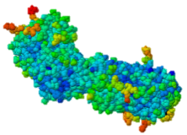
B-Cells Produce Antibodies
B-cell antibody receptors recognise antigens
Antigens are molecules that cause an organism to generate antibodies
B-cells activate when their antibody receptors bind antigen
Activated B-cells differentiate into plasma cells and memory B-cells
Plasma cells secrete antibodies
Y
Y
Y
Antibody receptors
Plasma cell
Y
Y
Y
Y
Y
Antigen
Y
Y
Secreted antibodies
Y
Y
Y
Y
Y
B-cell
Y
Y
Activated B-cell
Memory B-cell
Sompayrac L (2012). How The Immune System Works. Hoboken: Wiley-Blackwell.
Notes:
Antibodies are produced by B-cells which originate and mature in the bone marrow.¹ Each new B-cell creates antibodies with a unique variable region. The human immune system has millions of different B-cells, each with unique antibodies and it is this variability that enables the immune system to recognise the multitude of foreign molecules we come in contact with.
Each B-cell displays its unique antibody on the outside of the cell as membrane-bound receptors <CLICK>. The molecule the antibody binds to is called an antigen which is short for “antibody generator”. <CLICK> An antigen is any molecule which when introduced into an organism, generates antibodies. Many (though not all) antigens are 0proteins.
<CLICK> B-cells become activated when antigen binds to the antibody receptors.
<CLICK> Activated B-cells proliferate to create plasma cells and memory cells.
<CLICK> Plasma cells are short-lived white blood cells that produce and secrete antibodies. An active plasma cell can secrete up to 2,000 antibodies per second.² These secreted antibodies bind to their antigen and tag it for destruction by the immune system.
Memory B-cells are long-living cells which will circulate and patrol for future invasion of that particular antigen. This allows the body to respond quickly if infected again with the same pathogen. It is memory B-cells which enable an organism to build immunity to pathogens.
¹ Different sources site the origin of the moniker B-cell from either the bone marrow (a) or the bursa of fabricius (b). The bursa of fabricius is an organ found in birds such as chickens, which produces B-cells. Mammals do not have such an organ. (a)Alberts B, Johnson A, Lewis J, Raff M, Roberts K, Walter P (2002) Molecular Biology of the Cell. Garland Science: New York, NY p. 1367 (b)Muljadi P, “Bursa of Fabricius” http://www.scribd.com/doc/142483335/Bursa-of-Fabricius
² Sompayrac, L. How The Immune System Works, Wiley-Blackwell, 2012.
Ref 1/ Sompayrac 2012/ pg 6/col 2 to pg7/col1

Slide 5
Monoclonal Antibody Evolution
e.g. ibritumomab
Mouse variable
Mouse constant
e.g.
rituximab and abciximab
Human variable
Human constant
e.g.
trastuzumab and bevacizumab
e.g.
adalimumab and
panitumumab
Highly immunogenic
100% Mouse
Immunogenicity
Still immunogenic
~30% Mouse
Still immunogenic
~5-10% Mouse
Least immunogenic
Fully Mouse
1st generation
Chimeric
2nd generation
Humanised
3rd generation
“Fully” Human
4th generation
1. Foltz I et al. Circulation 2013 Jun 4;127(22):2222-30; 2. Nelson AL et al. Nature Reviews Drug Discovery 2010 Oct;9(10):767-74.
Notes:
The first therapeutic monoclonal antibodies were developed in mice. These fully mouse antibodies are recognised by the human immune system as foreign and are immunogenic. Immunogenicity against the therapeutic antibody leads to destruction of the antibody and can also result in hypersensitivity or allergic reaction.
Second and third generation monoclonal antibodies incorporate all or some of the mouse variable region but retain a human constant region. Such fusion proteins have decreased immunogenicity in comparison to the fully mouse antibody.
Current biotechnology practices enable the creation of fully human antibodies for use as therapeutics. These have the lowest potential for immunogenicity and are the gold standard in development today.
¹ Catapano, A. a. (2013). The safety of therapeutic monoclonal antibodies: Implications for cardiovascular disease and targeting the PCSK9 pathway. Atherosclerosis, 1-11.
Ref 1/ Foltz 2013/ pg 2225/ figure 2
Ref 2/ Nelson 2010/ pg771/ table 1 & pg 768/ box 1

Slide 6
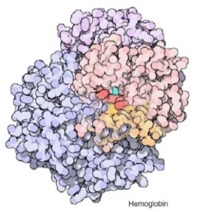
Biologic And Small Molecule Drugs
Large Molecule (Biologic)¹ | Small Molecule (Drug)¹
Extremely high specificity² | Good specificity²
Parenteral administration³ | Commonly administered orally³
Eliminated primarily by cellular endocytosis, phagocytosis and target-mediated clearance^{3,4} | Metabolised and eliminated primarily by liver and kidneys^{3,4}
Unlikely to have drug-drug interaction⁴ | May have drug-drug interactions⁴
Longer half-life, less frequent administration⁴ | Shorter half-life, more frequent administration⁴
Produced by genetically engineered cells or purified from natural sources³ | Synthesised chemically or purified from natural sources³
Typically do not cross blood-brain barrier⁵ | Some cross blood-brain barrier⁵
Can be immunogenic⁴ | Rarely immunogenic⁴
1. Generics and Biosimilars Initiative. (2012, June 29). Small molecule versus biological drugs. Accessed http://www.gabionline.net/Biosimilars/Research/Small-molecule-versus-biological-drugs (17th July 2014); 2. Webb, D.R., et al. (2013). Biochemical Pharmacology , 85(2):147-152; 3. Vugumeyster Y et al. (2012). World Journal of Biological Chemistry, 3(4), 73-92; 4. Catapano, AL et al.(2013). Atherosclerosis, 228(1):18-28; 5. Gabathuler (2010). Neurobiology of Disease, 48-57.
Notes:
Biologic therapeutics are generally proteins that are physically much larger and more complex than traditional small molecule drugs. For example, a monoclonal antibody is approximately 750-fold larger than aspirin. ¹
While many small molecules have good specificity for their target, an advantage of biologics and of antibodies in particular, is their extremely high specificity. ²
Most small molecules are orally available whereas biologic therapeutics must generally be administered parenterally. ³
Protein therapeutics are eliminated from the patient’s system primarily through cellular endocytosis, phagocytosis and target-mediated clearance while small molecules are metabolized and eliminated primarily by the liver and kidneys. ^{3, 4}
Drug-drug interactions that are of concern for small molecule drugs are unlikely for protein therapeutics because of their limited interaction with the cytochrome P450 system.⁴
Proteins in general and antibodies in particular have a longer serum half-life than small molecules and therefore require less frequent administration. ^{3, 4}
While small molecules can be synthesized chemically or extracted from natural sources, proteins are generally produced by cells that have been given the genetic instructions for production of the protein. Although some proteins may also be extracted from natural sources. ³
Finally, protein therapeutics generally do not cross the blood brain barrier while some small molecules are able to. ⁵
¹ Generics and Biosimilars Initiative. (2012, June 29). Small molecule versus biological drugs. Retrieved from GaBi Online: www.gabionline.net/Biosimilars/Research/Small-molecule-versus-biological-drugs
² Webb, D.R., et al. (2013). Biochemical Pharmacology , 85(2):147-152.
³ Vugumeyster Y, X. X. (2012). Pharmacokinetics and toxicology of therapeutic proteins: Advances and challenges. (Z. X, Ed.) World Journal of Biological Chemistry, 3(4), 73-92.
⁴Tabrizi, M. (2006). Elimination Mechansims of Therapeutic Monoclonal Antibodies. Drug Discovery Today, 81-88.
⁵ Catapano, A.L., et al.(2013). Atherosclerosis, 228(1):18-28
⁶ Gabathuler. (2009). Approaches to transport therapeutic drugs across the blood-brain barrier to treat brain diseases. Neurobiology of Disease, 48-57.
Ref 2/ Webb 2013/ pg147 / para2
Ref 3/ Vugumeyster 2012/ pg74/ col1/ para4
Ref 3/ Vugumeyster 2012/pg77/col1/ para3-5
Ref 4/ Catapano 2013/pg4/para3 to pg5/para1
Ref 5/ Gabathuler 2010/pg49/col1/para2
Ref 3/Vugumeyster 2012/pg73/col2/ para1
Ref 1/ Generics and Biosimilars Initiative website/ Small molecule vs biologic drugs/ table 1

Slide 7
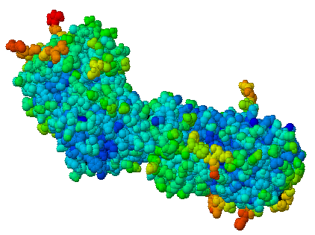
Multiple B-Cells Generate Antibodies That Bind Different Regions Of The Antigen
Y
Y
Y
Y
Y
Plasma B-cells producing antibodies
1. Khanna R (2011) Immunology. Oxford: Oxford University Press;
2. Sompayrac L (2012) How The Immune System Works. Hoboken: Wiley-Blackwell.
Notes:
When the body is infected with a foreign pathogen, the immune system will likely have <CLICK> multiple B-cells which produce <CLICK> antibodies recognizing the antigen. But because the antibody created by each B-cell is unique, each antibody will bind <CLICK> to a slightly different region of the antigen.
Ref 2/ Sompayrac 2012/ pg 27/col1
Ref 1/Khanna 2011/page 1-2

Slide 8
Multiple B-Cells Generate Antibodies That Bind Different Regions Of The Antigen
Epitope 1
Epitope 2
Epitope 5
Epitope 3
Epitope 4
Plasma B-cells producing antibodies
1. Khanna R (2011) Immunology. Oxford: Oxford University Press;
2. Sompayrac L (2012) How The Immune System Works. Hoboken: Wiley-Blackwell.
Notes:
The precise location on the antigen where the antibody binds is called the epitope.
Ref 2/ Sompayrac 2012/ pg 27/col1
Ref 1/Khanna 2011/page 1-2

Slide 9
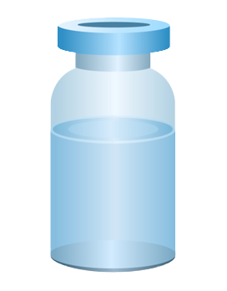
Polyclonal Vs. Monoclonal Antibodies
Y
Y
Epitope 1
Epitope 2
Y
Y
Y
Y
Y
Epitope 5
Y
Epitope 3
Polyclonal antibody
Epitope 4
Y
Y
Monoclonal antibody
1. Khanna R (2011) Immunology. Oxford: Oxford University Press;
2. Köhler G, C Milstein (1975) Nature 256:495-497.
Notes:
If these antibodies were collected and purified the resulting solution would be called a polyclonal antibody. A polyclonal antibody is a collection of antibodies from different B-cells that all bind the same antigen.
<CLICK> In contrast, a monoclonal antibody is a collection of antibodies derived from a single B-cell line.
Ref 1/Khanna 2011/page 2-3
Ref 2/ Kohler 1975/pg497/col1/para2

Slide 10
Monoclonal Antibodies In The Clinic
Cumulative number of human monoclonal antibodies entering clinical study between 1985 and 2008¹
Monoclonal antibodies were first introduced into clinical practice in 1986²
Over 30 monoclonal antibodies are approved for clinical use by European and US regulatory agencies for a wide variety of indications, including but not limited to²:
  Asthma
  Autoimmune diseases
  Oncology
  Ophthalmic disorders
Approximately 235 monoclonal antibodies are in active PIII trials for a wide variety of indications, including but not limited to³:
  Alzheimer’s disease
  Autoimmune diseases
  Cardiovascular disease
  Infectious disease
  Osteoporosis
All human monoclonal antibodies
Antineoplastic only
Immunomodulatory only
Anti-infective only
Other indications
150
140
130
120
110
100
90
80
Number of clinical candidates
70
60
50
40
30
20
10
0
1985
1987
1989
1991
1993
1995
1997
1999
2001
2003
2005
2007
1. Adapted from: Nelson AL et al. Nat Rev Drug Discov 2010;9:325–38; 2. Landes Bioscience (2014). mAbs: About this journal. Available at: http://www.landesbioscience.com/journals/mabs/about/. Accessed July 2014; 3. ClinicalTrials.gov (July 2014). Available at: http://www.clinicaltrials.gov/.
Year
Notes:
Monoclonal antibodies were first introduced into clinical practice in 1986 and have been developed successfully as therapeutics for a wide variety of clinical indications including asthma, autoimmune disorders, oncology and ophthalmic diseases. ^{1,2}
Over 200 antibodies are in clinical development for indications as diverse as allergy, Alzheimer’s disease, cardiovascular disease, infectious disease, and muscle wasting. ³
As demonstrated by the graph, the number of monoclonal antibodies entering clinical development has steadily increased since their introduction in 1986. ¹
33 monoclonal antibodies have been approved by the EMA⁴
45 mAbs have been approved by the FDA⁵
¹ Nelson AL, D. E. (2010). Development trends for human monoclonal antibody therapeutics. Nature Reviews Drug Discovery, 9, 767-774.
² Foltz, I. (2013). Evolution and Emergence of Therapeutic Monoclonal Antibodies. Circulation, 2222-2230.
³ Reichert, J. (2013, Nov 25). Antibodies to watch in 2014. mAbs, 6(1).
⁴ Landes Bioscience (2014). mAbs: About this journal. Available at: http://www.landesbioscience.com/journals/mabs/about/. Accessed July 2014
⁵ Gómez-Mantilla, et al. J Pharmacokinet Pharmacodyn 2014; DOI 10.1007/s109280149367z
Ref 1/ Nelson 2010/ pg770/ figure2
Ref 3/ clinicaltrials gov website/
Search “monoclonal antibodies”, phase III, active/open/recruiting/invitation studies
Ref 2/ mAbs journal website/ Background: Monoclonal antibody therapeutics/ table 1

Slide 11
Cardiovascular Monoclonal Antibodies
EMA Approved¹
mAb Name | Year | Indication | Comment | Trade Name
Muronomab-CD3 | 1986 | Acute heart transplant rejection | 1st mAb approved; murine monoclonal antibody targeting CD3 | Orthoclone OKT3
Abciximab | 1995 | GpIIb-IIIa Antiplatelet | Chimeric Fab | ReoPro
Digoxin Immune Fab | 2011 (UK only)² | Digoxin toxicity | Sheep Fab Ovine | DigiFab, DigiBind
1. Landes Bioscience (2014). mAbs: About this journal. Available at: http://www.landesbioscience.com/journals/mabs/about/. Accessed July 2014; 2. MHRA (2014). DigiFab. Available at: http://www.mhra.gov.uk/home/groups/par/documents/websiteresources/con126289.pdf. Accessed July 2014
Notes:
Table showing the European Medicines Agency approval years for cardiovascular monoclonal antibodies
Ref 1/table/rows 1 and 2
Ref 2/pg2

Slide 12
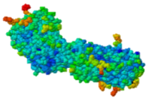
Target Discovery
Signalling molecule
Cell
Receptor
Receptor
Signalling molecule
Nucleus
Validated targets
Disease pathology
1. Foltz, I., et al. (2013). Circulation, 127:2222-2230; 2. Hughes, J. (2011). Principles of early drug discovery. British Journal of Pharmacology, 1239-1249.
Notes:
Therapeutic antibodies are specifically selected to target a particular antigen referred to as the drug target.¹
Thus the first step in selecting a good therapeutic antibody is identifying an appropriate target.
A good target is any molecule that plays a key role in driving disease pathology.
Common targets include cell-surface receptors and signaling molecules.
Once a protein is identified as playing a key role in disease progression, this role is confirmed through rigorous lab-based testing.²
A target whose role in disease pathology has been confirmed is called a validated target.
¹ Foltz, I. (2013). Evolution and Emergence of Therapeutic Monoclonal Antibodies. Circulation, 2222-2230.
² Hughes, J. (2011). Principles of eraly drug discovery. British Journal of Pharmacology, 1239-1249.
Ref 1/Foltz 2013/ pg2224/col1/para2
Ref 2/ Hughes 2011/ pg1240/col2/para3 – pg1241/col1/ para1 and figure 3

Slide 13
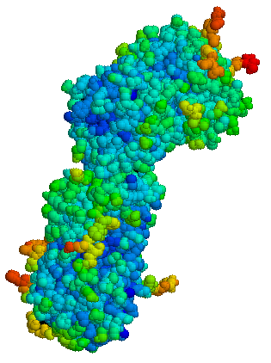
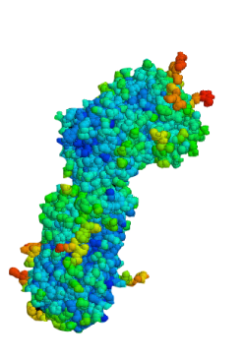
Monoclonal Antibodies
Bind the same epitope
From a single B-cell; have genetically identical variable regions
Multiple selection options
  Hybridoma
  Phage display
  Genetically engineered mice
Myeloma
cells
B-cells
Receptor
Spleen
Single epitope
Hybridoma
cells
Monoclonal
antibodies
1. Köhler G, C Milstein.(1975). Nature 256:495-497.
Notes:
13
Monoclonal antibodies, in contrast, bind the same epitope. A monoclonal antibody is derived from a single B-cell and therefore a single gene.
<CLICK> Scientists have developed several methods to select monoclonal antibodies including the hybridoma technology developed in the 1970s and more recently phage display and the use of genetically engineered mice.
<CLICK> Let’s look first at the hybridoma technology that won researchers Kohler and Milstein the 1984 Nobel Prize in medicine.
<CLICK> First a mouse is immunized with the target. Rather than collecting the animal’s serum, which contains antibodies from many B-cells, the goal is to isolate a single B-cell that binds the target or antigen. <CLICK> Mature B-cells are collected from the animal’s spleen.
Because the collected B-cells cannot be maintained in cell culture, and would soon die, they have to be immortalized. This is accomplished by fusing the B-cells to cancer cells called <CLICK> myeloma cells. Each B-cell is physically fused <CLICK> with a myeloma cell to create a hybrid cell that is appropriately called a hybridoma.
The hybridoma cells retain the B-cells’ antibody-producing capability and the cell culture immortality of the myeloma cells. Once the hybridoma cells have been created, clones can be selected by a method called limiting dilution. Cells are diluted so that <CLICK> colonies are grown from a single cell. The clonal cell lines are then screened to find B-cells that bind the target antigen.
<CLICK> Because each cell line originated from a single hybridoma, all the cells are genetically identical and the <CLICK> antibodies produced by a hybridoma cell line all bind a <CLICK> single epitope and thus are monoclonal antibodies.¹
¹ Köhler, G., C. Milstein. (1975) Continuous cultures of fused cells secreting antibody of predefined specificity. Nature 256:495-497
Ref 1/ Kohler 1975/pg495/col1/para1 – col2/para1

Slide 14
Humanising Mouse Antibodies:
Genetically Engineered Mice
Scientists use genetic engineering to create mice to contain a human antibody gene
Mouse antibody gene silenced
X
Human antibody gene added
Mouse embryo
Genetically engineered mouse with human antibody gene
When injected with antigen, genetically engineered mice produce fully human antibodies
Receptor
Fully human antibody
1. Frenzel A et al. (2013). Expression of recombinant antibodies. Frontiers in Immunology, 4, 217.
Notes:
Another method for selecting fully human antibodies is to use genetically engineered mice that produce human antibodies.¹
To create such mice, <CLICK> the antibody gene in a mouse embryo is first silenced. <CLICK> Next, a human immunoglobulin or antibody gene is added.
Following implantation in a surrogate, <CLICK> the genetically engineered embryo develops into a mouse that produces human antibodies.
These mice are then bred to create a line of mice that have the human antibody gene.
A genetically engineered mouse can then be <CLICK> injected with antigen and every antibody the mouse produces will be fully human <CLICK>.
The B-cells from these mice can then be screened to select those that bind to the target of interest and the gene for the desired antibody is simply transferred to a manufacturing cell for production.
A disadvantage of this technology is that the mouse’s immune system does not easily recognise the human antibody. As a result, the mouse has a less robust immune response and will create fewer B-cells that recognize the antigen of interest. This may decrease the likelihood of finding an antibody that binds the target with high affinity.
¹ Frenzel, A., et. al. (2013). Expression of recombinant antibodies. Fronteirs in Immunology, 4, 217.
Ref 1/ Frenzel 2013/pg 1/ col1/ para2 – col2/para1

Slide 15
Selected Monoclonal Antibody Gene Transferred
To Chinese Hamster Ovary (CHO)
Cells For Manufacture
Y
Y
Human variable
Human constant
Y
B-cell
Y
Y
Y
Human variable
Human constant
Selected phage
1. Rodrigues ME et al. (2013). J Microbiol Biotechnology, 23(9):1308-21
Notes:
Whether the antibody is selected by use of a genetically engineered mouse or by phage display, the next step is to transfer the antibody gene to a manufacturing cell.
<CLICK> The gene encoding the antibody variable region is isolated and spliced with the gene encoding the human constant region.
Ref 1/ Rodrigues 2013/ pg1309/col1/ para3

Slide 16
Selected Monoclonal Antibody Gene Transferred
To Chinese Hamster Ovary (CHO)
Cells For Manufacture
Y
Y
Y
B-cell
Insertion of antibody gene into CHO cell for manufacture
Y
Y
Y
Selected phage
1. Rodrigues ME et al. (2013). J Microbiol Biotechnology, 23(9):1308-21
Notes:
Once isolated, these genes will be transferred to a manufacturing cell such as a CHO cell.¹
The antibody gene that has been transferred to the CHO cell provides the information the cell needs to create the protein. <CLICK> The CHO cells will use this genetic recipe to produce the therapeutic protein – in this case a monoclonal antibody.
¹ Rodrigues, M.E., et al.(2013). J Microbial Biotechnology, 23(9):1309-21
Ref 1/ Rodrigues 2013/ pg1309/col1/ para3

Slide 17
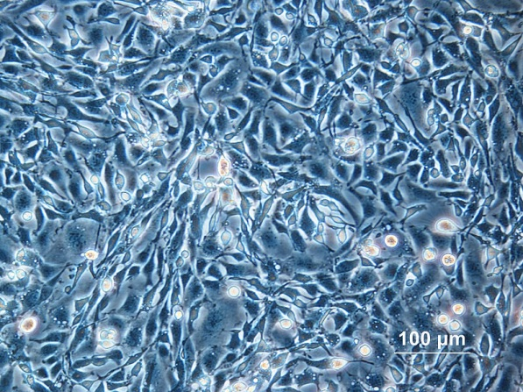
CHO: Chinese Hamster Ovary Cells
Cell line established in 1957 by Dr. Puck at the University of Colorado
Most widely-used mammalian commercial production line
HIV, influenza, polio, herpes, and measles do not replicate in CHO
CHO cells
1. Jayapal KP et al. (2007). Recombinant Protein Therapeutics From CHO Cells — 20 years and Counting. Chem. Eng. Prog., 103 (10): 40–47
Notes:
What are CHO cells, and why are they so widely used to manufacture therapeutic proteins?
In 1957, Dr. Theodore T. Puck at the University of Colorado obtained a female Chinese hamster from the Boston Cancer Research Foundation and used it to derive the original Chinese hamster ovary (CHO) cell line. Since then, CHO cells have been a manufacturing cell of choice because of their rapid growth and high protein production.¹
CHO cells have also been granted GRAS, or Generally Regarded As Safe, status by the FDA. CHO cells are resistant to infection by a range of human pathogens including HIV, influenza, polio, herpes and measles, a factor which contributes to their safety profile as a means of human therapeutic protein production.
¹ Jayapal K. P. et al. (2007). Recombinant Protein Therapeutics From CHO Cells — 20 years and Counting. Chem. Eng. Prog. 103 (10): 40–47
Ref 1/ Jayapal 2007/
pg40/col1/para2
pg41/col1/para1
pg42/col2/para3

Slide 18
Therapeutic Monoclonal Antibody Manufacturing
Upstream Process
~50 L
~1 L
~100 mL
Stock
culture
Small scale
culture
CHO cells produce monoclonal antibodies
Small scale
bioreactor
~10,000 L
~3,000 L
Industrial scale operation
Larger scale
bioreactor
1. Daugherty E (2012) Biotechnology St. Paul: Paradigm Publishing, Inc.
Notes:
Large-scale protein manufacture for clinical use requires the production of large volumes of protein-producing cells.¹ Because cell growth is optimal at a specific cell density, production is performed in a step-wise manner. Collectively the steps of growing the cells are called upstream processing.
Protein manufacturing is a highly controlled, sterile process which safeguards the product from contamination. Not only is contamination carefully avoided, multiple steps are included to inactivate and remove adventitious agents (such as viruses, bacteria and mycoplasma) throughout the process.
Each new batch is grown from the same stock of cells to assure consistent product by using identical starting material. The cell stock is stored frozen in small vials. <CLICK> Production is initiated by removing a vial of stock culture from storage and thawing the cells.
<CLICK> First the cells are grown in a small volume of a few hundred milliliters.
<CLICK> The next steps involve a scale-up process, which utilizes bioreactors of increasing size <CLICK>. A bioreactor is a sterile vessel that grows cell cultures in large volumes and that maintains all the proper growth conditions, which are closely monitored. This step-wise scale-up process is required to obtain optimum cell growth and protein production.
<CLICK> Scale-up leads to final high volume growth conditions at industrial scale operations, utilising large production bioreactors. For CHO cells, production bioreactors can be as large as 20,000 L in volume. Having completed cell growth, or upstream processing, the product will now be purified from the cells, formulated and packaged. Collectively, this is known as downstream processing.
¹ Daugherty, E. (2012). Biotechnology. St. Paul: Paradigm Publishing, Inc.
Ref 1/Daughtery 2012/ pg1

Slide 19
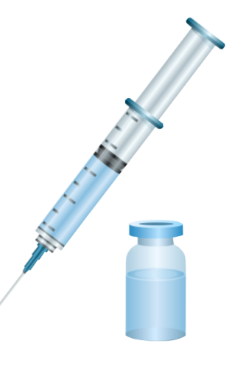

Therapeutic Monoclonal Antibody Manufacturing Downstream Process
Centrifuge
Filtration
Column chromatography
Formulation, filtration & fill
Therapeutic
packaged
1. Daugherty E (2012) Biotechnology St. Paul: Paradigm Publishing, Inc.
Notes:
The purpose of downstream processing is to recover the therapeutic monoclonal antibody from the large-scale culture, which is harvested and purified by production engineers, and to formulate and package it for administration.
The first steps of purification are <CLICK> centrifugation and filtration which removes the CHO cells, <CLICK> leaving a mixture of the monoclonal antibody and other proteins and molecules produced by the CHO cells.
<CLICK> The antibody is next purified from the mixture by column chromatography; a process that separates molecules based on differences in their size, structure or charge. <CLICK> A typical manufacturing process will require multiple, successive chromatography steps to completely purify the protein. The process will also include steps to ensure removal of any potential adventitious agents including measures such as a low-pH hold and viral filtration.
<CLICK> The purified protein is then formulated, filtered again and <CLICK> finally packaged for clinical use.
Ref 1/Daughtery 2012/ pg1

Slide 20
Conclusion
Monoclonal antibodies are used for a wide variety of clinical indications
Therapeutic monoclonal antibodies can be selected by use of hybridoma technology, phage display or genetically engineered mice
Humanised and fully human monoclonal antibodies have lower incidence of immunogenicity than mouse monoclonal antibodies
Once the monoclonal antibody is selected, the monoclonal antibody gene is transferred to mammalian cells for manufacture
Monoclonal antibodies can tag a cell for destruction, block cell receptors to interrupt disease pathology or capture signaling molecules to interrupt disease pathology

Slide 21


